Slide 1
TRANS-CATHETER AORTIC VALVE REPLACEMENT
DR.M.S.SHIVENDRRAN
CIII UNIT SEMINAR PRESENTATION

Slide 2
references
The Lancet jan 1986
Braunwald 12th edition
Catherine Otto, Valvular Heart Disease, Companion To Braunwald Heart Disease
The PCR –EAPCI Textbook

Slide 3
Anatomy of aortic root:
1)Aortic Valve Cusp
2)Aortic Valve Annulus
3)Aortic Root Complex
Notes:
1)3 cusp/in semilunar fashion-entire length of aortic root highest point at sinotubular jn and lowest point below anatomic ventricular arterial jn
2)annulus:virtual ring that connects 3 most basal insertion point of the cusps.

Slide 4
Notes:
1)Sinus of Valsalva(aortic sinus)<<1.anterior/right 2.right posterior-nc 3.left posterior-lc>> are areas of aortic root with insertion margin at basal cusp insertion point;superior margin at sinotubular jn.
Each sinus separated by intercusp triangle.
Interleaflet triange or fibrosa are part of extension of lv outflow tract.

Slide 7
History:
SAVR(1960s) was the only treatment for Aortic stenosis for more than 4 decades
Low mortality in good surgical candidates
Return to normal life expectancy
Declined in 1/3 of cases

Slide 8
1985,
Cribier and Colleagues introduced Balloon Aortic Valvuloplasty as an alternative to SAVR in inoperable pts.
Symptomatic improvement
No effect on long term survival
Early valvular restenosis
Notes:
Bav ->use progressively stopped

Slide 9
BAV –still in use?
ACC/AHA GUIDELINES(2014): Bridge to TAVR/SAVR in severe symptomatic AS
ESC GUIDELINES(2012):Urgent non cardiac surgery and palliation of symptoms
Remain integrated to many TAVR procedures (pre/post dilatation , Balloon Interogation)

Slide 10
Need for tavi?
1/3 patients in real world are deemed unsuitable for surgery
Elderly patients are reluctant after SAVR counselling
People prefer Minimally invasive techniques and quick discharge.

Slide 11
Dr. Cribier;(2002)
57/m pt with Inoperable AS (Bicuspid aortic valve)
Ejection fraction -10%
Cardiogenic shock
Intra lv thrombus
Blocked femoral arteries
23mm Bovine Pericardial Balloon expandable stent valve
with 24Fr catheter delivery system(transeptal approach)
Good results
Notes:
Tavi-Anderson in pig model in 1992

Slide 12
FIRST SERIES(ROUEN,2002-2004)
40 CRITICAL CASES
I-REVIVE/RECAST TRIAL
Transseptal approach(80%)
Retrograde approach(20%)
PVL> Grade 2 (25%)
5 patients survived > 5 years
Notes:
Intially done in pigs 1992

Slide 13
In subsequent studies, retrograde approach via femoral artery was done.(predominant approach today)
In 2007,Trans-apical approach was introduced.

Slide 14
Aortic stenosis
Incidence of Aortic stenosis
2% of pts more than 65 years
12% above 75 years has Aortic stenosis
3.4% above 75 years has Severe Aortic stenosis

Slide 15
Stages:

Slide 17
Notes:
D2- dcm and calcified vessel that is not severly stenotic
D3-elderly pts with small hypertrophied lv/concurrent htn with normal ef
Such cases evalution of valve parameters after treating htn & ct assessment of valve calcification to be done.

Slide 18
Notes:
Asc 532

Slide 19
Candidates for intervention:
Symptomatic severe aortic stenosis(D1,D2.D3) (class I)

Slide 20
Asymptomatic Severe aortic stenosis
EF<50% (class I)
Other heart surgeries(+CABG) (class I)
Abnormal exercise stress testing (class IIa)
V max > 5m/s (Very severe Aortic stenosis) (class IIa)
BNP > x 3 times ULN (class II a)
Rapid progression of disease(V max > 0.3m/s)(class IIa)
IIb Indications-
1)excessive LVH and no HTN ;
2)mean gradient> 20mm increase with excercise
Notes:
Abnormal stress test: breathless at low work load; chest pain, dizziness,sbp fall more than 20 or fall from baseline , horizontal or downsloping st depression more than 2mm or more than 3 consequtive ventricular beats.
Uncertainity of tavi intervention in asymptomatic AS

Slide 22
AHH/ESC –

Slide 24
Notes:
THERE ARE VARIOUS FACTORS THAT HAVE TO BE TAKEN INTO ACCOUNT BEFORE DECIDING TAVI VS SURGICAL REPLACEMENT.

Slide 25
DECISION MAKING FACTORS | FAVORING SAVR | FAVORING TAVR | FAVORING PALLIATION
AGE AND LIFE EXPECTANCY | Younger age(<65 year) Longer life expectancy | Older age (>80 years) Few expected remaining years of life (only 5 year data available) | Limited life expectancy
PROSTHETIC VALVE PREFERENCE | Mechanical or surgical Bioprosthesis valve preferred Concern for patient prosthesis mismatch | Bioprosthesis valve preferred
FROM:Eurheartj/goals of care in patients with aortic stenosis
Notes:
1)Although 5 years data are encouraging, longer term data is needed as we treat younger pts.
65-80 years-shared descision making.

Slide 27
DECISION MAKING FACTORS | FAVORING SAVR | FAVORING TAVR | FAVORING PALLIATION
VALVE ANATOMY | 1)Bicuspid aortic valve 2)Rheumatic HD 3)Small or Large aortic annulus 4)Coronary ostial heigth | 1)Calcific AS of a trileaflet valve
Bicuspid valve:
1)Oval annulus,
2)Unequal leaflet size,
3)Heavy/uneven calcification,calfied raphe,
4)associated Aortopathy
Large annulus – not suitable for current transcatheter valve size
Small aortic annulus or aorta- surgical annular enlarging is required
Notes:
Tavr in treatment of calcific as due to reliance on calcified native valve tissue for secure prosthesis anchoring

Slide 28
DECISION MAKING FACTORS | FAVORING SAVR | FAVORING TAVR | FAVORING PALLIATION
CONCURRENT CARDIAC CONDITIONS | 1)Aortic dilation 2)Severe Primary MR 3)Severe CAD requiring Bypass graft 4)Septal hypertrophy requiring myomectomy 5)Atrial fibrillation | Severe calcification of ascending aorta (Porcelein aorta) | 1)Irreversible severe lv systolic dysfunction 2)Severe MR due to annular calcification
Severe AS and Severe primary MR ->
SAVR and combined Mitral valve surgery
High risk surgery- TAVI+ mitral valve edge to edge repair
Secondary MR improves after TAVI
Notes:
5)If a patient in as+af is a surgical candidate, savr+maze procedure+left atrial appendage occlusion to be done
af+ if planned for tavr_>the use of combined transcatheter appendage closure is studied

Slide 29
DECISION MAKING FACTORS | FAVORING SAVR | FAVORING TAVR | FAVORING PALLIATION
CONCURRENT CARDIAC CONDITIONS | 1)Aortic dilation 2)Severe Primary MR 3)Severe CAD requiring Bypass graft 4)Septal hypertrophy requiring myomectomy | Severe calcification of ascending aorta (Porcelein aorta) | 1)Irreversible severe lv systolic dysfunction 2)Severe MR due to annular calcification
In presence of complex left main and/or multivessel disease with SYNTAX >33, SAVR with CABG preferred
Severe CAD- impaired mid and long term outcomes after TAVI
Coronary access may be challenging in proportion of patients after TAVR.
THV with low commissure height and large open cells may help in access of coronary ostia
Notes:
PORCELEIN AORTA- Difficulties in Open heart surgery due to technical issues related to clamping
even in tavi risk of cerebro vascular events present

Slide 30
DECISION MAKING FACTORS | FAVORING SAVR | FAVORING TAVR | FAVORING PALLIATION
NON CARDIAC CONDITIONS |  | Severe lung disease, liver disease and renal disease Mobility issues High risk for sternotomy | 1)Symptoms due to non cardiac conditions 2)Severe dementia 3)Involvement of two or more other organ
FRAILITY | Not frail or few fraility measures | Fraility likely to improve after AVR | Severe Fraility unlikely to improve after AVR
FROM:Eurheartj/goals of care in patients with aortic stenosis
Notes:
No randomized comparison of tavi vs savr in these settings, less invasive nature of tavi is particularly attractive

Slide 31
Notes:
While presence of fraility supports tavi
Advanced fraility suggest futility to treatment.

Slide 32
DECISION MAKING FACTORS | FAVORING SAVR | FAVORING TAVR | FAVORING PALLIATION
SURGICAL RISK | TAVR RISK HIGH | Chest irradiation\ TAVR RISK LOW TO MEDIUM
GOALS OF CARE | 1)Accepts longer hospital stay 2)Pain in recovery period 3)Lower risk of permanent pacer 4)Avoid repeat intervention 5)Avoids vascular complications | 1)Prefers shorter stay 2)Less periprocedural pain 3)High risk of permanent pacer 4)Possible repeat intervention | 1)Life expectancy post procedure <1 year 2)Avoid procedural stroke risk 3)Avoid possibility of cardiac pacer
PATIENTS PREFERENCE
FROM:Eurheartj/goals of care in patients with aortic stenosis
Notes:
Low surgical risk
STS or Euro SCORE II <4%
Logistic EURO SCORE I <10%

Slide 33
SURGICAL RISK : STS PROM AT 30 DAYS
LOW: <4%
INTERMEDIATE: 4-8%
HIGH: 8-15%
PROHIBITIVE: >15%
Recent RCTs have used STS in
Stratifying patients.
Clinical risk assessment, anatomic characterstics
And functional assessment are vital for optimal TAVI results
Notes:
Clearly the choice of sx vs tavr depends on 4 factors:
1)Age and life expectancy favoring tavr in old pts ; sx in younger pts with longer life expectancy due to well understood bioprosthetic valve durability
2)Clinical comorbitis favoring less invasive tavr 3)anatomic constraints challenging safety of sx 4)shared decision making

Slide 34
IMAGING MODALITIES IN TAVI
ACCESS EVALUATION-ILIOFEMORAL
1)CT
2)ANGIO
3)IVUS/DOPPLER + PLAIN CT
DEVICE SIZING
1)TTE
2)TEE
3)ICE
4)CT ANGIO/MDCT
5)ANGIO WITH BALLOON INTEROGATION
Notes:
ICE-NOT GOOD MODALITY
Angio-ass0ciated coronary artery disease
CORONARY OSTIAL HEIGHT >10MM(IF LESS THAN 10MM CHANCE OF CORONARY OBSTRUCTION AND AV BLOCK)

Slide 35
MONITORING OF COMPLICATIONS:
1)HEAMODYANAMIC MONITORING
2)TEE
3)TTE/ICE
4)ANGIO
POST PROCEDURE FOLLOW UP
1)LONG TERM VALVE FUNCTION
Notes:
ROOT ANGIO FOR PARAVALVULAR AR
Look for aortic rupture/leak/coronary occlusion

Slide 37
AORTIC VALVE COMPLEX:
AORTIC VALVE
1)Bicuspid vs Tricuspid / Valve opening
2)Aortic valve gradient and area
3)Aortic valve calcification and ectopic calcification
4)Other abnormalities(vegetation/masses)
ANNULAR DIMENSION
1)Select suitable balloon and valve
LEFT VENTRICULAR OUTFLOW TRACT
1)Ectopic Calcification
2)Basal septal morphology
AORTIC ROOT DIMENSION
1)Location of coronary ostia
2)Sinotubular dimensions and calcification
Notes:
Ectopic calcification-conduction blocks after procedure
Annuluar calcification- risk of annular rupture
Basal septal morphology to r/o subvalvular pathology

Slide 38
MITRAL VALVE/ TRICUSPID VALVE
Severity of MR
1)Primary
2)Secondary
Severity of Ectopic calcification
Anterior leaflet calcification may affect placement of valve
LEFT VENTRICULAR FUNCTION
LV cavity size
Wall motion
Ejection fraction
Wall thickness
LV internal dimension
Exclude LV thrombus

Slide 39
Ct analysis
Aortic root assessment
Aortic annulus measurements for valve sizing
Landing zone calcification
Valve morphology
Vascular anatomy
Notes:
1)Calcification/sov diameter/stj height and diameter
2)diameter/perimeter/area/ellipticity

Slide 40
Vascular access-practical aspects
Notes:
94% transfemoral
2nd 3% transaxillary
Transapical approach- severe peripheral artery disease with heavily calcified asc aorta and arch, where chance of embolic events are there

Slide 41
Notes:
Subclavian access appears best established outcomes of established non femoral access
Tavi operators should aim to master 2 or more non femoral access options.

Slide 43
Procedural planning using ct
Does the patient have adequate Transfemoral access
Alternate access
Precise stick location
Awareness of high risk groups:
1)Balloons/covered stents availability
2)Adequate contralateral access
3)Blood product availability
Notes:
Measure femoral artery diameter and level of puncture
*calibre+calcium +curves

Slide 44
Vascular access workup
Clinical evaluation
CT angiogram
Angiography
MRI
IVUS/DUPLEX/ PLAIN CT

Slide 45
Notes:
CEREBRAL PROTECTION AND CORONAR;Y PROTECTION

Slide 46
Role of cerebral embolic protection
To capture/deflect debris released during TAVI to reduce risk of stroke.
FDA approved- Sentinel Cerebral Protection System- contains 2 filters placed in innominate artery and left carotid artery through right radial artery
Notes:
Although RCT have not proved to demonstrate efficacy
Some metaanalysis showed reduced 30 day stroke rate

Slide 47
Notes:
Coronary height<10mm
Sov<28mm
Severity of valve calcification
Thickeness of leaflet
Height and width of sinotubular junction

Slide 48
Coronary protection
Notes:
Small coronar;y ostial length and large leaflet

Slide 50
Notes:
Stent is pulled back and deployed in chimney fashion

Slide 52
Percutaneous aortic valve designs:
Balloon Expanding Valve
Self Expanding Valve

Slide 53
Balloon expandable valves
1)First Generation - Cribier Edwards Valve
2)Modified Second Generation-Sapiens Series (Sapeins and Sapiens XT)
3)Third Generation- Sapiens 3 valve (Edward lifescience)
Notes:
Sapein-22/24 f
Sapeins xt-18-19 f
Sapiens 3-14f
Catheter miniaturization
Greater reduction in major vascular mortality

Slide 54
Edwards sapiens 3
Balloon expandable Cobalt Chromium alloy
Tubular Frame
Sewn with Bovine Pericardium Leaflets
Outer skirt to Minimize Paravalvular Leak
Lower delivery Profile
Notes:
14Fr for 20 23 26mm valve
16Fr for 29mm valve

Slide 55
Notes:
For transarterial implantation, the transcatheter valve is crimped into a command delivery catheter and introduced through sheath placed in femoral artery.
It is Balloon expanded within diseased native valve under rapid ventricular pacing, displacing ;native leaflets and anchoring calcium of the native aortic annulus.

Slide 56
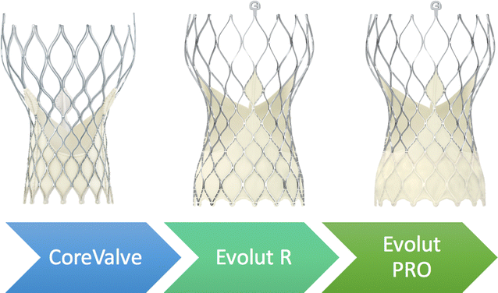
Self expanding valves
Core valve System - Evolut R
*porcine pericardium
*nitinol frame
The Multistage frame is anchored within aortic annulus. Due to length->it extends superiorly to anchor in the aorta above the coronaries.
Notes:
Evolut R- supraannular valve made of porcine pericardium-self expanding nitinol frame.
UPPER PART- TO ORIENT THE VALVE TO AORTIC ROOT
MIDDLE THIRD-HIGH HOOP STRENGTH –VALVE ATTACHED HERE
LOWER THIRD-HIGH RADIAL STRENGTH-SEAL THE SYSTEM AND PREVENT LEAK
They can be recaptured to optimize positioning before deployment. Evolut pro-contains external pericardial covering to reduce paravalvular regurgitation

Slide 57
En Veo R delivery System
Notes:
Delivered via subclavian or femoral artery

Slide 58
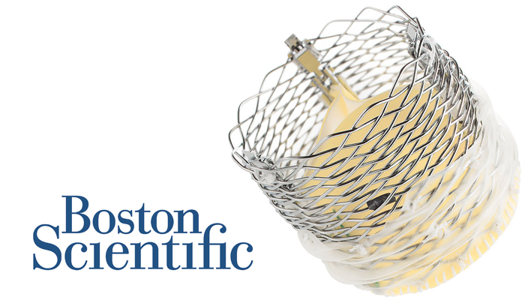
valve system:
LOTUS EDGE VALVE:
1)Minimize the depth of deployment and interaction of left ventricular outflow tract.
*lowering need of Permanent pacemaker
2) Approved for commercial use in high surgical risk pts.
Notes:
d)Lotus valve:

Slide 59
ACURATE NEO VALVE
Valve is supraannular
Smaller foot prints in Ascending Aorta
Easier access to coronaries

Slide 60
Jena valve
Anchors by clipping onto the native leaflets
Rather than radial force in the left ventricular outflow tract
Only Transcatheter valve used in treatment of AS+AR

Slide 61
procedure
ANAESTHESIA:
Local vs General anaesthesia
General anaesthesia: Non femoral access TAVI / anticipated complex procedures
ANTITHROMBOTIC THERAPY:
Preprocedural loading with low dose aspirin
Procedural anticoagulation with UFH (ACT-250-300s)
For patients on OAC, decision should be made on individual basis.
NOAC were omitted in the day of procedure
Notes:
In a European multicentre study, inr on the day of tavi was targeted to 2.0-2.5. they were not associated with increased bleeding or vascular complication.

Slide 62
ANTIBIOTIC PROPHYLAXIS:
Perioperative antibiotic prophylaxis covering the most frequent micro-organism underlying early PVE.
Studies showed recent Infections non suspectible to cephalosporins.
They are contributed to entercoccal infections.(respond to amoxiclav/ampicillin sulbactum)
Notes:
Early PVE- coagulase negative staph and staph aureus

Slide 63
Procedural steps(Transfemoral tavi)
STEP 1
Femoral main access ---for delivery of THV
Contralateral access ----for aortic root angiography to guide implantation of THV

Slide 64
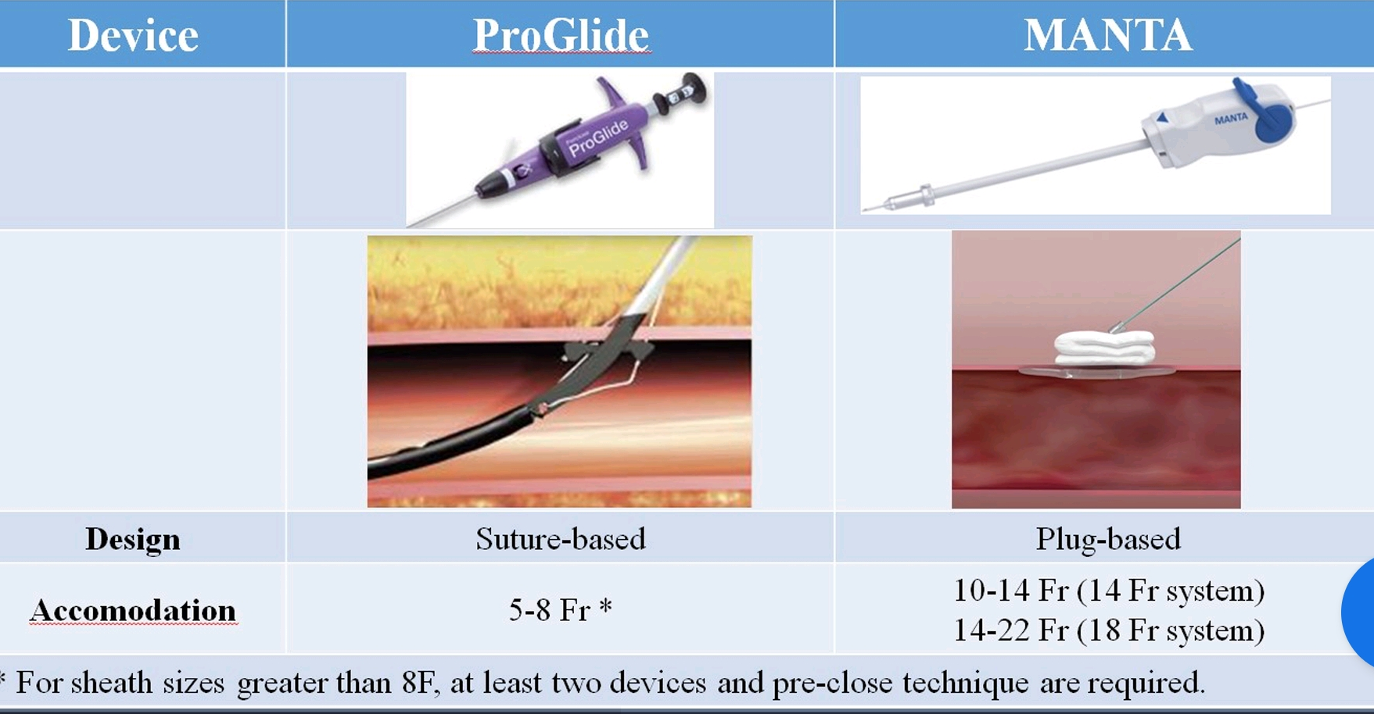
STEP 2
Access site – Preclosed by one or two suture based vascular closure device
Alternate closure can be done by Plug Based.

Slide 65
STEP 3
TAVI Delivery sheath(14-18F) inserted into main access using stiff wire
Provide support and straighten Iliofemoral tortorusity
In difficult cases, Balloon angioplasty / intravascular lithotripsy is used
Notes:
Iliofemoral vascular disease with stenosis and calcification

Slide 66
STEP 4
TPI via femoral/internal jugular vein vs LV epicardial pacing
LV epicardial pacing-
1)Reduce risk of separate puncture
2)Reduce risk of Pericardial effusion
3)Reduced procedure duration

Slide 67
STEP 5
3 Cusp Coplanar angle for valve implantation -→MDCT
Confirming using aortic root angiography
The nadir of 3 aortic cusp should lie along single line in implantation angle

Slide 68
STEP 6
Using Amplatz left catheter and a standard straight tipped wire ,the aortic valve is crossed.
Then replacing catheter with PIG TAIL catheter and pre shaped stiff wire.
Notes:
Simultaneous pressure assessment in lv and aorta allow measurement of transvalvular pressure gradient

Slide 69
STEP 7
THV Is checked for appropriate loading onto delivery system
In cases of Calcified / Very severe stenosis, Predilatation may be done under rapid ventricular pacing.(160-200 bpm for 20 -30s)
Size of the balloon should not exceed minimum aortic annulus diameter
Notes:
Although predilatation was associated with a lower post dilatation rate, device success rate was similar between groups.

Slide 70
STEP 8
Under fluoroscopic guidance, the THV is delivered over the pre shaped stiff wire.
The system is carefully advanced across aortic arch avoiding direct interaction
Once the TAVI system has reached the aortic arch, fluoroscopic angle is changed to 3 cusp coplanar view.
Now they are checked under fluoroscopic guidance and deployed
Post dilatation may be needed in few cases.
Notes:
Each deployment techniques are device specific.

Slide 71
Check for complications:
STEP 9
Measurement of transvalvular gradient and diastolic pressure
Root angiogram –
1)Assess Prosthetic valve regurgitation
2)THV in correct position
3)R/O aortic root rupture
4)R/O coronary artery obstruction
+ECHOCARDIOGRAPHY/ CARDIAC MONITOR
Notes:
Using pig tail
ECHO- VALVE FUNCTION/PERICARDIAL EFFUSION
CARDIAC MONITOR- LBBB/CHB

Slide 72
STEP 10
Removal of femoral sheath
Preclosure sutures tightened
Additional closure device Such as Angio seal / Manual compression is required.
Failure to stop bleeding:
Contralateral femoral access used for balloon angioplasty / covered stent implantation.

Slide 73
Procedural complications

Slide 74
Paravalvular regurgitation
If leak is due to
Underexpanded stent → Post dilatation
THV malposition→ valve in valve procedure

Slide 75
Annular rupture
Suspected in pts with sudden hemodyanamic collapse
Diagnosed with root angio + echo with pericardial effusion
Treatment is surgical/interventional repair/reconstruction
/conservative

Slide 76
Coronary artery obstruction
Prevention strategies
Lesion should be treated with PCI

Slide 77
Valve dislocation/embolization
Risk factors: pre existing AR ,acute aortic angulation, non calcified native valve
Valve dislodges either into aorta or lv cavity
Bailout measures include
Repositioning using snare
Conversion to surgery
Notes:
Incidence is 1%

Slide 78
Av conduction disturbances
LBBB / Complete Heart block
Self expanding valve > balloon expandable valve
Usually by 24 hours
Sometimes even after discharge
Monitor by telemetry after discharge
Notes:
Care to be taken for young pts with longer life expectancy

Slide 79
stroke
Acute stroke ->
1)Embolization of debris
2)Sustained hypotension
Subacute stroke->
1)Bioprosthetic valve thrombus
2)New onset AF
Optimal anticoagulation during procedure
Cerebral embolization protection device

Slide 80
Post op care
Immediate post op – pericardial effusion / conduction disturbances / vascular related bleeding / stroke and arrythmia.,
Echo at follow up at 1,6 and 12 months and then annually
Prophylaxis with bacterial endocarditis if pt undergoes any invasive procedures

Slide 81
Antithrombotic treatment
Life long SAPT(low dose aspirin) (class II a )
If there is an established indication for DAPT, the pt can continue the same.
For patients with established indication for taking OAC, additional antiplatelet therapy is not recommended.
Notes:
1)p2y12 inhibitor is aspirin is contraindicated
2)Post mi pci- dapt for 12 months
3)However warfarin vs noac is the subject of debate

Slide 82
Valve in valve procedure
TAVR in surgical bioprosthetic valve failure (alternative to reoperative surgical AVR)
The previously implanted surgical bioprosthesis serves as an ideal “landing zone” for TAVR implantation.
There is also increasing evidence of placing TAVR valves within degenerated TAVR valves (TAV in TAV procedure)
Notes:
Current issues regd viv procedure is coronary obstruction / prosthesis patient mismatch and unknown long term valve durability

Slide 83
Long term adverse effects
BIOPROSTHETIC VALVE THROMBOSIS
PROSTHETIC VALVE ENDOCARDITIS
Notes:
1)RARE;MDCT;OAC USEFUL

Slide 84
CONCLUSION
TAVI SUPERIOR / NON INFERIOR TO SAVR IN MID TERM FOLLOW UP(5 YEARS)
LESS INVASIVE NATURE / LOWER STAY/ FASTERY RECOVERY
HIGHER RISK OF PVR / AV BLOCK POST PROCEDURE
FURTHER RESEARCH FOR TAVI IN YOUNGER POPULATON WITH LONGER LIFE EXPECTANCY

Slide 85
THANK YOU

