Slide 1
CORONARY ANGIOGRAM -ESSENTIALS

Slide 2
OUTLINE OF THE TOPIC
PART 1 - INDICATIONS,CONTRAINDICATIONS,
COMPLICATIONS
PART 2 -BASIC TECHNIQUE,HARDWARE
PART 3 -CORONARY ANATOMY,ANGIOGRAPHIC VIEWS
PART 4 -LESION CHARACTERISTICS

Slide 3
HISTORY
Werner forsmann -First angiogram
Cournard- Catheterisation
Mason sones -coronary angiogram
Andreas greuntzig - First angioplasty

Slide 5
Coronary angiogram
Radiographic visualisation of coronary arteries after injection of radio opaque contrast media
"Lumen - o - gram"
Cannot visualise exterior of the artery,plaque and endothelial surface
Does not provide hemodynamic significance of a lesion
Hence the role of FFR,IVUS,OCT

Slide 6
Types of coronary artery disease
Stable angina - Angina only on exertion
Unstable angina -Angina at rest,biomarker neg
NSTEMI -Angina at rest + Postive biomarker
-ECG- STD,T inv, No ST elevation
STEMI - ST elevation in > 2 contiguos leads

Slide 7
Indications
1.STEMI
2.NSTEMI - High risk
3.Unstable angina -High risk
4.Stable angina -refractory angina,positive for inducible ischemia on stress test
5.Valvular heart disease undergoing other cardiac surgery
6.Suspected coronary artery anomalies

Slide 8
Contraindications
Active infection
Coagulopathy (Increased INR,Abnormal BT,CT)
Severe anemia(hemoglobin <8 mg/dl)
Severe electrolyte imbalance
Active GI bleeding

Slide 9
Acute aortic valve endocarditis
Acute renal failure
Known contrast allergy or history of anaphylaxis to contrast agents
Known radiation sensitivity
Caution - Pregnany

Slide 10
Complications
1.Acute kidney injury(renal failure)
2.Access site complications
3.Coronary dissection
4.Air embolism
5.Acute pulmonary edema
6.Arrhythmias
7.MI,Stroke
8. Infection
9.Radiation injury(Stochastic effects)
10.Contrast allergy

Slide 11
Consent
1.Explanation of the procedure
2.Risks involved
3.Risk vs clinical benefit
4.Explain to the patient and bystander
5.Written informed consent in patient's own words
6.Reassurance

Slide 12
A thorough history
Medications
Co morbidites
In STEMI taken for primary,quick history of drugs,CKD,past procedures,immunocompr.status
In pts with prior PTCA -date,indication,hardware used
In pts with prior CABG - grafts,arterial or venous

Slide 13
Patient preparation
Sedation overnight to allay anxiety
Preparation of parts
Examine access site
Peripheral pulses
Pallor,vitals
Cardiovascular status
Pre procedure ECG,ECHO,biomarkers,RFT

Slide 14
During procedure
Constant monitoring of ECG,HR,BP,RR,SPO2
IV line should be ready before procedure
Allen's test on both hands,Barbeau method
ECHO
Emergency medications
Intubation set
Defibrillator

Slide 15
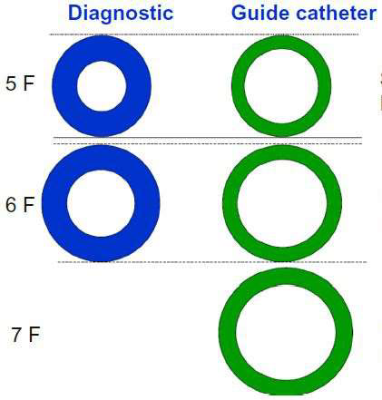
CORONARY CATHETERS
Diagnostic
GUIDE
Thicker shaft
Internal DM
Smaller
Tapering tip
Less Reinforced construction ( 2 layers)
Thinner shaft
Internal DM larger
Non tapering tip
More Reinforced construction ( 3 layers)

Slide 16
CHARACTERISTICS OF AN IDEAL CATHETER
Better torque control
Pushability
Flexibility
Trackability
Radio-opacity
Atraumatic tip
Kink resistance

Slide 18
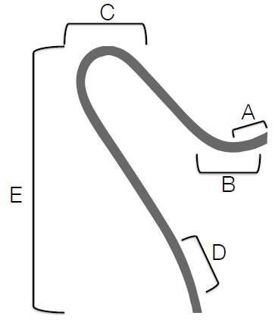
A) TIP LENGTH – Increased length offers more
stability in target vessel
B) PRIMARY CURVE – angle of the target vessel
from its parent artery.
C) SECONDARY CURVE -- width of the parent
vessel.
D) TERTIARY CURVE –normal curvature of the
parent vessel.
E) CATHETER LENGTH – Usually 100 or 110 cm

Slide 19
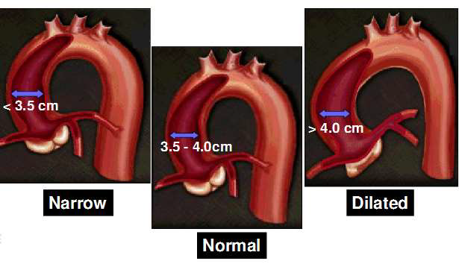

Slide 20
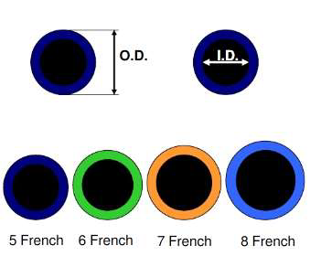
SIZE MEASUREMENT
FRENCH CATHETER SCALE:
outer diameter of cylindrical medical instruments.
D(mm) = Fr/3
Most commonly in adults -- Diagnostic Catheters of 5 – 7 Fr size.
Colour coding

Slide 21
CATHETER MATERIALS
TEFLON
POLYETHYLENE
POLYURETHANE
POLY VINYL CHLORIDE
Notes:
Radio opacity by incorporating Ba , Bi , Ir

Slide 22
Commonly used catheters

Slide 23
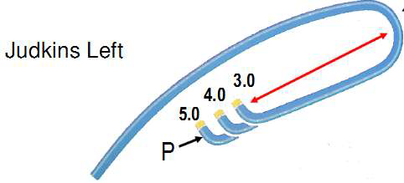
JUDKINS
Curve length = distance between P
(primary curve) & S (secondary curve)
Notes:
Melvin Judkins in 1967, Tapered tip with end hole, Designed for femoral route , Length 100 cm, Size 3.5to 6 by most
Companies, 4-7 French available.

Slide 24
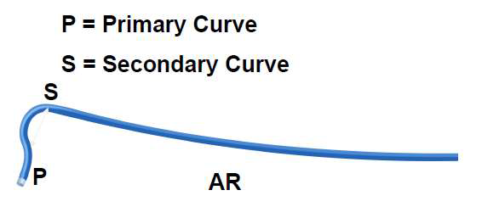
AMPLATZ
Notes:
Kurt Amplatz , Austrian Radiologist,1967 , usual sizes 1 ,2,3 with increasing curvature, AL - Coronory ostia out of conventional judkins Like high and posterior origin.. It can selectively canulate LAD or LCX if short left main stem. IT IS MORE TOLERENT OF ROTATIONAL MANEUERING
Separate origins of left anterior descending and left circumflex coronary arteries.
High anterior right coronary arteries (RCAs) or Shepherd’s Crook RCA.

Slide 25
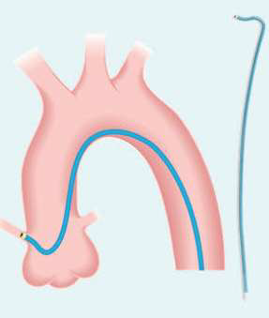

Slide 26
MULTIPURPOSE CATHETER
Polyurethane catheter
Single curve with straight tip an end hole and two side holes.
Use: CAG – Both native vessel and graft ,Ventriculography , Right heart catheterization.
MP A-1 : 1 end hole only
MP A-2 : 2side holes ,1end hole
MP B-1 : 1 end hole only
MP B-2: 2 sideholes and an end hole
Notes:
By Schoonmaker & King , In 1974

Slide 28
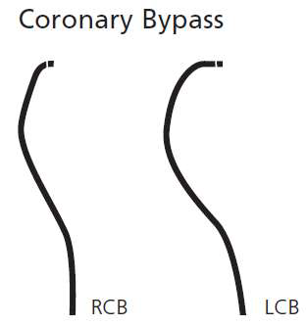
BYPASS CATHETERS
RCB
Resembles JR4 with a tip curved >90 degree
LCB
more secondary curve

Slide 29
Internal mammary catheter
Same as JR4 except for
tighter primary curve (80degree) and
longer tip

Slide 30
ACCESS SITE
Puncture site ,preparation,LA
Femoral,radial
Modified seldinger technique
High puncture,low puncture -problems
Heparin,spasmolytics in radial

Slide 31
ADVANCING THE GUIDEWIRE
Under flouroscopy
Resistance
At aortic bifurcation - PVOD
Aortic arch
Anomalous subclavian in radial
Use of hydrophilic wire

Slide 32
RADIAL APPROACH
0.035 inch guidewire
J tip wires - may cause vasospasm
Angled-tip hydrophilic guidewires useful to negotiate anomolous SCA
Significant subclavian tortuosity can be negotiated by use of a stiff shaft hydrophilic-coated guidewire . Having the patient take a deep breath can also straighten the vessel.

Slide 33
Insertion and Flushing of the Coronary Catheter
The Catheter with guidewire inserted upto ascending aorta
Aspirate blood and column made air free
Record baseline tip pressure –
Catheter lumen filled with contrast & look for alteration in tip pressure
Selective engagement of coronary.

Slide 34
Damping and Ventricularization of the Pressure Waveform
A fall in overall catheter tip pressure (damping) or a fall in diastolic pressure only (ventricularization)
Indicates obstruction of the catheter tip or interference with coronary inflow
Notes:
indicate ostial stenosis with absent reflux into the aortic root or retention of the injected contrast in the proximal- and midportion of the vessel

Slide 35
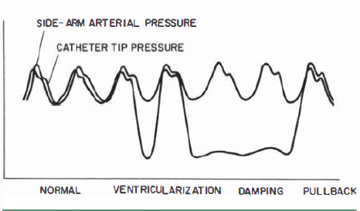
Small vessel
Ostial Spasm
Selective Engagement Of The Conus Branch
Ostial Stenosis

Slide 36
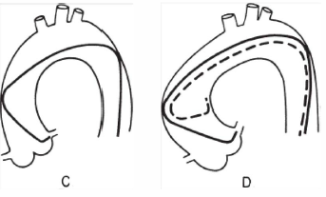
Cannulation of the Left Coronary Ostium
Notes:
IF NARROW OR SHORT - The left ostium may still be engaged despite this somewhat unfavorable situation by pushing the catheter down into the left sinus of Valsalva for approximately lO seconds to tighten the tip angle and then withdrawing the catheter slowly. Having the patient take a deep breath during this maneuver also helps by pulling the heart into a more vertical position to assist in engagement of the left ostium. The most satisfactory approach, however, is to exchange for a JL3 . 5 catheter with a shorter curve.

Slide 37
Cannulation of the Right Coronary Ostium
Notes:
To catheterize the rt coronary ostium , the R JL is advanced around the aortic arch with its tip directed leftward , as viewed in the LAO projection , until it reaches a position 2 to 3 cm above the level of the le ft corona ry ostium (E). Clockwise rotation causes the catheter tip to drop into the aortic root and point anteriorly ( F ) . Slight further rotation causes the catheter tip to enter the right coronary ostium (G).

Slide 38
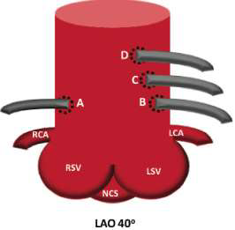
Saphenous Vein and Arterial Grafts
Right Grafts
– Primary choice - MP
– Alternative – JR , RCB , AL
Left Grafts :
– Primary Choice – JR4 , AL1
– Upward trajectory may require - special LCB , IMA
– More anterior origin – AL

Slide 39
INJECTION TECHNIQUE
IDEAL - contrast at an adequate rate and volume to transiently replace the blood contained in the involved vessel with slight but continuous reflux into the aortic root.
VIGOROUS - coronary dissection or excessive myocardial blushing.
PROLONGED – increased myocardial depression,staining , bradycardia
The rate and volume of injection - an average 7 mL at 2.1 ml/second in the left and 4.8 mL at 1.7 ml/second in the right coronary

Slide 41
RCA Branches
Conus branch
SA nodal branch
RV branch
Atrial branch
Acute marginal branch
AV nodal branch
Posterior descending artery
Posterolateral vessel
(branch -PLV/PLB)

Slide 43
SURGICAL SEGMENTS OF LAD
Proximal
Ostium to 1st major septal perforator or 1st diagonal artery whichever is first
Mid
1st perforator to 2nd diagonal
Distal
D2 to end

Slide 44
ANGIOGRAPHIC CLASSIFICATION OF LAD
Type 1
Small vessel reaches only 2/3rd of way from base of heart to apex
Type 2
reaches the apex of LV
Type 3
Extends from base to apex &
wraps around the diaphragmatic surface of LV.

Slide 45
SURGICAL SEGMENTS OF RCA
Proximal
Ostium to 1st main RV branch
Mid
1st RV branch to acute marginal branch
Distal
Acute margin to the crux

Slide 46
LCX
Proximal
Ostium to 1st major obtuse marginal branch
Mid
OM1 to OM2
Distal
OM2 to end

Slide 47
CORONARY DOMINANCE
Gives rise to PDA, posterolateral branch and AV nodal branch
Right dominant circulation: 85%
Left dominant circulation : 8%
Balanced dominant circulation: 7%
RCA give rise to PDA and terminates
LCx give rise to all PLV and sometimes a parallel posterior descending branch supplying part of the IVS

Slide 48
ANGIOGRAPHIC VIEWS

Slide 49
TWO TERMS
The angulation defined using two terms .
The first term - Rotation , the term RAO designates a view where the image intensifier is positioned over the patient's right anterior chest wall.
The second term - Skew, the amount of angulation toward the patient's head (cranial) or foot (caudal) depends on image intensifier position.

Slide 51
RIGHT AND LEFT

Slide 52
CAUDAL AND CRANIAL

Slide 53
LAO CRANIAL

Slide 54
Atrioventricular and Interventricular Planes

Slide 56
RAO views
RAO-caudal projection (0- 10° RAO and 15-20° caudal) -
left main bifurcation, the proximal LAD, and the proximal to mid LCX.
Notes:
Distal right coronary artery or distal circumflex, since it effectively unstacks the posterior descending and posterolateral branches and proj ects them without foreshortening.

Slide 59
RAO/Caudal

Slide 60
RAO CRANIAL
Shallow RAO-cranial projection (0-10° RAO and 25-40° cranial) –
mid & distal LAD, with origins of the septal and diagonal branches
distal RCA or distal LCX.

Slide 61
RAO CRANIAL

Slide 62
RAO CRANIAL -RCA

Slide 63
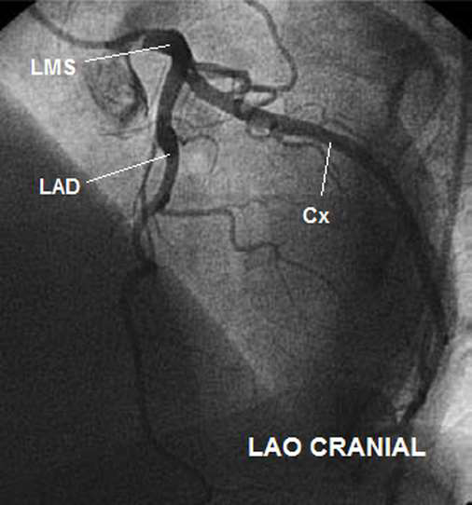
LAO CRANIAL
Notes:
LAO cranial view to separate the LAD and the diagonals, and expose the lesions at the ostium or bifurcations of the diagonals

Slide 64
SHALLOW LAO CRANIAL

Slide 66
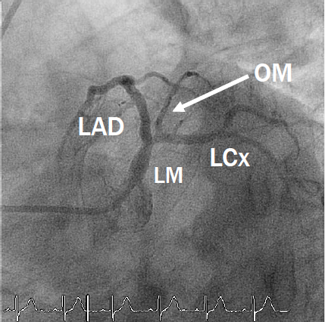
LAO CAUDAL(SPIDER VIEW)

Slide 67
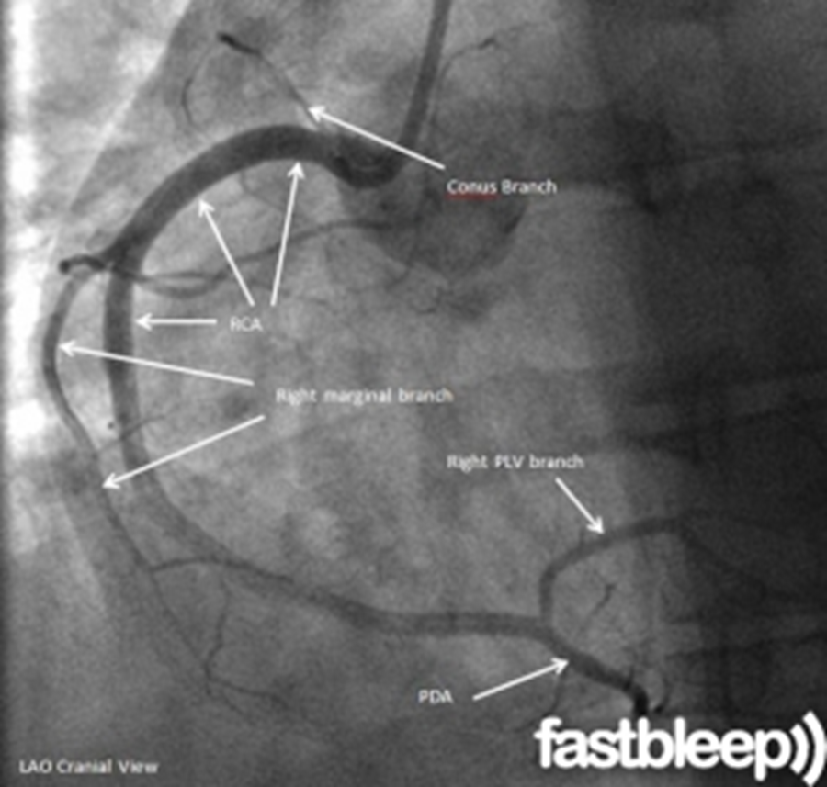
LAO - CRANIAL

Slide 68
STEEP LAO CRANIAL
(50 to 60 degrees) LAO and angulated cranial (20 to 40 degrees) skews.

Slide 69
Left coronary artery
1.RAO-caudal - left main, proximal LAD and proximal circumflex
2.RAO-cranial - mid and distal LAD without overlap of septal or diagonal branches
3.LAO-cranial - mid and distal LAD in an orthogonal projection.
4.LAO-caudal - left main , proximal circumflex & LAD.
5.AP Caudal & cranial - LMCA

Slide 70
RCA
In the LAO projection - appears like a letter C & in RAO position- like a letter L.
To check the correct alignment of the catheter with the ostial RCA, the best view is the RAO-shallow cranial projection.

Slide 71
RIGHT CORONARY ARTERY
1. LAO 60 - Proximal and mid RCA
2. LAO cranial - Distal RCA and its PDA & PLV branches
3. RAO-cranial - PDA & PLV
4. Lateral - Mid-RCA

Slide 73
HOW TO DIFFERENTIATE SEPTAL & DIAGONAL
DIAGONALS
SEPTALS
The diagonals would be in the left of the screen .
Diagonals move (buckle) during systole.
Branches at 45 degree
Septals - the right of the LAD
Septals are straighter and move very little with ventricular contraction
Branches at 90 degree
**Exposure of the high diagonal - a good spider view with steep caudal angulation is most likely the best view to expose a high diagonal

Slide 74
LESION QUANTIFICATION

Slide 75
CAD is defined as a > 50% diameter stenosis in one or more of these vessels
Subcritical stenoses < 50% nonobstructive CAD.
Obstructive CAD is classified as one-, two-, or three-vessel disease.

Slide 79
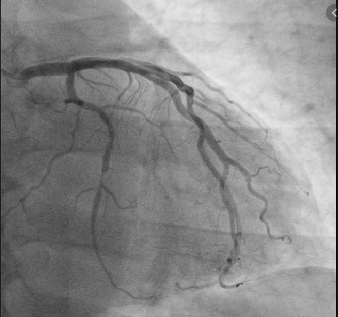
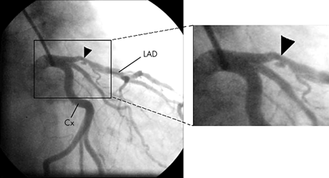
Notes:
1) Eccentric ,2)ulcer 03)intimal flap.

Slide 81
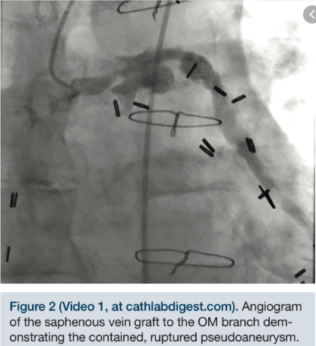
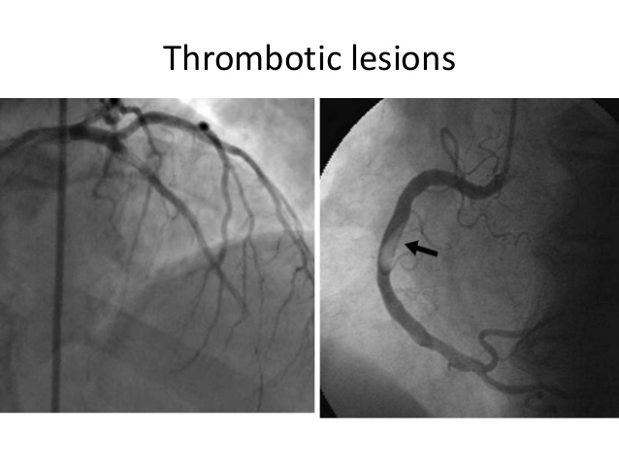

Slide 82
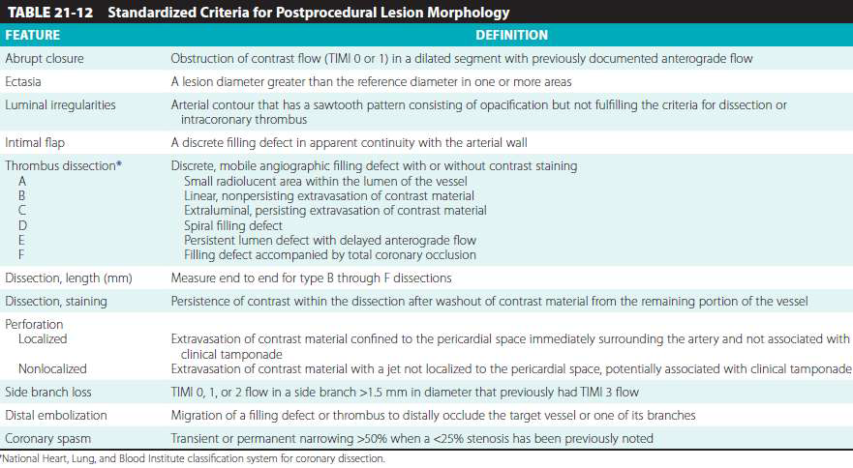

Slide 83
LESION ARRANGEMENT
Tandem - two lesions located within one balloon length
Sequential - two lesions located at a distance longer than the balloon

Slide 84
TORTUOSITY AND ANGULATION
PROXIMAL VESSEL TORTOUSITY
• Number of >75º bends to reach the lesion
- None
- Mild - one bends
- Moderate - two bends
- Severe - ≥ three bends
LESION ANGULATION
- None/Mild - lesion located on a straight segment or a bend <45º
- Moderate; 45º~90º bend
- Severe; bend >90º
Notes:
Vessel angulation should be measured in the most unforeshortened projection at the site of maximum stenosis using a length of curvature that approximates the balloon length. Balloon angioplasty of angulated lesions increased the risk for dissections, although with the advent of coronary stenting, the inability to deliver the stent and subsequent straightening of the vessel that may predispose to late stent fracture are the largest challenges of highly angulated lesions.

Slide 85
CALCIFICATIONS
None
Mild - densities noted only after contrast injection
Moderate - densities noted only with cardiac motion prior to contrast injection
Severe -radiopacities noted without cardiac motion prior to contrast injection
Notes:
Thrombus - conventional angiography is a relatively insensitive method for detection of coronary thrombus

Slide 86
OSTIAL LESION
Origin of the lesion ≤ 3mm of the vessel origin
- Aorto-ostial - (LMCA, Prox RCA)
- Branch-ostial - major epicardial artery
LAD & LCx os
Dx os
OM os
PDA and PL os

Slide 88
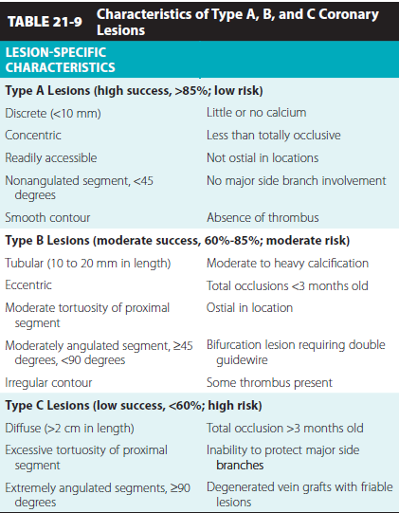

Slide 89
SYNTAX SCORE
Each lesion is assigned a numerical number and then sum of all lesions score for a patient is calculated to come up with the final numerical SYNTAX score
Patients are divided in 3 groups:
Low <22
Intermediate 23-32
High >32

Slide 90
MYOCARDIAL BRIDGE
Myocardial Bridges - coronary arteries occasionally dip below the epicardial surface under small strips of myocardium.
During systole, the segment of the artery surrounded by myocardium is narrowed and appears as a localized stenosis
Most common in LAD

Slide 91
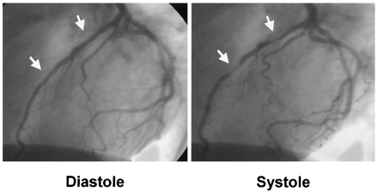
LAD

Slide 92
THANK YOU

