Slide 1
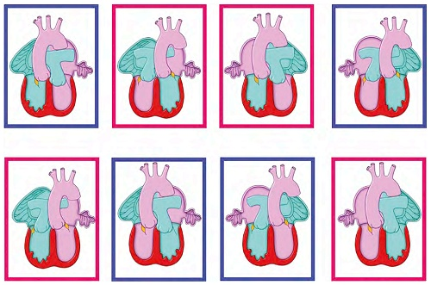
Speaker
Dr.Suneesh.K
Senior Resident, Dept. of Cardiology
Calicut Medical College
Transposition of the Great Arteries
Topic presentation
13.11.2014

Slide 2
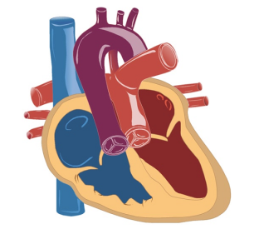
Overview
Introduction
Epidemiology
Embryology and pathogenesis
Anatomy
Hemodynamics
Clinical presentation
Diagnosis
Management

Slide 3
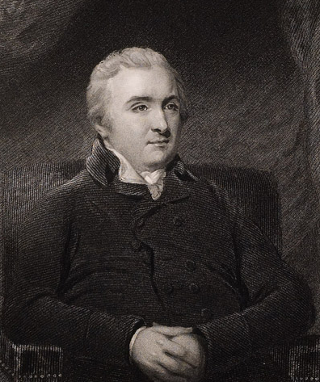
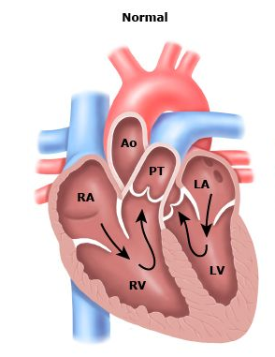
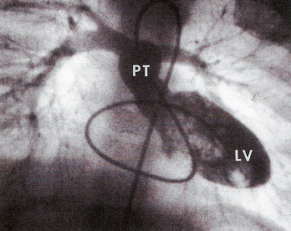
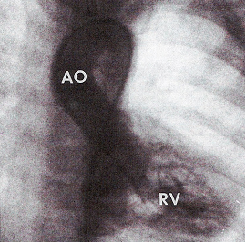
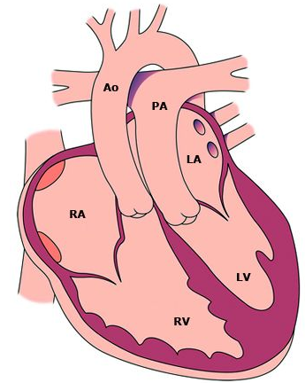

Introduction
Abnormal origin of the Aorta and PA from the ventricular complex
Atrio-ventricular concordance with ventriculo-arterial discordance
Results in two circulations in parallel
Ultimately cyanotic heart disease
Spatial relationship of the great arteries also abnormal
Matthew Baillie is credited with first identifying TGA and situs inversus in 1797
Notes:
The spatial relationships of the great arteries are also often abnormal. Normally, the pulmonary artery is placed anteriorly and to the right in the superior mediastinum. The aorta arises posteriorly and to the left and the valve is also caudal to the pulmonary valve. In aortopulmonary transposition, the aorta is placed anteriorly at its origin from the right ventricle and the pulmonary artery is posterior, arising from the left ventricle.
The aortic valve is also positioned cephalad to the
pulmonary valve. However, the relationships of the aorta and pulmonary artery may vary considerably; the diagnosis should be based on the presence of ventricular–arterial discordance rather than the spatial relationships of the aorta and pulmonary artery.
He is credited with first identifying transposition of the great vessels (TGV) and situs inversus.

Slide 4
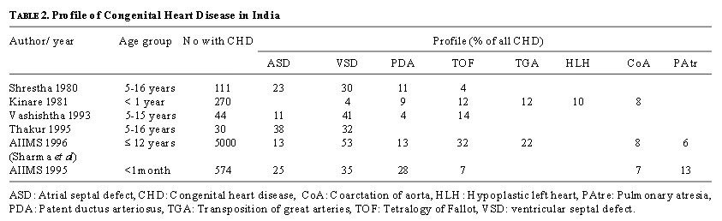
Epidemiology
Prevalance 4.7 per 10,000 live births in US
CDC-Improved national prevalence estimates for 18 selected
major birth defects-US 1999-2001
2.3 per 10,000 live births (a population-based surveillance)
Reller MD et al; Prevalence of congenital heart defects
in metropolitan Atlanta 1985-2005 J pediatr 2008;153:807
Accounts for 3 % of all CHD and almost 20% of all CCHD
Male preponderance (4:1)
Moss and Adams’ heart disease in infants children and adolescents
Congenital Heart Disease in India: A Status Report; Anita Saxena
Indian Journal of Pediatrics, Volume 72—July, 2005
Notes:
We have no community-based data for incidence of CHD at birth in India. Since a large number of births in our country take place at home, mostly unsupervised by a qualified doctor, hospital statistics are unlikely to be truly representative.

Slide 5

Epidemiology (Contd..)
One-fifth of cardiac deaths in infancy prior to the era of surgical correction
No definite aetiological factors have been identified
Diabetic mothers
Maternal intake of alcohol
Poor nutrition
Stressful life event during pregnancy
Notes:
Although a rare malformation, accounting for only about one-twentieth of all congenital cardiac malformations, transposition was responsible for up to one-fifth of cardiac deaths in infancy prior to the era of surgical correction.
Boys are affected two to three times as frequently as girls. Although no definite aetiological factors have been identified, the condition is held to be more frequent in infants of diabetic mothers.
Maternal intake of alcohol, poor nutrition or a stressful life event during pregnancy may increase the risk of transposition in the offspring, while addition of folic acid to the maternal diet may result in a modest reduction in risk.

Slide 6
Embryology and pathogenesis
Normal development of ventricular situs
Occurs during the 5th week of gestation
Twisting of the primordial heart tube to right (d-looping)
Normal development of the great arteries
Occurs during 5th -6th week of gestation
Genetically influenced by neural crest cells
Formed from common trunk at the top of the fetal heart
Places eventual morphologic right ventricle on right side of heart
Places eventual morphologic left ventricle on left side of heart
Brings atrium to right and posterior of ventricles

Slide 7
Trunco-conal malseptation Hypothesis
Lack of spiraling of the septum that grows in the primitive truncus arteriosus communis to separate it into the aortic and pulmonary trunk
Normally related great arteries result from spiral downgrowth of the trunco-conal septum, whereas
TGA results from straight downgrowth of the trunco-conal septum

Slide 8
Embryology (Contd..)
During development of the conotruncal region, the PA is related to the left conus and the aorta to the right conus
Normal movement of the PV proceeds from posterior to anterior on the left side in the interval between 30 and 34 days of age and is related to normal development of the subpulmonary infundibulum
During this same interval, the aortic valve remains stationary, apparently because of the normal lack of development (or absorption) of the subaortic infundibulum
Notes:
During development of the conotruncal region, the pulmonary artery is related to the left conus and the aorta to the right conus

Slide 9
Embryology (Contd..)
Abnormal growth and development of the subaortic infundibulum and the absence of growth of the subpulmonary infundibulum
AV is protruded superiorly and anteriorly by the development of the subaortic infundibulum, placing it above the anterior RV
Failure of development of the subpulmonary infundibulum prevents the normal morphogenetic movement of the PV from posterior to anterior and further results in abnormal pulmonary to mitral valve ring fibrous continuity

Slide 10
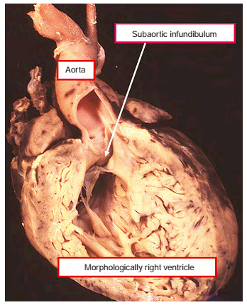
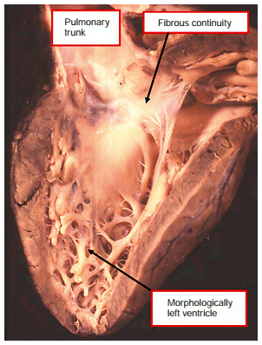
Embryology (Contd..)
Notes:
The morphologically right ventricle in this heart, connected by the tricuspid valve to the morphologically right atrium, supports the aorta above a muscular infundibulum. In this case with an intact ventricular septum.

Slide 11
Genetics
Not associated with any specific genetic abnormality
Prevalence in siblings of affected children same as that of the general population
Becker TA et al; Occurrence of cardiac malformations in
relatives of children with transposition of the great arteries.
Am J Med Genet 1996; 66:28.
Noncardiac anomalies less (<10 %) compared to other CHD defects
Tennstedt C et al; Spectrum of congenital heart defects and
extra-cardiac malformations
associated with chromosomal abnormalities: results of a seven year necropsy study. Heart 1999; 82:34
Notes:
Carpenter’s syndrome

Slide 12
Anatomy and physiology

Slide 13
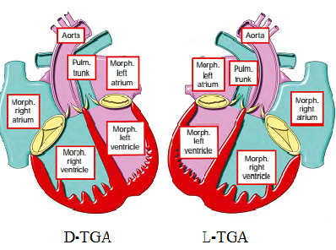
Nomenclature
Transposition: aorta from morphologic RV and pulmonary artery from morphologic LV
Complete TGA (D-TGA): Situs solitus of atria, Concordant AV and Discordant ventriculo-arterial alignment
TGA {S,D,D} - TGA with situs solitus (S) of the atria and viscera, usual (D) looping of the ventricles and an anterior and rightward (D) aorta
Simple TGA: D-TGA with IVS and no obstruction to the LVOT
Notes:
Normal anatomy- In normal cardiac anatomy, the aorta is positioned posterior and to the right of the main pulmonary artery. Also, the morphologic right ventricle has a large outflow tract component known as the infundibulum or the conus arteriosus. In D-TGA, as noted above, the subpulmonary conus is absent and the subaortic conus fails to resorb resulting in the aorta being positioned anterior and slightly rightward of the pulmonary artery. These changes cause the aorta to arise from the right ventricle and the pulmonary artery from the left ventricle (ventriculoarterial discordance).
The dextro connotation of D-TGA refers to the looping of the ventricles during cardiac morphogenesis that positions the right ventricle to the right of the morphologic left ventricle. This provides a shorthand moniker to help differentiate this form of transposition from L-TGA.

Slide 14
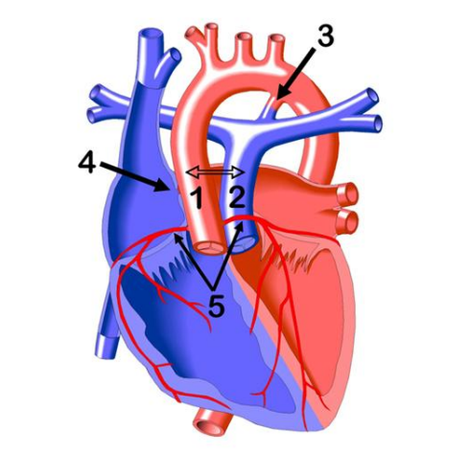
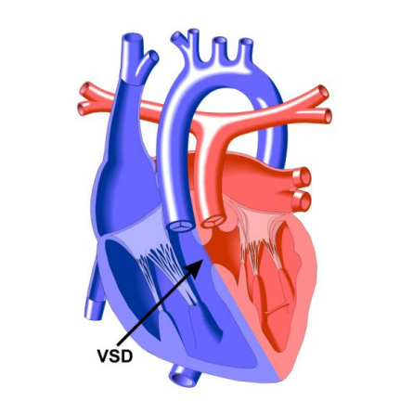
Anatomy
Abnormal septation
Communication between the pulmonary and systemic circuits
  Required for survival
  Three levels
In about half of cases, D-TGA occurs only in association with a PFO or a small PDA
Notes:
In normal cardiac anatomy, the aorta is positioned posterior and to the right of the main pulmonary artery. Also, the morphologic right ventricle has a large outflow tract component known as the infundibulum or the conus arteriosus. In D-TGA, as noted above, the subpulmonary conus is absent and the subaortic conus fails to resorb resulting in the aorta being positioned anterior and slightly rightward of the pulmonary artery. These changes cause the aorta to arise from the right ventricle and the pulmonary artery from the left ventricle (ventriculoarterial discordance).

Slide 15
Morphological considerations
Aortic valve is abnormally anterior, superior, and to the right
PV is posterior to AV and is displaced inferior and right
Well-developed infundibulum in the subaortic region of RV
Wide separation between the septal leaflet of TV and AV
Contiguity of the septal leaflet of the MV with the PV
Ascending aorta is large in diameter and isthmus frequently is as wide as the descending aorta
Main pulmonary trunk tends to be shorter than normal
AV-aortic valve, MV- mitral valve,
PV- pulmonary valve, TV- Tricuspid valve
Congenital Diseases of the Heart Clinical-Physiological Considerations;
Abraham M. Rudolph 3rd Edition;page 469
Notes:
The main pulmonary trunk tends to be shorter than normal and frequently the trunk is oriented toward the right. With this orientation the right pulmonary artery is often considerably larger than the left, which may appear to be hypoplastic.

Slide 16
Co-existing anomalies
VSD
LVOTO
PDA
TV or MV anomalies
Coronary anomalies
COA or aortic arch anomalies
Juxtaposition of atrial appendages
Notes:
Simple and complex D-TGA
About 50% are Complex D-TGA

Slide 17
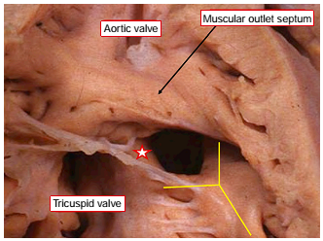
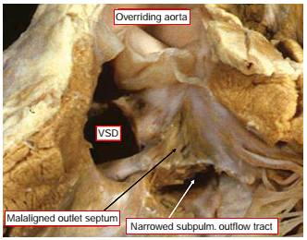
VSD
Most frequent coexisting anomaly (≈50%)
Notes:
Patients with a VSD are more likely to have additional cardiac anomalies including pulmonary stenosis or atresia, overriding or straddling of an atrioventricular valve, and coarctation or interruption of the aorta.
The presence and size of a VSD may have significant impact on clinical presentation.
The typical membranous defect lies adjacent to the membranous septum and tricuspid annulus at the anteroseptal tricuspid valve commissure and is situated between the conal (outlet) septum above and the muscular ventricular septum below. Defects in this location may close spontaneously or become smaller with time.
Most muscular defects are in the midseptum, and others occur in the posterior inflow, apical, or high anterior septum; muscular defects are rarely multiple. Spontaneous decrease in size with eventual closure has been documented frequently, particularly with an initially small, slit-shaped muscular inlet or trabecular defect.
Atrioventricular canal (inlet septum) types of VSDs may be associated with coexisting AV valve or conduction tissue anomalies. This type of defect provides the potential for the tricuspid valve/orifice to straddle the ventricular septum and sometimes is associated with a hypoplastic right ventricle.
Of particular surgical importance are the malalignment (outlet) septal defects. Anterior (rightward) malalignment defects are associated with varying degrees of overriding of the pulmonary annulus onto the right ventricle. With increasing degrees of overriding, a series of anomalies are encountered that culminate, effectively, in double-outlet right ventricle with subpulmonary defect in the morphologic spectrum of the Taussig “Bing anomaly.
The VSD is an anterior defect, often with a muscular posterior rim, but it sometimes extends posteriorly to the tricuspid annulus (perimembranous extension). The subaortic stenosis caused by the anterior malalignment of the infundibular septum is frequently associated with aortic arch hypoplasia, coarctation, or even complete interruption of the aortic arch. Posterior (leftward) malalignment is associated with varying degrees of LVOTO, “subpulmonary stenosis, annular hypoplasia, or even pulmonary valvar atresia (see also LVOTO).

Slide 18
LVOTO
Present in up to 25 % of patients
20% of patients with IVS & 30% of with VSD
Dynamic
Fixed
Notes:
(20% in those with IVS and 30% in those without IVS)

Slide 19
LVOTO (Contd..)
Dynamic LVOTO
In TGA/IVS
Usually mild
Dynamic leftward bulging of basal muscular septum
SAM of AML
Hyperkinetic LV free wall
Rare in neonates
Surgical correction of the parallel circulations eliminates this
The obstruction is
usually not severe and the pressure gradient across
The LVOT is not usually more
than 30– 40 mmHg
Notes:
This form of obstruction is rare in neonates as elevated pulmonary vascular resistance and the presence of a large patent ductus arteriosus result in near systemic pressure of the left ventricle, reducing this “septal bulge”

Slide 20
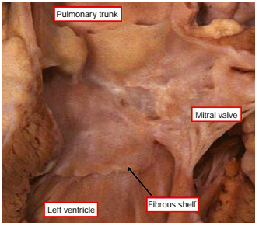
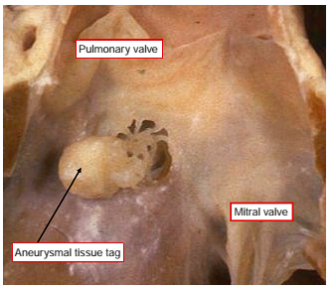
LVOTO (Contd..)
Fixed LVOTO
D-TGA with VSD at greater risk
Patch of endocardial thickening on septal bulge or,
Posterior malalignment VSD or
Subpulmonary fibromuscular ridge or,
Tissue tag originating from TV
More severe
Higher incidence of aortic arch obstruction (COA)
Notes:
Patch of endocardial thickening on septal bulge evolve into sharp fibrous ridge
Higher incidence of aortic arch obstruction including coarctation and interruption of the aorta

Slide 21
Tricuspid valve anomalies
Nearly 31%
Functionally important 4%
Anomalous chordal attachment to edges of perimembranous or outlet septum defects
Protrusion of redundant tricuspid septal valve tissue through VSD to LVOT (Tricuspid pouch)
Annular overriding or tensor apparatus straddling if inlet septum VSD
Ratio of tricuspid to mitral annulus circumference is less than 1 in almost 50% of cases of TGA, whereas in normal hearts this ratio is always greater than 1

Slide 22
Mitral valve anomalies
Nearly 20%
Functionally imp 4%
Cleft anterior mitral valve leaflet
Anomalous papillary muscles and chordae
Straddling the VSD
Redundant tissue tags

Slide 23
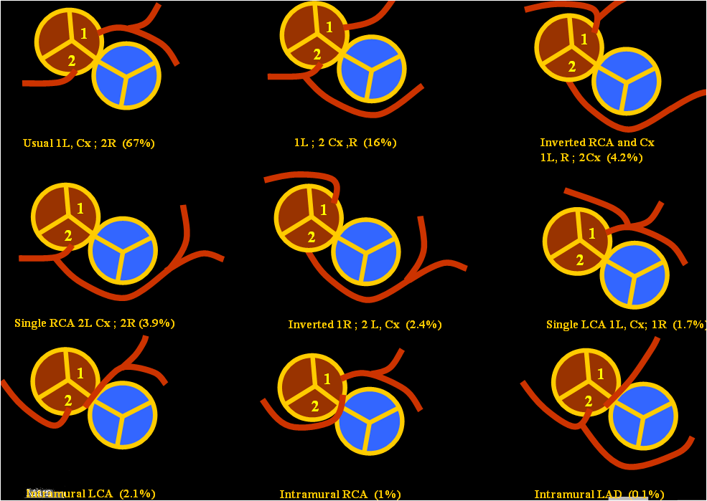
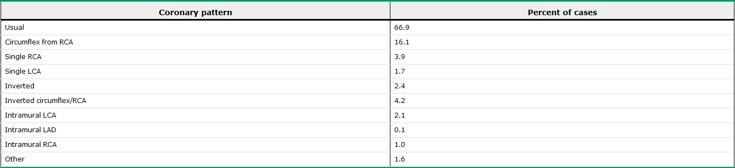
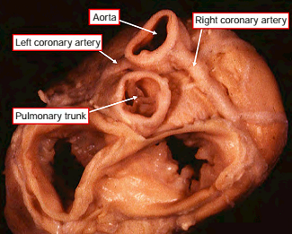
Coronary anomalies
Surgical importance
Coronaries typically arise from the sinuses of Valsalva that face PA and follow the shortest course to their intended distribution
LCA from the anterior and leftward facing sinus
RCA arises from the posterior and rightward facing sinus
Right coronary artery tends to be larger than the left
Notes:
Physiologically not important
But anatomical importance
The coronary arteries both originate from the aorta. Both coronary arteries arise from the aortic sinuses adjacent to the pulmonary artery. Whereas normally the noncoronary sinus is the right posterior sinus, in aortopulmonary transposition the
right anterior sinus does not give rise to a coronary
artery.
Unlike in normal individuals, the right coronary artery tends to be larger than the left; the left circumflex artery arises from the right coronary in about 20% of individuals. A single coronary artery occurs in about 10% of patients with transposition.

Slide 24
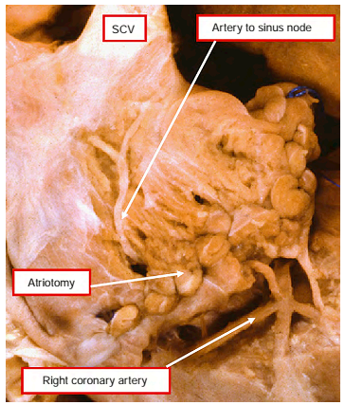
SA node artery
Origin and proximal course may be variable
Reaches the sinus node by the interatrial groove on the anterior surface of the heart, or
Intramyocardial course in the anterosuperior rim of the fossa ovalis
Surgical importance
Notes:
It can be damaged easily during balloon atrial septostomy, during surgical septectomy or when this portion of the septum is widely excised as in the Mustard or Senning atrial switch operation.
The artery to the sinus node arises from the right coronary artery, and crosses the atrial appendage to reach the node located
in the terminal groove. it was transected by the standard atriotomy.

Slide 25
Aortic arch obstruction
About 5% with complete TGA
Coarctation, hypoplasia or interruption
Association more commonly with anterior malalignment types of VSD
Rightward and anterior displacement of the infundibular septum
Sub-aortic Obstruction
Notes:
The aortic arch is usually left-sided, but a right-sided arch is not uncommon, especially in those patients with associated ventricular septal defect and left ventricular outflow tract obstruction

Slide 26
Juxtaposition of atrial appendages
2-6%
Both appendages or left + part of right are adjacent
Left > right -6x (Right atrial appendage passes immediately behind the transposed MPA)
More in females
Often additionally associated dextrocardia, VSD, bilateral infundibulum, right ventricular hypoplasia ,TS or TA.
Notes:
Female preponderance

Slide 27
Hemodynamics
Notes:
The lesions that commonly affect the hemodynamic and clinical features are ventricular septal defect, pulmonary stenosis, and atrial septal defect.
The size of the defects and severity of the stenosis are important in determining the manifestations.

Slide 28
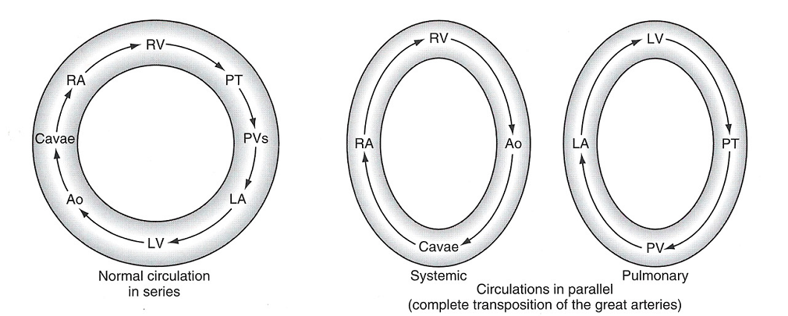
Physiology
Systemic and pulmonary circulations are parallel circuits
This circulation is incompatible with life unless there is communication between the two parallel circuits
Mixing can be either intracardiac or via extracardiac connections
Notes:
D-TGA prior to surgical repair is physiologically uncorrected, which means that the systemic and pulmonary circulations are parallel circuits. Deoxygenated systemic venous blood drains appropriately into the right atrium and then is pumped from the right ventricle back to the systemic circulation via the aorta. Oxygenated pulmonary venous blood returns to the left atrium and ventricle, and is then recirculated to the lungs via the pulmonary artery
This circulation is incompatible with life unless there is communication between the two parallel circuits. Mixing can occur either intracardiac across a patent foramen ovale or a ventricular or atrial septal defect (VSD or ASD), or via extracardiac connections including a patent ductus arteriosus (PDA) or the bronchopulmonary collateral circulation.

Slide 29
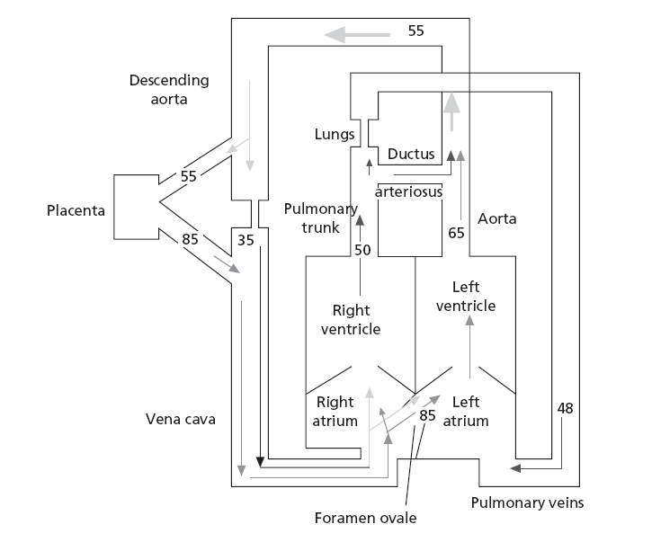
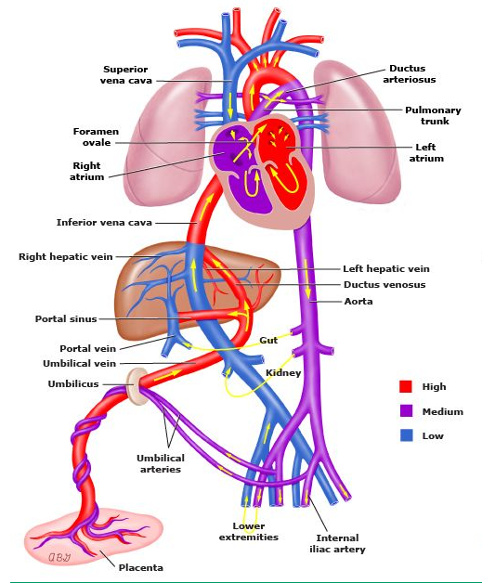
Fetal physiology
Congenital Diseases of the Heart Clinical-Physiological Considerations;
Abraham M. Rudolph 3rd Edition; page 469
Notes:
Brain and heart — Blood flowing through the coronary and carotid arteries has a high degree of oxygen saturation because oxygenated blood from the umbilical vein flows to the right atrium (via the ductus venosus and inferior vena cava) and is shunted through the foramen ovale to the left side of the heart and aorta. This shunting is achieved through differential velocities of incoming venous blood streams and directing of oxygenated blood to the foramen ovale. This reduces mixing of oxygenated blood with deoxygenated blood entering the right atrium from the superior vena cava. The deoxygenated blood is directed toward the right ventricle and shunted through the ductus arteriosus to the aorta but distal to the origin of the carotid and coronary arteries.
Aortopulmonary transposition is compatible with fetal survival and normal body growth and development. There is no evidence that there is a significantly high incidence of aortopulmonary transposition in stillbirths. The gestational development of the fetus also appears to be normal in most cases; in fact, there is a tendency for these infants to be rather large and heavy at birth. This relatively normal development of the fetus is related to the presence of the foramen ovale and the ductus arteriosus.

Slide 30
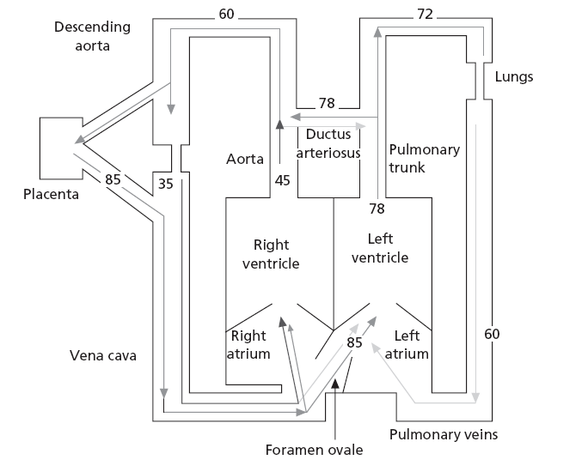
Fetal circulation in TGA
PASPO2 greater than normal
PVR less than normal
Increased PBF
Increased LA LV pressure
Restricted FO +/-
Ductus constriction +/-
Increased PA pressure
Increased PV SM development
PPHTN of the newborn +/-
Notes:
The vascular resistance provided by the placenta is lower than the pulmonary capillary bed, which allows for right-to-left blood flow through the ductus arteriosus (DA) and into the descending aorta. However, one potential fetal problem is the normal flow of oxygen rich blood towards the head and neck vessels is disrupted by the inability to pump the oxygenated blood directly into the ascending aorta from the left ventricle
Pulmonary arterial oxygen saturation is considerably greater than normal. The aorta arises from the right ventricle and oxygen saturation in the ascending aorta is less than normal. Descending aortic blood oxygen saturation is similar to that in the normal fetus.
The pulmonary vascular resistance, which is very sensitive to small changes in Po2, will be considerably lower than normal and thus pulmonary blood flow will be higher than normal. In the fetus, oxygen consumption of the lung is very low, so the pulmonary venous blood has a relatively high oxygen saturation and this facilitates maintenance of a very high oxygen saturation of left atrial and left ventricular blood.

Slide 31
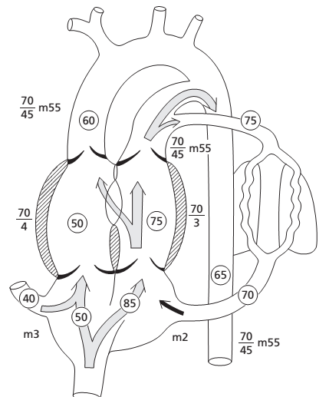
TGA with VSD in Fetus
Shunt depend on afterload
Bidirectional shunting can occur
RV to LV during systole
LV to RV during diastole
Notes:
Depending on the afterload on each ventricle, some shunting could occur in either direction, and it is possible that bidirectional shunting could occur. The high oxygen saturation of pulmonary arterial blood will decrease pulmonary vascular resistance, and during systole blood will probably shunt from the right to the left ventricle. This will result in some decrease in Po2 of blood distributed to the lungs as well as through the ductus arteriosus. During diastole, a large volume will return from the pulmonary veins to the left atrium and ventricle and thus a shunt from the left to the right ventricle is likely to occur.

Slide 32
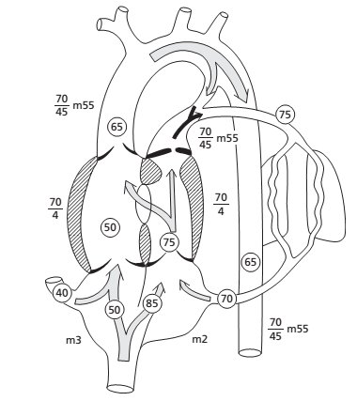
TGA +VSD+PS in fetus
LV to RV mainly
Po2 of ascending and descending aortic and PA blood are similar
Blood supply to the lungs provided by DA
Blood distributed to the lungs will have a lower Po2 than that in transposition with no associated defects and there would be a lesser reduction in PVR
Notes:
If pulmonary stenosis is severe, blood entering the left ventricle will be largely ejected through the ventricular septal defect into the right ventricle. This would result in almost complete admixture of SVC and IVC streams, so that the Po2 of ascending and descending aortic and pulmonary arterial blood would be similar.
Blood supply to the lungs would be provided by flow from the aorta to the pulmonary artery beyond the stenosis through the ductus arteriosus. The blood distributed to the lungs would therefore have a lower Po2 than that in transposition with no associated defects and there would be a lesser reduction in pulmonary vascular resistance. Ascending and descending aortic blood will have a similar Po2 and this will be higher than that in transposition without other lesions.

Slide 33
Postnatal physiology of TGA
Notes:
Once the infant is born, the stability of the child will be largely determined based on the degree of mixing that occurs between the two parallel circulations. For viability, some degree of oxygenated pulmonary venous return must make its way to the systemic capillary bed (effective systemic blood flow), while a similar degree of systemic venous return must enter the pulmonary capillary system (effective pulmonary blood flow). Oxygen saturations and the degree of hypoxemia are largely based on the amount of intercirculatory mixing that occurs through the intracardiac and extracardiac connections. The goal of optimizing intercirculatory mixing is achieved by balancing the effective pulmonary and systemic blood flows. This mixing occurs most efficiently at the level of the atria as lower pressure differences allow for bidirectional flow across the atrial septum; flow can occur in both systole and diastole. Intracardiac (eg, VSDs) and extracardiac (eg, PDAs) mixing at other sites is more limited, due to the presence of larger pressure gradients, which typically direct blood in only one direction. Shunting of blood preferentially towards either the systemic or pulmonary circulation tend to results in clinical deterioration.
It is essential that there be some means for systemic venous blood to enter the pulmonary circulation to be oxygenated and also for pulmonary venous blood to pass into the systemic arterial system to supply oxygen to the tissues. This bidirectional shunting after birth may occur through persistent patency of fetal channels, the foramen ovale and the ductus arteriosus, or through abnormal channels, such as ventricular or atrial septal defects.
A left-to-right shunt represents the volume of blood passing from the left atrium or ventricle, or the aorta, directly into the right side of the heart. In most congenital cardiac lesions, it reflects the volume of pulmonary venous or oxygenated blood that recirculates through the lungs. However, in aortopulmonary transposition the pulmonary venous blood shunted from the left to the right side of the heart enters the systemic circulation and does not recirculate to the lungs. The pulmonary venous blood returning to the left atrium and ventricle that is not shunted is ejected into the pulmonary artery and does recirculate.
To avoid confusion, it is convenient to introduce the concept of anatomical and physiological shunting

Slide 34
Transitional Circulation
PVR fall and SVR increases
Increased RAP compared to normal baby
Bidirectional flow at foramen ovale
In TGA with IVS, the DA is widely patent after birth
Early after birth, ductal flow is bidirectional
With fall in PVR, shunt at the PDA is from aorta to PA with an equal amount of blood passing from the pulmonary to systemic circuit at the atrial level
Rarely, there is a delayed fall in PVR that results PPHTN
Notes:
After birth, the pulmonary vascular resistance falls with expansion of the lungs and pulmonary blood flow and left atrial pressures increase in accordance with the more or less normal neonatal transitional physiology. The systemic vascular resistance increases because of removal of the low-resistance placental circulation. In the normal neonate, the right atrial pressure falls as the right side of the heart faces the rapidly decreasing pulmonary vascular resistance and the interatrial pressure difference favors closure of the septum primum flap over the foramen ovale. With TGA, however, the right atrial pressures are increased, and the similarity of atrial pressures tends to keep the foramen ovale open (incompetent valve), with resulting bidirectional shunting
In TGA with IVS, the ductus arteriosus is often widely patent after birth. Early after birth, when pulmonary vascular resistance is still high, there is bidirectional ductal flow: in systole, left ventricle, pulmonary artery, ductus, descending aorta; and in diastole, aorta, ductus and pulmonary artery. With continued fall in pulmonary vascular resistance, the shunt at the PDA is primarily from aorta to pulmonary artery (effective pulmonary blood flow), with an equal amount of blood passing from the pulmonary circuit to systemic circuit at the atrial level (effective systemic blood flow).
Rarely, there is a delayed fall in pulmonary vascular resistance that results in persistent pulmonary hypertension, little ductal shunting, and limited intercirculatory mixing. Urgent balloon septostomy or even surgical septectomy will not improve the severe hypoxemia, and these neonates may need urgent support with early repair or extracorporeal membrane oxygenation. Finally, severe hypoxemia in some neonates may be due to an intact or virtually intact atrial septum.
Despite a widely patent ductus arteriosus (PDA), there is poor intercirculatory mixing at this site alone; the primarily aorta-pulmonary artery shunting cannot be balanced by an equal volume of shunting from left atrium to right atrium. These neonates are typically severely hypoxemic and acidotic shortly after birth, may have severe pulmonary edema and hemorrhage, and may not survive if septostomy or arterial repair cannot be accomplished in a timely fashion.

Slide 35
Definition of shunts
Anatomical shunts
  Left to Right: Blood flowing from left sided chambers to the right sided chambers
  Right to Left: Blood flowing from right sided chambers to the left sided chambers

Slide 36
Definition of shunts (Contd..)
Physiological shunts
  Left to right: The volume of oxygenated pulmonary venous return re-circulated to pulmonary circulation (Qp – Qep)
  Right to left shunt: volume of systemic venous blood that re-enters the systemic arteries without passing through the lung (Qs – Qep)

Slide 37
Definition of shunts (Contd..)
Effective pulmonary blood flow (Qep)
  The volume of systemic venous return that is effectively oxygenated in the lungs
Effective systemic blood flow (Qes)
  The volume of oxygenated pulmonary venous return that enters the systemic circulation and perfuses the systemic capillary bed

Slide 38
Intercirculatory mixing
Systemic venous return
Pulmonary venous return
Anat R-L
Anat L-R
RIGHT
HEART
LEFT
HEART
Physio R-L
Physio L-R
Q es
Q ep
Body
Lungs
QS
QP
Notes:
The net volume of blood passing from the pulmonary circulation (left atrium, left ventricle, pulmonary arteries) to the systemic circulation (right atrium, right ventricle, aorta) represents the anatomic left-to-right shunt and is, in fact, the effective systemic blood flow (i.e., oxygenated pulmonary venous return perfusing the systemic capillary bed). Conversely, the net volume of blood passing from the systemic circulation to the pulmonary circulation represents the anatomic right-to-left shunt and is, in fact, the effective pulmonary blood flow (systemic venous return perfusing the pulmonary capillary bed). The effective pulmonary blood flow, effective systemic blood flow, and net anatomic right-to-left and net anatomic left-to-right shunts are each equal to each other, and this volume is the intercirculatory mixing.

Slide 39
Intercirculatory mixing depends on
Anatomic communication
Number
Size
Position
TBF through the pulmonary circuit
The effective PBF, effective systemic blood flow, and net anatomic right-to-left and net anatomic left-to-right shunts are each equal to each other, and this volume is the intercirculatory mixing
Notes:
The extent of intercirculatory mixing in TGA depends on the number, size, and position of the anatomic communications and on the total blood flow through the pulmonary circuit. In the neonate with an intact ventricular septum and a closed or closing ductus arteriosus, severe hypoxemia secondary to inadequate mixing at the foramen ovale level is usually present. When the interatrial or interventricular shunting sites are of adequate size, the level of arterial oxygen saturation is influenced primarily by the pulmonary-to-systemic blood flow ratio, with a high pulmonary blood flow resulting in relatively high arterial oxygen saturation. If the pulmonary blood flow is decreased by subpulmonary or pulmonary stenosis or elevated pulmonary vascular resistance, the arterial oxygen saturation will be lowered, despite adequately sized anatomic shunting sites.

Slide 40
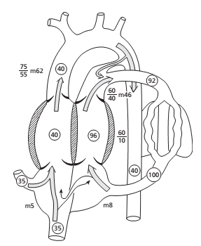
TGA with inadequate pulmonary–systemic communication
Decreased PVR
Reduce afterload on LV
Increased SV to PA
If DA remains open, flow occur from aorta to PA and quantity of flow depend on size of ductus and PA and aortic pressure
If the ductus is widely patent and PA and aortic pressures are the same, the flow will be determined by relative resistance in the pulmonary and systemic circulations
Notes:
In the presence of aortopulmonary transposition, the right ventricle, which ejects into the aorta, is confronted
a greater afterload and initially its stroke volume will fall. End-diastolic volume and pressure will be elevated to raise stroke volume and the right atrial a wave will increase. The decrease in pulmonary vascular resistance associated with ventilation will reduce the afterload on the left ventricle, allowing a greater stroke volume into the pulmonary artery. If the ductus arteriosus remains open, the fetal flow pattern will be reversed and blood will flow from the aorta to the pulmonary artery, the quantity of flow being determined by the size of the ductus and the pulmonary arterial and aortic pressures.
If the ductus is widely patent and pulmonary arterial and aortic pressures are the same, the flow will be determined by relative resistance in the pulmonary and systemic circulations. In the early postnatal period, while pulmonary vascular resistance is still relatively high, pulmonary blood flow as well as the ductus shunt are not very large, but with further maturation of the pulmonary vasculature, an increasing pulmonary blood flow will develop.

Slide 41
TGA with small VSD
Similar to DA
Early postnatal period (PVR high) - only a small shunt from RV to LV
When PVR fall - Increased RV to LV shunt, increased LA and LVDP
LA to RA flow is necessary for bidirectional shunting
If inter atrial flow is limited, LA and PV pressure rises and lead to pulmonary edema
Decrease in VSD size over time fall in arterial SPO2
VSD of moderate size may permit somewhat greater bidirectional mixing, with less hypoxemia
Notes:
In the early postnatal period, while PVR is still elevated, only a small shunt will occur from the right to the left ventricle.
As pulmonary vascular resistance falls, right-to-left ventricular shunting will increase, raising pulmonary blood flow and left atrial as well as left ventricular diastolic pressure. Left-to-right atrial flow of blood is necessary to establish bidirectional shunting. Although some left-to-right ventricular shunt will develop as left ventricular diastolic pressure increases, it is limited because at the low pressures in diastole, only a small shunt will occur through the small defect. As described above for the ductus arteriosus, if the foramen ovale does not permit adequate flow from the left to the right atrium, left atrial and pulmonary venous pressures will increase and pulmonary edema may develop. The tendency is for the size of the ventricular septal defect to decrease over time, and this will result in a fall in arterial oxygen saturation.
A ventricular septal defect of moderate size may permit somewhat greater bidirectional mixing, with less hypoxemia. A spectrum thus exists between the infants with very small or insignificant ventricular septal defects and those with very large ventricular defects.

Slide 42
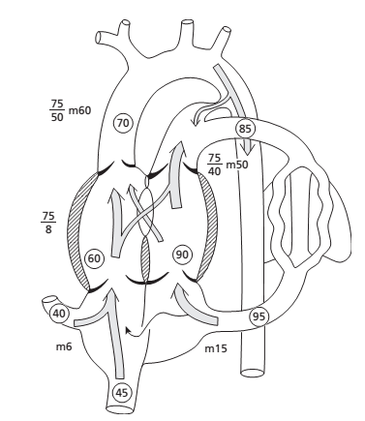
TGA with Large VSD
Only minimal systemic arterial hypoxemia
CCF develop within 2 to 6 week
Development of CCF depend on relationship of PVR and SVR
Progressive increase in pulmonary vascular resistance
PVOD develop much earlier than isolated VSD
Notes:
When a large VSD is present, shunting between the pulmonary and systemic circulation may be so effective that only minimal systemic arterial hypoxemia occurs, but severe cardiac failure is often encountered. The development of cardiac failure is primarily dependent on the relationship of pulmonary and systemic vascular resistances.
The presence of a large ventricular septal defect will maintain left ventricular and pulmonary arterial systolic pressures at systemic levels. This will delay the postnatal fall in pulmonary vascular resistance and the child will be subject to the risk of developing a subsequent increase in pulmonary vascular resistance with permanent pulmonary vascular obstructive changes. The increase in pulmonary vascular resistance causes a decrease in pulmonary blood flow and relief from cardiac failure but also a decrease in arterial oxygen saturation.
Progressive increase in pulmonary vascular resistance usually develops at a much younger age than in individuals with ventricular septal defect alone. Not infrequently, pulmonary vascular changes are already present by 3– 4 months of age and significant changes are almost always present by 1 year of age. The reason for the earlier onset of pulmonary vascular obstruction in infants with transposition and a large ventricular septal defect is not known. One possible explanation is that the main pulmonary artery is short and the kinetic forces of left ventricular ejection may be more readily transmitted to the peripheral vessels, creating greater shear forces.

Slide 43
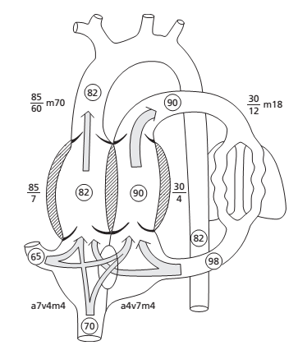
TGA with Large ASD
Not a common association
Good bidirectional shunting
Increased PBF
But LV eject large volume at low pressure
So cardiac failure unlikely
PVOD develop much earlier than normal ASD patients
Notes:
A large atrial septal defect is not a common association with aortopulmonary transposition but it is the most desirable lesion with regard to prognosis. Bidirectional shunting allows good systemic–pulmonary mixing so that cyanosis is usually mild. The left ventricle handles a large volume of blood, but at a relatively low pressure, so cardiac failure is not a major concern.
Pulmonary blood flow will be increased, but because the left ventricle ejects a large volume at low pressure, cardiac failure
is not likely to occur. With the fall in pulmonary vascular resistance, the left ventricle is faced with a lower afterload and stroke volume will increase. This will result in greater emptying with a smaller residual volume. During atrial systole and in the rapid-filling phase of ventricular diastole, blood will flow preferentially from the right to the left atrium, and the volume entering the left ventricle will be greater than that entering the right ventricle.
In individuals with atrial septal defect with normal aortopulmonary relationship, pulmonary vascular obstructive changes are unusual; if they do develop, it is rare before the age of 15–20 years. Individuals with aortopulmonary transposition with an atrial communication appear to be more likely to develop pulmonary vascular obstruction and at a much
earlier age. The reason for the different behavior of the pulmonary circulation is not known. My impression is that early pulmonary vascular changes are more frequent in patients in whom systemic arterial oxygen saturation has been below about 70% during the first 6–12 months after birth. The reduced systemic arterial oxygen saturation cannot have a direct effect because the pulmonary vessels are exposed to normal alveolar oxygen and high oxygen saturation levels in pulmonary arterial and pulmonary venous blood.
One mechanism that should be considered is an increased hematocrit, with increased blood viscosity. The lower the systemic arterial oxygen saturation, the higher the hematocrit. The high hematocrit will increase the shear on the small pulmonary vessels and this, associated with the increased shear related to the high pulmonary blood flow, may result in early intimal proliferation and luminal obstruction. Another possibility that should be considered is that the increased bronchial arterial collateral circulation directs blood with a low arterial oxygen saturation through the pulmonary vessels and may contribute to the development of pulmonary vascular obstruction.

Slide 44
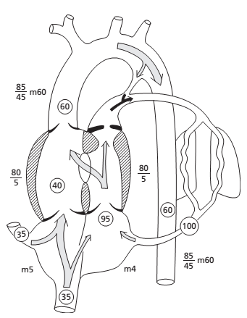
TGA with Severe PS
Usually a/w a large VSD
Adequate PBF is necessary to maintain a good systemic saturation
PBF has to be provided by a communication from the aorta to the PA beyond the stenosis
Cardiac failure rare
If pulmonary flow and bronchial flow are adequate to prevent severe hypoxemia, these patients may tolerate the lesion well and may survive for many years without treatment
Notes:
Cardiac enlargement is not usually present and cardiac failure does not usually occur. If pulmonary flow and bronchial flow are adequate to prevent severe hypoxemia, these patients may tolerate the lesion well and may survive for many years without treatment

Slide 45
Unique feature of shunt in TGA
Net inter-circulatory mixing volume is constant: net R-L, L-R, Qep and Qes are equal to each other
Any major difference in the volumes would result in depletion of blood volume of one circulation at the expense of overloading the other circulation

Slide 46
Flow across the communications
“Rules of the Heart”
If VSD alone, the flow has to be bidirectional
If the flow is only or predominantly left to right across the ASD, it suggests presence of additional shunt (VSD or PDA)
Unrestrictive VSD - flow is bidirectional
Except in the initial few days, PDA flow is always left to right (Aorta to PA)

Slide 47
Factors influencing systemic saturation
Extent of inter-circulatory mixing and Total PBF
High PBF results in increased oxygenated blood available in the left sided chambers for mixing: higher systemic SO2 if there is good mixing
Reduced PBF will result in low systemic SO2 in spite of adequate anatomic shunts
Anatomic communication
Number
Size
Position
TBF through the pulmonary circuit

Slide 48
Factors influencing systemic saturation
If there is delay in the fall of PVR (PPHN), hypoxemia will persist despite adequate ASD and
Need ECMO or urgent ASO
Hypoxemia provokes a fall in SVR and increase the recirculating systemic volume
Fall in SVR may deplete the pulmonary circulation further

Slide 49
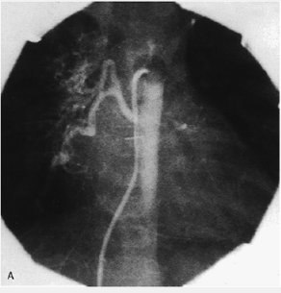
Role of broncho-pulmonary collaterals
Bronchopulmonary anastomotic channels have been visualized by angiography in >30% of infants with TGA (<2year)
Systemic arterial hypoxemia may stimulate development of bronchpulmonary collaterals
Usually in TGA with solely a restrictive inter-atrial communication
Prolonged survival of such infants may be due to this extra-cardiac site of shunting/mixing
Preoperative transvenous descending aortogram in a neonate with TGA/IVS showing enlarged bronchial arteries (following the right main stem bronchus) to the right lung
Notes:
Preoperative transvenous descending aortogram in a neonate with TGA/IVS showing enlarged bronchial arteries (following the right main stem bronchus) to the right lung

Slide 50
Clinical presentation

Slide 51
Clinical presentation
Influenced by the presence of the associated cardiac anomalies
Large VSD without LVOTO presents with cardiac failure
Morphologically tricuspid valvular incompetence due to dysplasia of the valvular leaflets presents with heart failure
Severe PS or LVOTO presents with cyanosis and ductal-dependent pulmonary circulation

Slide 52
TGA-physiologic clinical classification
1. TGA (IVS OR small VSD) with increased PBF and small ICS
2. TGA (VSD large) with increased PBF and large ICS
3. TGA(VSD and LVOTO), with restricted PBF
4. TGA(VSD and PVOD),with restricted PBF

Slide 53
History
Males outnumber females (4:1)
2 times increased risk in multipara pregnancies
Usually normal birth weight
Familial recurrence-monogenic or oligogenic inheritance in selected families
Digilio MC et al: Complete TGA-Patterns of congenital heart disease in familial precurrence.Circulation104:2809,2001
Notes:
Seldom in 1st born infants

Slide 54
History (Contd..)
Cyanosis
As early as day 1 in pts with IVS (1st hr-56%;1st day-90%)
More intense if a/w PS/Pulmonary atresia
Mild and delayed if a/w large non restrictive VSD or large PDA
PS rarely cause hypercyanotic spells-intense cyanosis, tachypnea, extreme irritability and hypothermia
Squatting is rare
Cyanosis is not affected by exertion (eg, crying or feeding) or the use of supplemental oxygen
Reverse differential cyanosis
(Higher postductal saturations than preductal saturations)
PVOD

Slide 55
History (Contd..)
CCF
In patients with a large PDA/large VSD
Spontaneous closure result alleviate CCF symptoms but sudden fall in systemic arterial oxygen saturation
Dynamic LVOTO or PVOD alleviate CCF but hypoxemia worsens
Large VSD – CHF develops within 1-3 wks
Notes:
Large VSD – CHF develops within 1-3 wks; UPTO THAT USUALLY ASYMPTOMATIC OR MILD CYANOSIS

Slide 56
Survival and natural course
Survival tightly coupled to inter play between inter circulatory communications and PBF
Non-restrictive VSD with PVOD-6 months survival 30% and 1 year survival 20%
Moderate PS increase longevity of large VSD with TGA- 75% Survival for 1 year
If patients do not receive treatment, most will die within the 1st year of life. About 30 % of untreated patients die in the 1st week, 50 % in the 1st month, and 90 % within the 1st year of life
Notes:
NEONATE SURVIVAL DEPENT ON INTER CIRCULATORY MIXING
OLDER INFANTS SURVIVAL DEPENDS ON PBF
SPORADIC EG OF UNUSUAL LONGEVITY HAS BEEN EXPLAINED
SURVIVAL POOR IF FO IS RESTRICTIVE VS INTACT OR DA IS CLOSED

Slide 57
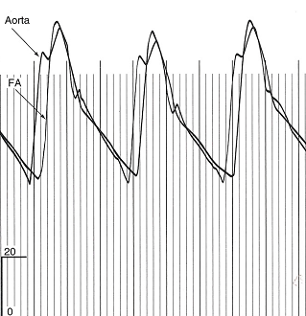
Arterial Pulse
Bounding pulse
  Due to large volume of highly unsaturated blood recirculating in hyperkinetic low resistance systemic vascular blood
Diminished femoral pulses
  CoA
  Subaortic stenosis-anterior and rightward displacement of septum
Complete TGA with VSD with severe PS
WIDE PULSE PRESSURE
BRISK RISE OF AORTIC PULSE
BISFARIENCE
Notes:
WIDE PULSE PRESSURE
BRISK RISE OF AORTIC PULSE
BISFARIENCE

Slide 58
Palpation
RV impulse is transiently normal or nearly normal in neonates
Prominent RV impulse if CCF with nonrestrictive VSD
(RV overloaded with large volume of unoxygenated blood that re-circulate in hypervolemic hyperdynamic systemic vascular blood)
Palpable S2 at left base→ A2 (anterior aorta)
Dilated hypertensive posterior pulmonary trunk doesnot transmit its impulse

Slide 59

Auscultation
Single loud S2 (Loud A2) : A2 precedes P2 because low PVR and increased capacitance of pulmonary vasculature
When PVR equal SVR A2 and P2 coincide -- single loud s2
LV S3-mildly cyanosed patients, increased PBF,LV failure
RV S3-deeply cyanosed patients, increased systemic flow, RV failure
Ejection click-Pulmonary (dilated hypertensive posterior pulmonary trunk); does not decrease with inspiration because PA arise from LV
Ejection click-Aortic-Subaortic stenosis → dilated aortic root (due to malalignment of infundibular septum)

Slide 60
Auscultation (Contd..)
No murmur: if inadequate systemic–pulmonary communication
Aortic MSM (Flow): If hypervolemic and hyperkinetic systemic circulation
Pulmonary valvular MSM (Flow): Due to dilated pulmonary trunk (Usually not audible)
Pulmonary subvalvular MSM (dynamic obstruction)-appears after a few weeks of life, 3rd LICS and radiates to the right
Notes:
Pulmonary valvular MSM (Flow): Due to dilated pulmonary trunk (Usually not audible)- SOFT AND ANTERIOR AORTA
Pulmonary subvalvular MSM (dynamic obstruction) DEVELOP AFTER 1ST FEW WEEKS OF LIFE AND PROGRESSIVELY INCREASES

Slide 61
Auscultation (Contd..)
VSD: Holosystolic (audible when PVR fall) →shortens →abolished (when PVOD develop)
Restrictive VSD: Holosystolic or early systolic (disappear when defect close spontaneously)
PDA:
  Systolic if large PDA since high PVR curtails diastolic flow
  Continuous if restrictive PDA (But damped by anterior aorta)
MDM may be heard across AV valves
Notes:
MDM may be heard across MV vale- IF INCREASED PBF
ACROSS TV IF SEVERLY CYANOTIC PATIENTS BECAUSE SYSTEMIC CIRCULATION IS HYPERKINETIC OR HYPER DYNAMIC

Slide 62
ECG
The ECG in the first days of life is typically normal for age
Within weeks RVH develops, if TGA with IVS or small VSD
RAE-increased pressure(CHF) or volume (hypervolemic systemic circulation)
RAD predominates when the septum is intact
LAD when TGA with AV canal types of VSD, with or without straddling TV or RV hypoplasia.

Slide 63
ECG (Contd..)
RVH - NR VSD + high PVR/ LVOTO
BVH (In 70% large VSD) - NR VSD + low PVR
Right precordial T waves not inverted but rather distinctly taller than the left sided T waves
Dysrhythmias are rare
Atrial flutter may be seen during and after balloon atrial septostomy

Slide 64
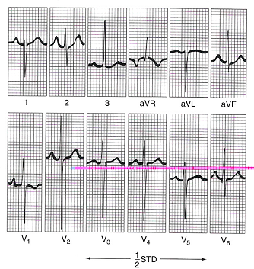
ECG (Contd..)
RAD, RAE, BVH
Notes:
RAD, RAE, BVH, LVH

Slide 65
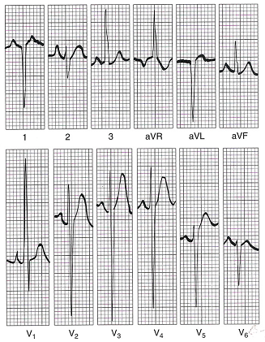
ECG (Contd..)
TGA VSD SEVERE PS
RAE, RVH, RAD
Notes:
TGA VSD SEVERE PS
RAE RVH RAD

Slide 66
CXR
Oval or egg-shaped cardiac silhouette with narrow superior mediastinum
Mild cardiomegaly
Normal or increased pulmonary vascular markings
Right aortic arch -11-16%
Juxtaposition-localized bulge along the mid left cardiac border which represents contiguous mass of the 2 appendages together
TGA/IVS, the diagnostic triad

Slide 67
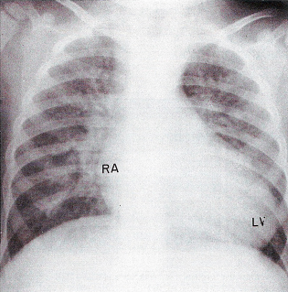
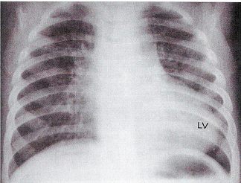
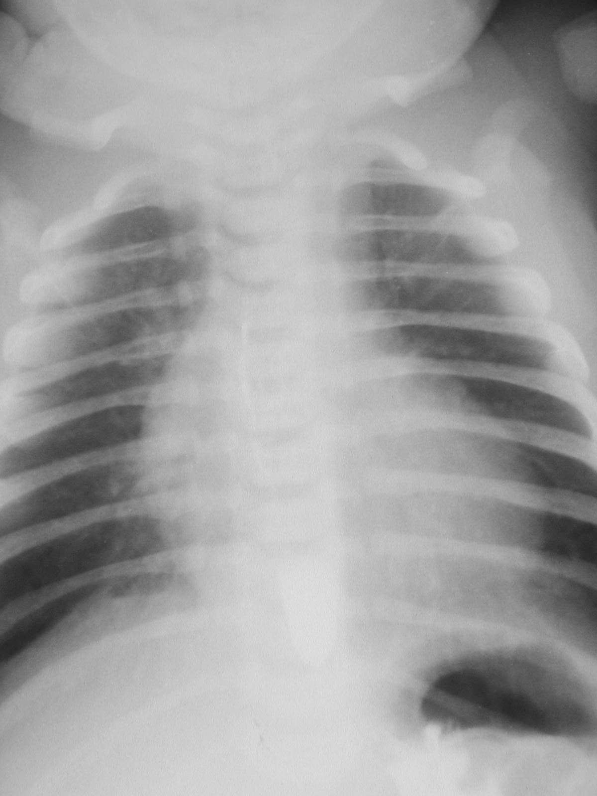
CXR (Contd..)
Notes:
NONRESTRICTIVE VSD INCREASED PBF NARROW PEDICLE EGG RA AND LV ENLARGED

Slide 68
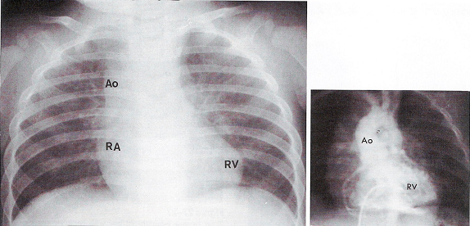
CXR (Contd..)
d-TGA Nonrestrictive VSD, Severe fixed subpulmonary stenosis
Decreased PBF, dilated aorta and widened vascular pedicle
Notes:
D tga NONRESTRICTED VSD, SEVERE FIXED SUBPULMONARY STENOSIS DECREASED PBF, DIALTED AAORTA AND WIDENED VASCULAR PEDICLE

Slide 69
ECHO
Diagnosis
Detection of shunt
Detection of outflow obstructions
Associated anomalies
Coronary Anatomy
Notes:
The diagnosis of D-TGA is generally made by two-dimensional echocardiography and Doppler examination. Subcostal imaging of the heart demonstrates a great artery that branches into the left and right pulmonary arteries arising from the posterior left ventricle, and short-axis or parasagittal plane imaging shows the aorta rising anteriorly from the right ventricle.
The echocardiographic testing should systematically delineate atrioventricular or ventriculoarterial connections, the presence or absence of other commonly associated cardiac anomalies, such as a ventricular septal defect (VSD), and the coronary artery anatomy.
The presence and size of the atrial level communication is critical to determine the amount of intercirculatory mixing. Measurement of restriction to flow by using color Doppler should be performed.
The ventricular septum should be evaluated for any VSD. The presence of a VSD, particularly an anterior malalignment type, increases the probability that the patient will have aortic arch anomalies. Patients with complex transposition, including a VSD and coarctation, are at higher risk for surgical morbidity and mortality.
Detection of any abnormalities of the atrioventricular valves and the relationships of the chordal attachments to the ventricular septum and outflow tracts must be well understood prior to surgery.
Evaluation for a patent ductus arteriosus and, if present, determination of the degree of shunting should be performed.
Coronary artery anatomy is typically delineated with echocardiography and it is rarely necessary to perform other forms of diagnostics such as angiography or cardiac magnetic resonance imaging (MRI) to help clarify the coronary artery anatomy. Coronary artery variations must be well delineated prior to surgical intervention.
Imaging can be used to guide catheter placement and movements during balloon atrial septostomy and to assess the anatomic adequacy of the septostomy.

Slide 70
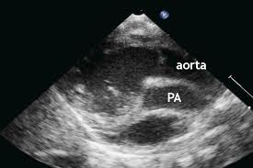
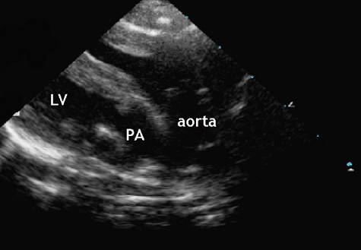
ECHO(Contd..)
PLAX view showing the 2 great vessels parallel to each other. In a normal heart, the 2 great vessels should not appear together in any plane as they cross each other in their proximal course. The aorta here is anterior.
Notes:
The aorta here is anterior, not posterior as it normally should be.

Slide 71
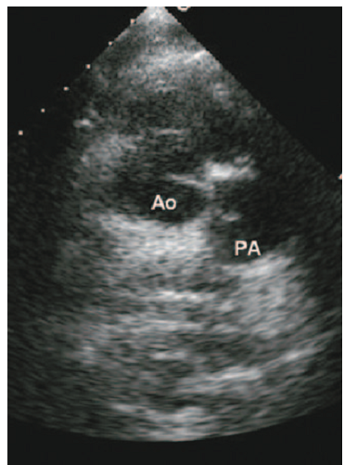
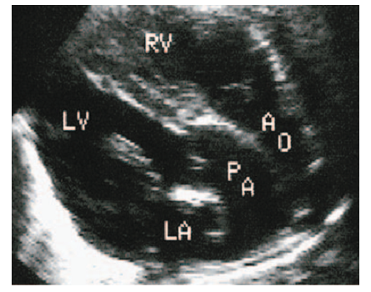
ECHO(Contd..)
Parasternal short-axis view displays the aortic and pulmonary root with the
respective semilunar valves, (double circle appearance) due to the
parallel position of the great arteries

Slide 72
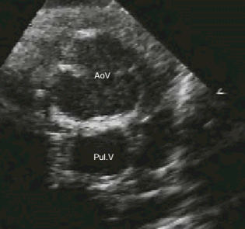
ECHO(Contd..)
Cross sectional image obtained from a high parasternal window, demonstrating the antero-posterior relationship of the aortic (aoV) and
pulmonary (Pul.V) valves

Slide 73
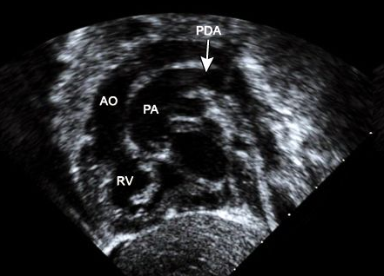
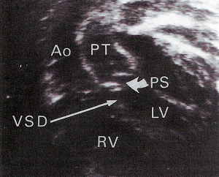
ECHO(Contd..)
Subcostal short axis view
Subcostal view showing complete TGA, moderately restrictive VSD and PS
Notes:
Subcostal short axis view demonstrates the anteriorly positioned right ventricle (RV) giving rise to the aorta (Ao). The pulmonary artery (PA) is posteriorly related to the aorta and arises from the left ventricle. The aorta is identified as the vessel that gives rise to the head and neck vessels as well as the coronary arteries, while the pulmonary artery branches into the right and left pulmonary arteries. Mixing of blood between the two parallel circuits occurs through the patent ductus arteriosus (PDA).

Slide 74
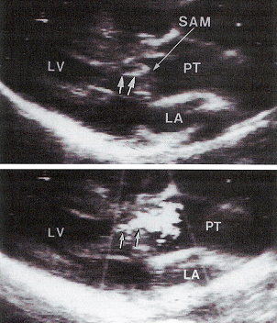
ECHO(For detection of outflow obstructions)
PLAX showing dynamic subpulmonary stenosis due to SAM of AML
Accelerated flow across narrow LVOT
Notes:
Detailed echocardiographic assessment of the origin and course of the coronary arteries should routinely be performed prior to surgical intervention. This requires subcostal views of the outflow tract, as well as parasternal short-axis views of the arterial trunks

Slide 75
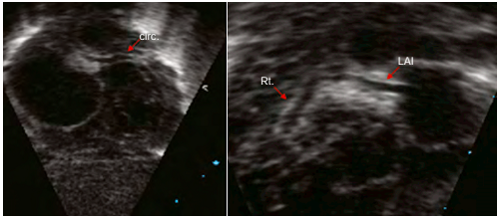
ECHO(For coronary anomalies)
Differentiation from Taussig-Bing anomaly
Differentiation between TGA with a large VSD and DORV of the Taussig–Bing variety associated with a subpulmonary VSD may be difficult
In Taussig–Bing anomaly vessals overrides the ventricle
In Taussig–Bing anomaly usually there is a separation between the mitral and pulmonary valves. If there is a substantial separation, the diagnosis is not in doubt
The aortic arch should be carefully imaged to detect either isthmus narrowing or coarctation. The presence of aortic obstruction strongly suggests the presence of Taussig–Bing anomaly
Subcostal window demonstrating the coronary arteries. Anterior angulation demonstrates the course of the circumflex artery (circ). Further angulation demonstrates the right (rt.) and left anterior interventricular arteries (lai) originating from a common origin
Notes:
Detailed echocardiographic assessment of the origin and course of the coronary arteries should routinely be performed prior to surgical intervention. This requires subcostal views of the outflow tract, as well as parasternal short-axis views of the arterial trunks

Slide 76
Cardiac catheterization
Most important role is performance of balloon atrial septostomy (BAS)
Angiography is seldom required to make the diagnosis of D-TGA
Diagnostic evaluation of complex forms of TGA
CAG - gold standard for elucidating coronary arteries’ courses and origins prior to surgical intervention
Notes:
Cardiac catheterisation is no longer routinely performed; all necessary anatomical information should be obtained from cross sectional echocardiography. there is still an occasional role for cardiac catheterisation in the assessment of the pulmonary vascular resistance of patients in whom there is a clinical suspicion of pulmonary vascular disease. The course and distribution of the coronary arteries can be demonstrated by angiography, particularly when using the laid-back view, although the important features will usually have been visualised with echocardiography.
In addition to the use of catheterization for diagnostic purposes, balloon atrial septostomy was the most important therapeutic procedure; however, in recent years this procedure can be performed using two-dimensional echocardiography for guidance. Cardiac catheterization is indicated in the rare infant in whom the foramen ovale is almost closed and creation of an atrial communication is urgent.

Slide 77
Cardiac catheterization (Contd..)
PASP, PBF and PVR
Coronary artery anatomy
Morphologic details of pulmonary or subpulmonary obstruction
VSD number, site, and size
Great vessel alignments in relation to the VSD and outlet septum
Type and severity of aortic arch abnormalities

Slide 78
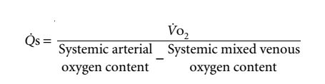


Cardiac catheterization (Contd..)
Fallacies in application of Fick’s Principle in calculating shunts and flows in TGA
SPO2 of systemic arterial and venous blood are often very low
At low levels of saturation oximetry is not very accurate
Error in calculation of systemic blood flow
True mixed venous sample cannot be obtained
SVC or IVC oxygen content has to be used in the calculation
PA SPO2 content is usually very high
Arterio-venous oxygen difference is low
Small variations in measurement of oxygen saturation will result in major errors in calculation of flow
Bronchial arterial collateral circulation overestimate pulmonary blood flow
Notes:
Some individuals with aortopulmonary transposition, particularly those who have marked cyanosis, have a large bronchial arterial collateral circulation, which provides systemic arterial blood to precapillary pulmonary vessels. With transposition, the oxygen saturation of bronchial arterial blood may be markedly reduced. If it makes a major contribution to total pulmonary capillary flow, use of pulmonary arterial oxygen content in the calculation could greatly underestimate pulmonary blood flow.
Although calculation of systemic and pulmonary blood flows is subject to considerable error, estimation of effective pulmonary blood flow is not likely to be quite as inaccurate. There is usually a large difference in oxygen content of pulmonary venous and systemic venous blood, so that small errors in measurement do not produce great alterations in the estimated effective pulmonary
blood flow.

Slide 79
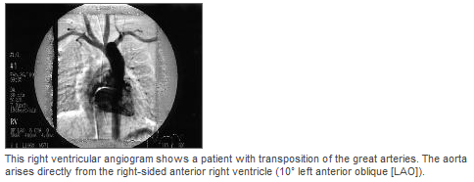



Angiocardiography

Slide 80
Management

Slide 81
Initial management
Prostaglandin (Alprostadil) infusion
O2 Supplementation
Balloon atrial septostomy
Management
Atrial level : Senning or Mustard Sx
Definitive Repair
At three levels
Ventricular level : Rastelli operation
Great artery level : arterial switch operation or Jatene procedure

Slide 82
Prostaglandin infusion
Continuous I.V. PG E1 infusion (0.05 microg/kg per min)
To maintain patency of the ductus arteriosus
Major side effect of prostaglandin is apnea and hypotension
PG E1 should be continued throughout the cardiac catheterization and until the time of surgery
Considerable benefit in first few days till PVR is elevated, especially if PFO is small
Enables bidirectional shunting, improves mixing
Notes:
Intubation should be considered prior to transport to a pediatric cardiac center
Vasodilation may cause hypotension, which is corrected with volume expansion using intravenous NS
Oxygen should be administered for severe hypoxia. Oxygen may help lower pulmonary vascular resistance and increase PBF, resulting in increased systemic arterial oxygen saturation.

Slide 83

Balloon Atrial Septostomy
(Rashkind procedure)
Introduced in 1966
Can be performed at the bedside
A Balloon is placed across the atrial septum into the LA either through cannulation of the umbilical vein or femoral vein. The balloon is inflated with diluted radiopaque dye and then pulled vigorously back across the septum. The procedure is repeated at least once, and then echocardiographic and hemodynamic assessment of the defect is performed to ensure intracardiac mixing is adequate for sufficient systemic oxygenation
If successful, SPO2 rises immediately
If there is adequate mixing at the atrial level, PGE1 can be discontinued as long as there is no concern regarding aortic arch obstruction
Notes:
The most important role for cardiac catheterization in D-TGA is to perform a balloon atrial septostomy (BAS).
Introduced in 1966, this procedure dramatically increased the survival of infants with D-TGA .
BAS now is performed to stabilize patients with severe hypoxemia as a consequence of inadequate mixing between the two parallel circuits. It can be performed at the bedside with echocardiographic guidance, or in the catheterization lab with the use of fluoroscopy and echocardiography.
A balloon is placed across the atrial septum into the left atrium either through cannulation of the umbilical vein or percutaneous access of the femoral vein. The balloon is inflated and then pulled vigorously back across the septum.
The procedure is repeated at least once, and then echocardiographic and hemodynamic assessment of the defect is performed to ensure intracardiac mixing is adequate for sufficient systemic oxygenation.
If a BAS is performed and successful, systemic oxygen saturations should begin to increase immediately. If there is adequate mixing at the atrial level, prostaglandin ( alprostadil ) infusion can often be discontinued as long as there is no concern regarding aortic arch obstruction.

Slide 84
Definitive Repair
At three levels:
Atrial level : Senning or Mustard surgery
Ventricular level : Rastelli operation
Great artery level : arterial switch operation or Jatene operation
Mortality of D-TGA has dramatically improved from 90 % for unoperated patients to rates of less than 5% following corrective surgery using the
arterial switch operation (ASO)
Notes:
Brain injury has been raised as a potential complication of BAS. This is based on the theory that patients with D-TGA are at increased risk for cerebral emboli during catheterization as the systemic venous return is in direct communication with the aorta and cerebral arterial circulation. However, the data are inadequate to support an association with BAS and an increased risk of brain injury.
In one study of 29 infants with D-TGA, 12 had evidence of brain injury on preoperative MRI that included focal ischemic changes suggestive of arterial emboli. All 12 patients had a BAS, and none of the 10 patients who did not undergo BAS had evidence of preoperative brain injury. However, this study did not control for the degree of hypoxemia, an indication for BAS, and a potential confounding variable for brain injury.
Subsequent studies of neonates with D-TGA have reported a lower incidence of focal ischemia and found no association between BAS and brain injury.
In a study of 64 neonates with CHD including 44 with TGA, brain injury, predominantly white matter injury, occurred in 19 patients (30 percent). There was no association between BAS and brain injury in infants with D-TGA. The rates and patterns of brain injury were similar in infants with D-TGA compared to those with other complex CHD (eg, hypoplastic left heart syndrome and pulmonary atresia).
In a study of 26 infants with D-TGA including 14 who underwent BAS, 10 patients had periventricular leukomalacia (PVL) due to hypoxia and no patients had evidence of a thromboembolic cerebrovascular accident. Patients with PVL were more likely to have lower preoperative oxygenation (measured by pulse oximetry and arterial blood gas testing), and a longer time to surgery than those without PVL.
The majority of these studies suggest that multiple factors are associated with brain injury, particularly the degree and duration of hypoxemia. Despite these results, our practice is to administer a bolus dose of heparin (50 units/kg) prior to performing BAS to minimize thrombus formation.

Slide 85
General approach
Simple D-TGA -Arterial switch operation (ASO) is the recommended procedure
D-TGA +VSD- preferred procedure is ASO and VSD closure
D-TGA, large VSD, and significant pulmonary stenosis- Rastelli procedure should be considered. Rarely ASO with or without repair of the LVOTO is done

Slide 86
Atrial switch procedures
Mustard operation
This oldest surgical technique redirects the pulmonary and systemic venous return at the atrial level by using either a pericardial or a prosthetic baffle
Senning operation
This is a modification of the Mustard operation. It uses the atrial septal flap and the RA free wall to redirect the pulmonary and systemic venous return
Convert the parallel circulations of D-TGA into a series circulation
Do not correct the underlying ventriculo-arterial discordance
Intra-atrial baffle is created to divert the deoxygenated systemic venous return through the mitral valve to the left ventricle, and into the pulmonary circulation via the pulmonary artery
Simultaneously, the baffle directs oxygenated pulmonary venous return across the tricuspid valve to the right ventricle and subsequently to the aorta and the systemic circulation

Slide 87
Atrial switch procedures (Contd..)
RV Failure
Baffle-associated complications
  Obstruction to the pulmonary venous return (<5% of all cases)
  Obstruction to the systemic venous return (<5% of all cases)
  Residual intra-atrial baffle shunt (=20% of all cases)
  Pulmonary vascular obstructive disease
Sudden death attributable to arrhythmias
Notes:
Atrial arrhythmias and heart failure are a/w late morbidity and mortality.
Morphologic RV pump for the systemic circulation
Supplanted by the arterial switch operation (ASO)
Right ventricular failure — Atrial switch procedures provide physiological correction; however, they are not anatomically correct and place the right ventricle and tricuspid valve into the systemic circulation. Although all patients undergoing an atrial switch procedure develop right ventricular dysfunction, some progress to late systemic (right) ventricular failure, which can result in death or serious morbidity requiring reoperation and possibly cardiac transplantation .
Arrhythmias — Atrial arrhythmias are common complications of the atrial switch repairs that may lead to significant morbidity and mortality in adulthood. In several long-term follow-up studies, about one-half to two-thirds of patients remain in sinus rhythm . The remaining patients have a variety of arrhythmias including sinus node dysfunction, atrial flutter and fibrillation, and ventricular tachycardia. The loss of sinus rhythm is felt to precipitate further dysfunction in the systemic right ventricle and can lead to worsening heart failure and sudden death .
Arrhythmias may be caused by the presence of numerous atrial suture lines or from long-standing atrial enlargement due to right ventricular dysfunction or tricuspid regurgitation .
Baffle-associated complications — Baffle-associated complications include the following :
Obstruction at the right atrial and superior vena caval junction is a recognized complication of the Mustard procedure. The clinical presentation may include chylothorax, upper extremity edema, or facial plethora.
Pulmonary venous obstruction is a complication more commonly associated with the Senning procedure.
Pulmonary venous congestion may be an early manifestation.
Progressive obstruction may be seen later and may present with symptoms of reactive airway disease.
Baffle leaks are uncommon and generally occur at the superior aspect of the right atrium.

Slide 88
Arterial switch operation (ASO)
Originally performed in 1975 (Jatene Switch)
Standard corrective procedure for patients with D-TGA without significant LVOTO
Involves transection of both great arteries, and then
Translocation of the vessels to the opposite root, thereby
Create ventriculoarterial concordance
Translocating the aorta also involves mobilization and reimplantation of the coronary arteries
Notes:
ASO involves transection of both great arteries, and then translocation of the vessels to the opposite root, thereby creating ventriculoarterial concordance (aorta to left ventricle, and pulmonary artery to right ventricle). Translocating the aorta also involves mobilization and reimplantation of the coronary arteries. In the ASO, “buttons” around the coronaries are created and then reimplanted into the neo-aortic root. As a result, it is important to delineate coronary artery anatomy, which is often aberrant, prior to surgical correction

Slide 89




ASO (Contd..)
Notes:
Surgical technique of the arterial switch operation.
(A) Aortic cannula is positioned distally in the ascending aorta, the ductus arteriosus is divided between suture ligatures, and the branch pulmonary arteries are dissected out to the hilum to provide adequate mobility for anterior translocation. The broken lines represent the levels of transection of the aorta and the main pulmonary artery. Marking sutures are placed in the anticipated sites of coronary transfer.
(B) Transection of the great arteries. The left ventricular outflow tract, neoaortic valve, and coronary arteries are thoroughly inspected.
(C) The coronary arterial buttons are excised from the free edge of the aorta to the base of the sinus of Valsalva.
(D) The coronary buttons are anastomosed to V-shaped excisions made in the neoaorta.
(E) The pulmonary artery is brought anterior to the aorta (Lecompte maneuver). Anastomosis of the proximal neoaorta is shown.
(F) The coronary donor sites are filled with autologous pericardial patches. A single U-shaped patch (F) or two separate patches (G) may be used.
(H) Anastomosis of the proximal neopulmonary artery and the distal pulmonary artery

Slide 90
Pre requisite
An LV that can support the systemic circulation after surgery
LV pressure should be near systemic levels at the time of surgery, or the switch should be performed shortly after birth (i.e., before 2 weeks of age)
If LV pressure is low, it can be raised by PA banding
LV pressure >85% and LV posterior wall thickness >4.5 mm appear to be satisfactory
Notes:
This surgical intervention involves transecting each great artery above the valves, which stay in place. The arteries are then “switched” back to their normal locations resulting in a complete anatomic correction for this lesion. The coronary arteries are also removed from the native aortic root with a “button of tissue” from the native aorta surrounding the orifice and are reimplanted in the “new” aortic root. Once repaired, the relocated great vessels are frequently referred to as the “neo-aorta” and “neo-pulmonary artery.”

Slide 91
Pre-op
Coronary artery pattern amenable to transfer to the neoaorta without distortion or kinking
High risk when the left main or LAD coronary artery passes anteriorly between the aorta and the PA
LV inflow and outflow tracts must be free of significant structural abnormality
RVOT should be free of significant stenosis

Slide 92
Predictors of perioperative mortality
Complex (additional cardiac anomaly) D-TGA compared to those with simple D-TGA
Prematurity <36 weeks gestation
Low birth weight
Intramural or single coronary artery
Aortic arch obstruction
Right ventricular hypoplasia

Slide 93

Complications of ASO
Main and branch pulmonary artery stenosis
Most common indication for reintervention following ASO in 1st year of life
Inadequate growth at the neo-pulmonary anastomotic site
Obstruction is generally located in the supravalvar area of the MPA
Supravalvar stenosis is due to scarring at the anastomotic site or inadequate growth of MPA
RV pressure should always be evaluated by routine TTE in patients who have undergone ASO; if there is concern for elevated pressure and the proximal PA cannot be identified, MRI should be considered to determine whether branch PA stenosis is present

Slide 94
Complications of ASO (Contd..)
Neo-aortic root dilation
Neo-aortic regurgitation (AR)
  late complication > 20% of patients especially PA banding
  An important cause of AR may be unequal size of the pulmonary cusps that leads to eccentric coaptation
Coronary artery obstruction
  Rare with newer surgical techniques
  Myocardial ischemia, infarction, and even death
  May present with unexplained ventricular dysfunction
  Majority occur during 1st 3 months
Notes:
In the early years of the ASO, the coronary artery transfer was the surgical step that created the most difficulty, and led to coronary insufficiency and high hospital mortality. As surgeons began to improve coronary artery transfer techniques, the hospital mortality dropped precipitously to its current low level. The long term success of this procedure, however, depends on the continued patency and growth of the coronary vessels to ensure adequate myocardial blood flow.
Risk factors for the development of coronary events include type of coronary anatomy (presence of a single coronary orifice or two coronary orifices originating close to each other) and the occurrence of a major intraoperative event (coronary translocation difficulty, left ventricular dysfunction, cardiac arrest, or temporary mechanical support at the end of the intervention). In this study, 11 patients underwent coronary revascularization at least one year after the ASO.
Many patients with coronary artery stenosis or obstruction may be asymptomatic. Coronary angiography remains the gold standard for detecting coronary lesions. Studies that performed postoperative angiography report rates of coronary lesions between 3 to 6.8 percent
Neo-aortic root dilation — By reversing the great arteries in the ASO, the native pulmonary valve becomes the neo-aortic valve, and over time, the neo-aortic root increases in size. In one report of 335 patients, neo-aortic root dilation (defined as a Z-score ≥3.0) was observed in 3, 8, 18, and 49 percent of patients at 1, 2, 5, and 10 years after ASO, respectively. Although neo-aortic root dilation continued to develop in late follow-up, the increase was not clinically significant over time. Risk factors for neo-aortic root dilation were previous pulmonary arterial banding and ASO performed in a later era. A change in surgical technique is a likely explanation for the association between surgery in a more recent era with neo-aortic root dilation, possibly related to the increased size of the coronary “buttons” taken for the translocation. In this current era, pulmonary arterial banding is very rare as complete repairs are typically performed in the first week of life, thereby reducing the frequency of pulmonary stenosis and neo-aortic root dilation.
Neo-aortic regurgitation — As mentioned above, in ASO, the native pulmonary valve becomes the neo-aortic valve and the competence of this valve has been a concern as it functions in the setting of systemic pressure. In particular, it is unknown what the effect of developing arterial hypertension in adult survivors will have on long-term function of the neo-aortic valve. Although mild aortic regurgitation (AR) appears to be a frequent finding, it does not usually progress to clinical significance. In one study of 1,156 survivors after ASO who were operated between 1982 and 2000, 15 percent developed AR. AR was mild and did not progress, as the overall rates of reoperation for AR were 2.3 and 3.2 percent at 10 and 15 years after ASO. Risk factors for AR include the presence of a ventricular septal defect and older age at the time of ASO.

Slide 95

Rastelli operation
In patients with large VSD and severe PS
The LV is directed to the aorta by creating an intraventricular tunnel between the VSD and AV
A conduit is placed between the RV and the PA
No attempt to resect the left ventricular outflow tract obstruction
Conduit obstruction (especially in those containing porcine heterograft valves)
Conduit needs to be replaced as the child grows
CHB(rarely occurs)
Other procedures- REV procedure or Nikaidoh procedure
Notes:
The Rastelli procedure requires a sizable and appropriately located VSD so that the baffle can be placed to redirect blood flow into the aorta. In some patients with a restrictive VSD, the defect is enlarged for appropriate baffle placement. VSD enlargement may contribute to late ventricular dysfunction, arrhythmia, and residual VSD.
Long-term, patients who undergo the Rastelli procedure require serial conduit replacements as conduits become stenosed over time as they do not grow with the child. In addition, atrial and ventricular arrhythmias are more frequent, and right and left ventricular failure may occur.

Slide 96
Pulmonary Artery Banding
Transposition associated with large VSD without LVOTO
To prevent
Heart failure
Pulmonary vascular disease
Present Indications
  Presence of complex/multiple VSDs
  Coexisting medical conditions that cause a delay in surgery
  To train LV before switch in TGA/IVS

Slide 97

Follow-up care
History
Episodes of syncope or palpitations
Increasing exercise intolerance
Exertional chest pain
Edema of the face and upper extremities
  Examination
  Irregular pulse
Cardiac auscultation to detect any murmur
Examination for signs of cardiac failure
ECG
Echo- Routine echocardiography is used to assess ventricular function, detect pulmonary artery stenosis, and evaluate competency of the neo-aortic valve
Activity - If no residual defects, normal ventricular function, a normal exercise test, and have no evidence of atrial or ventricular tachyarrhythmias, no restriction for any competitive sports
Notes:
Ongoing follow-up care is required in all patients with D-TGA by a cardiologist with expertise in congenital heart disease. Clinicians need to know the potential complications following the various surgical repairs. Follow-up care includes a focused history, physical examination and detailed imaging study by echocardiography and/or MRI.
The history includes asking about the following:
Episodes of syncope or palpitations that may suggest an underlying arrhythmia
Increasing exercise intolerance suggestive of declining systemic ventricular function or increasing pulmonary artery obstruction
Exertional chest pain may suggest coronary artery insufficiency
Edema of the face and upper extremities suggest superior venal caval obstruction due to a baffle complication seen in the Mustard procedure
The physical examination includes:
Vital signs particularly the pulse to determine any irregularity that suggests an underlying arrhythmia
Cardiac auscultation to detect any murmur (eg, pulmonary stenosis, aortic or tricuspid insufficiency) or gallop (eg, failure)
Examination for signs of cardiac failure including pulmonary congestion (rales), peripheral edema, and hepatomegaly
In addition, the following tests are routinely performed:
Electrocardiography and Holter monitoring are performed routinely to detect and diagnose arrhythmias.
The electrocardiogram can also be used to screen for ischemic changes, but its sensitivity to detect coronary insufficiency is poor.
Routine echocardiography is used to assess ventricular function, detect pulmonary artery stenosis, and evaluate competency of the neo-aortic valve. If there are historical features suggestive of ischemia or signs of unexplained depressed function on echocardiography, coronary artery insufficiency must be considered. Angiography remains the preferred modality to diagnose coronary artery occlusions in patients who undergo the arterial switch operation.
Risk assessment for atherosclerosis and lipid monitoring as patients who undergo ASO may be more likely to develop early coronary artery disease.

Slide 98

Thank you..

Slide 99
MCQ
Notes:
Activity — The 36th Bethesda conference provides exercise and athletic participation guidelines for patients with congenital heart disease. Patients who have undergone an ASO and have no residual defects, normal ventricular function, a normal exercise test, and have no evidence of atrial or ventricular tachyarrhythmias may participate in all competitive sports without restrictions

Slide 100
1.In a neonate with TGA false statement
a.Ductal closure can precipitate severe desaturation
b.The pulmonary and systemic circulations are arranged in series
c.It may be necessary to create an ASD
d.Immediate complete surgical repair is usually indicated

Slide 101
2.Most common coronary anomaly in TGA
a.Single LAD
b.Single RCA
c.LCX from RCA
d.Intramural LAD

Slide 102
3.Reverse differential cyanosis
a.TGA with PDA+ high PVR
b.PDA with reversal
c.L TGA with reversal
d.TGA+VSD+PS+PDA

Slide 103
4.Wrong statement in TGA
a.TGA babies are predominantly males
b.Maternal diabetes may be associated
c.Birth weight are normal
d.Extracardiac anomalies are frequent

Slide 104
5.Surgical procedure of choice for a neonate with complete TGA
a.Atrial switch surgery
b.Arterial switch surgery
c.Rastelli operation
d.Fontan operation

Slide 105
6.In TGA true statement
a.A2 loud
b.Arterial switch is the best option in the presence of pulmonary obstruction
c.Cardiac catheterisation is the investigation of choice
d.Egg on side in X ray always present

Slide 106
7.RVH in TGA at birth is defined by
a.Monomorphic R wave in V1
b.T upright after 1week in V1
c.RS ratio <1 in V6
d.Incomplete RBBB

