Slide 1
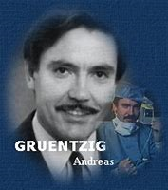
“God gave us 3 patent coronary arteries, and all has to be done to keep them patent”

Slide 2
SIHD

Slide 3
SIHD
Chronic coronary syndrome/chronic stable angina
Predictability and reproducibility
Silent ischemia in diabetes-confirmed by stress testing
2/3rd having atherosclerotic obstructive coronary lesion
1/3rd having microvascular disease
Severity assessment
  Stress test
  Cardiac imaging
  Coronary angiography

Slide 4
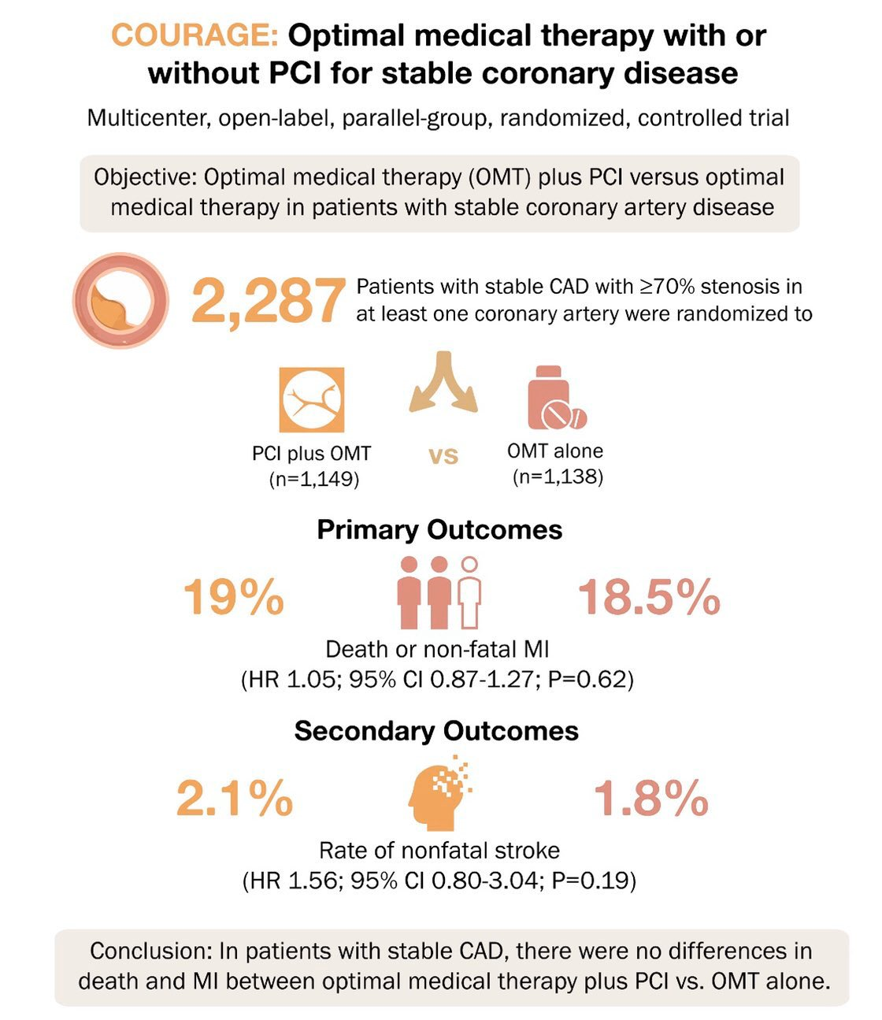
2007
Notes:
Angina relief was more in pci grp

Slide 5
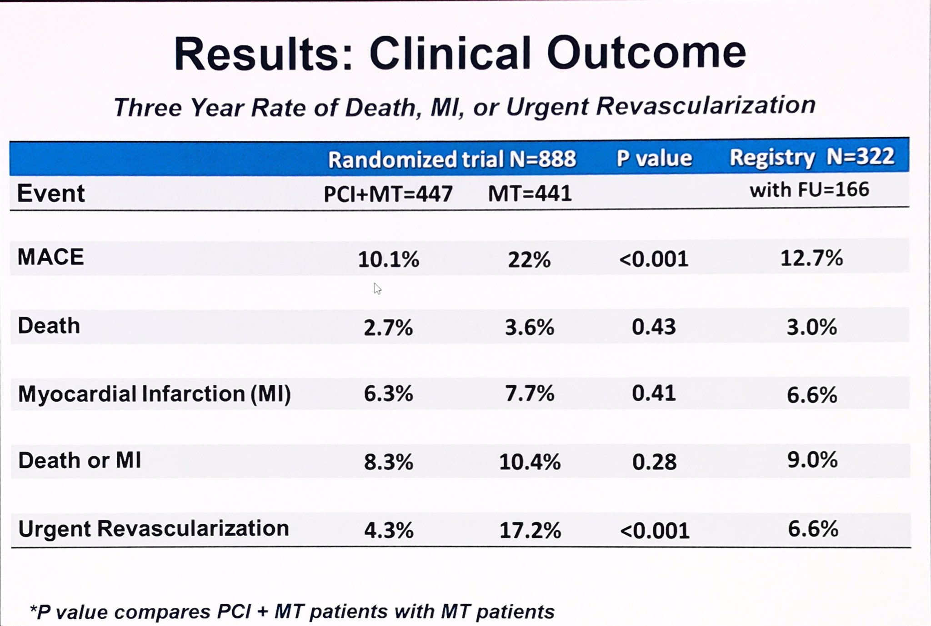
FAME II TRIAL 2012
Notes:
FFRPCI VS OMT

Slide 6
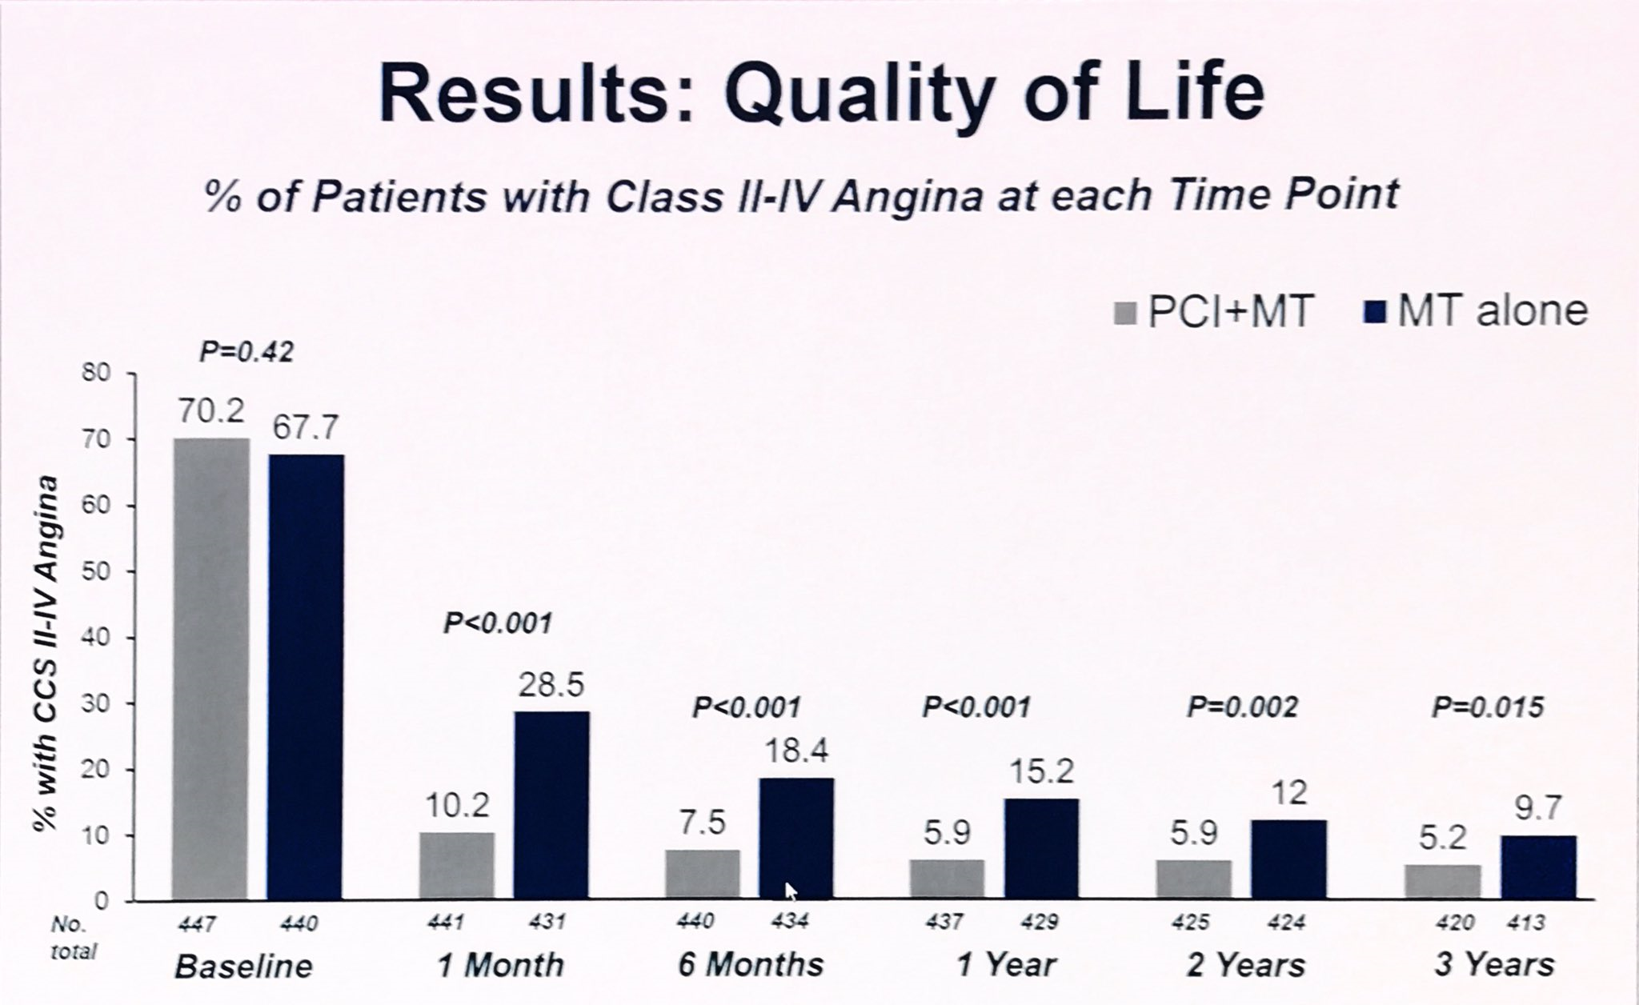
FAME II TRIAL 2012
Notes:
FFRPCI VS OMT

Slide 7
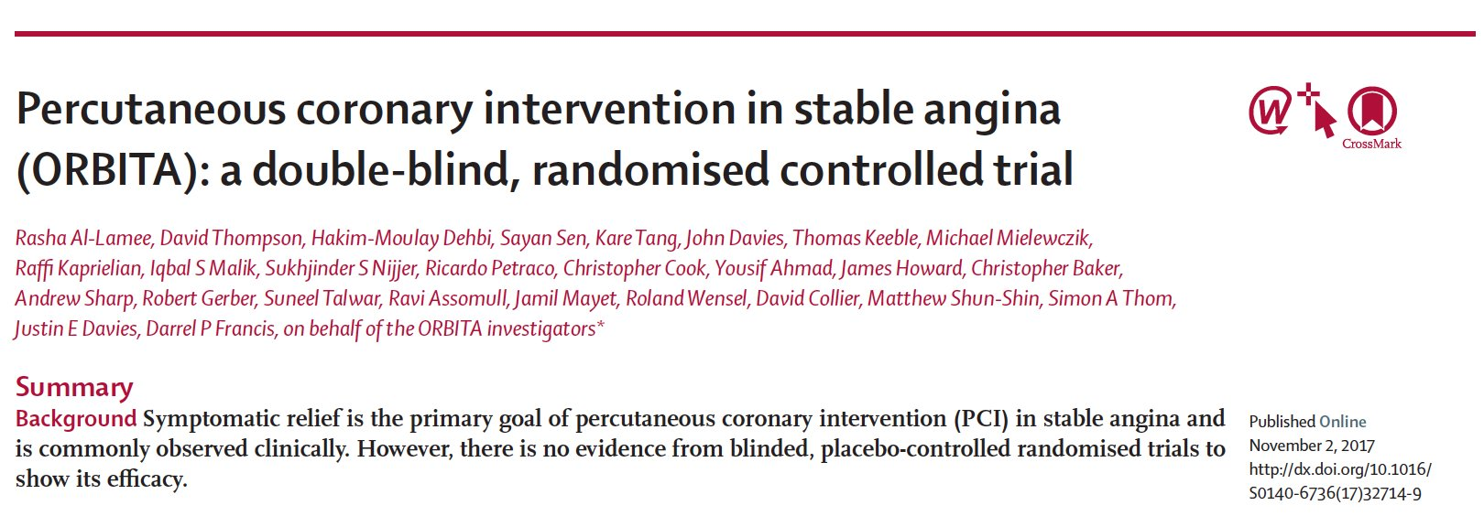
ORBITA TRIAL 2017

Slide 8
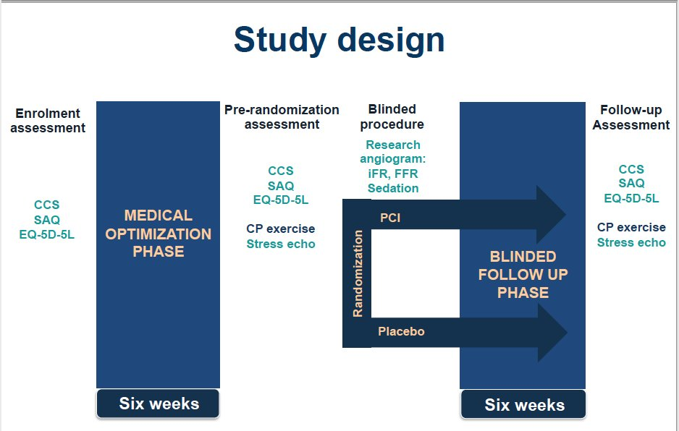

Slide 9
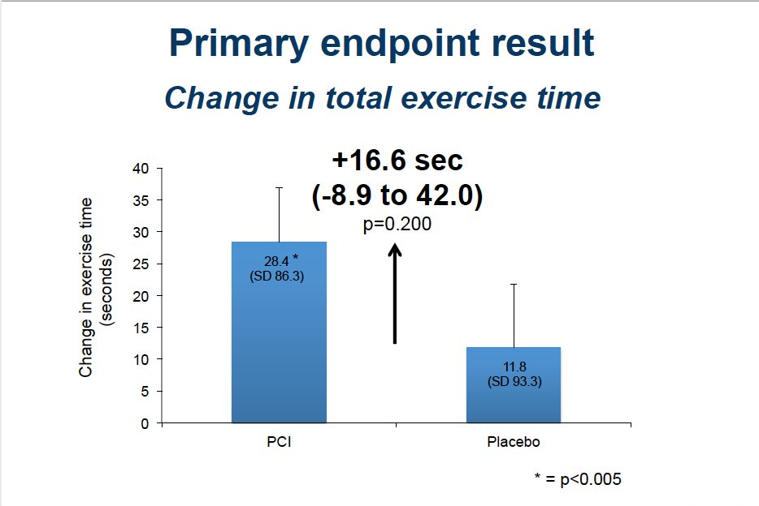

Slide 10
Summary of Medical therapy vs PCI Trials
Trial | Mortality | Prevent MI | Short term angina relief | Short term QoL↑ | Long term QoL↑
RITA 2 | No diff | No diff | PCI | PCI | No diff
ACME | No diff | No diff | PCI | PCI | N/A
ACME 2 | No diff | No diff | PCI | No diff | N/A
MASS | No diff | No diff | PCI | N/A | N/A
MASS II | No diff | No diff | PCI | PCI | N/A
AVERT | No diff | No diff | PCI | No diff | No diff
TIME | No diff | No diff | PCI | PCI | No diff
COURAGE | No diff | No diff | PCI | PCI | No diff
BARI 2D | No diff | No diff | PCI | PCI | No diff
FAME II | No diff | No diff | PCI | PCI | N/A
ORBITA | No diff | PCI | PCI | PCI | No diff

Slide 11
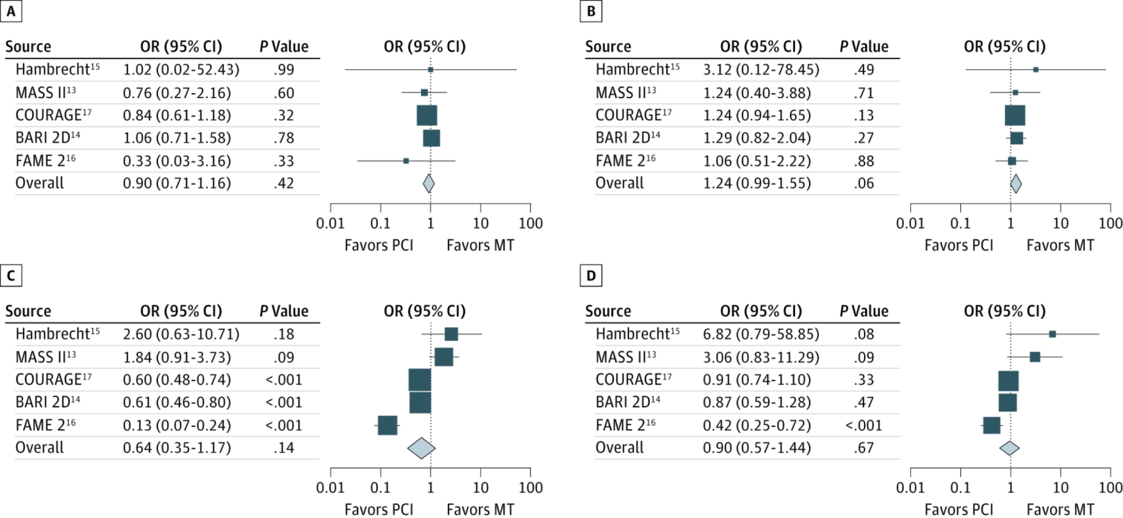
PCI vs Medical Therapy Alone in Patients With Stable Obstructive CAD and Myocardial Ischemia: Meta-analysis of RCTs
Selected for >50% statin use in both groups and >50% stent use
Subset of patients with ischemia documented (4064 of 5286)
Death
MI (non-fatal)
Unplanned Revascularization
Angina
Stergiopoulos et al. JAMA Intern Med. 2014;174:232-40.

Slide 12
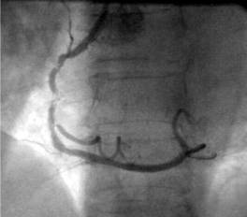
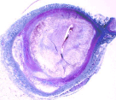
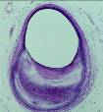
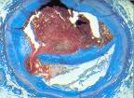
A paradigm that suggests why randomized trials have not demonstrated a survival benefit for revascularization in SIHD
Severe Obstruction (angina, no rupture) vs Mild Obstruction (no angina, likely to rupture)
Severe fibrotic plaque
Severe obstruction
No lipid
Fibrosis, Ca²⁺
Vulnerable plaque
Minor obstruction
Eccentric plaque
Lipid pool
Thin cap
Plaque rupture
Acute MI
Unstable angina
Sudden death
Exertional angina
(+) ETT
Pharmacologic stabilization
Early identification of high-risk?
Revascularization
Anti-anginal Rx
Courtesy of PH Stone, MD.
Notes:
Severe obstruction (angina, no rupture) vs mild obstruction (no angina,
likely to rupture)

Slide 13
Observational study: Revascularization was associated with lower risk of cardiac death only in those with >10% ischemia on perfusion imaging
5
N=10,627 no known CAD
146 Cardiac Deaths
4
Medical Rx*
3
log Hazard Ratio
Revascularization
2
1
p<0.001
0
0
12.5%
25%
32.5%
50%
% Ischemic Myocardium
Source: Hachamovitch Circulation 2003;107:2900-2907.

Slide 14
Prior Strategy Trials
Landmark trials (BARI 2D, COURAGE)
  Major contribution
Considerations to address in further studies
  Will higher risk patients based on substantial ischemia benefit?
  Eliminate referral bias by randomizing before cardiac catheterization
  Use newer stents and FFR as needed

Slide 15
Limitations of Prior Trials
Selection bias (randomization occurred after cath)
No minimum threshold of ischemia required
DES not used in COURAGE and BARI 2D*
PCI not FFR-guided in COURAGE and BARI 2D
CABG not done in COURAGE or FAME 2
CKD patients were under-represented
* DES only used in a small percentage of participants.

Slide 16
Remaining Gap
Is there any high risk group of SIHD patients, (other then LM) in whom a strategy of routine revascularization improves outcomes in the era of modern medical therapy?

Slide 17

International Study Of Comparative Health Effectiveness With Medical And Invasive Approaches (ISCHEMIA):
Dr.Muhammad Ameen C
SR Cardiology
GMCH Kozhikode

Slide 18
ISCHEMIA Research Question
In stable patients with at least moderate ischemia on a stress test, is there a benefit to adding cardiac catheterization and, if feasible, revascularization to optimal medical therapy?

Slide 19
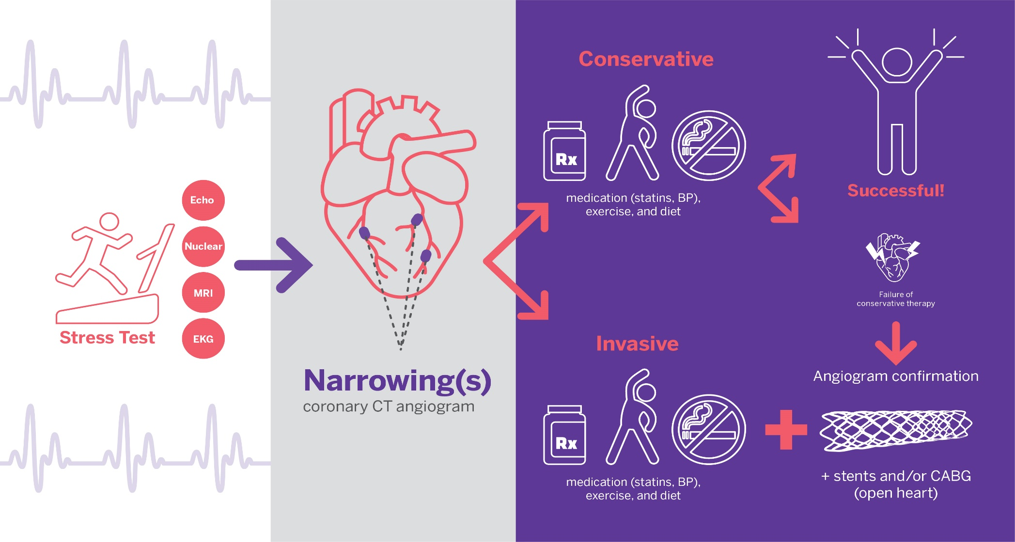
ISCHEMIA design overview
73% of randomized
patients
Moderate or severe ischemia

Slide 20
Study Design
Stable Patient
Moderate or severe ischemia
(determined by site; read by core lab)
CCTA not required, e.g., eGFR 30 to <60 or coronary anatomy previously defined
Blinded CCTA
Core lab anatomy eligible?
NO
Screen failure
YES
RANDOMIZE
INVASIVE Strategy
OMT + Cath +
Optimal Revascularization
CONSERVATIVE Strategy
OMT alone
Cath reserved for OMT failure
Maron DJ, et al. American Heart Journal. 2018; 201;124-135.

Slide 21
ISCHEMIA Organization
NIH/NHLBI
Leadership, Executive, Steering Committees
NYU School of Medicine
DSMB
Biostatistics Vanderbilt
Clinical Coordinating Center (CCC)
NYU School of Medicine Cardiovascular Clinical Research Center, NYU Langone Health
Statistical and Data Coordinating Center (SDCC)
Duke Clinical Research Institute
Economics and Quality of Life Coordinating Center (EQOL CC)
Duke Clinical Research Institute
Mid-America Heart Institute
Imaging Coordinating Center and Stress Core Labs
(Nuclear, Echo, CMR, ETT)
320 Sites* in 37 Countries
Country Leaders/ AROs
Independent Clinical Events Committee
St. Louis University
Duke Clinical Research Institute
Core Labs
ECG, Angiographic, CCTA
*Specific PCI and CABG volume and quality criteria were required for site participation.

Slide 22
Endpoints
Primary Endpoint:
Time to CV death, MI, hospitalization for unstable angina, heart failure or resuscitated cardiac arrest
Major Secondary Endpoints:
Time to CV death or MI
Quality of Life (separate presentation)
Other Endpoints include:
All-Cause Death
Net clinical benefit (stroke added to primary endpoint)
Components of primary endpoint
Maron DJ, et al. American Heart Journal. 2018; 201;124-135.

Slide 23
Statistical Considerations
Power and Precision (N = 5,179)
Power: >80% power to detect 18.5% relative reduction in primary endpoint assuming an aggregate 4-year cumulative rate of approximately 14%
Precision: 95% confidence interval around primary endpoint treatment effect hazard ratio will extend from 15% lower to 17% higher than point estimate
Pre-Specified Statistical Analysis
Intention-to-treat
Model-free: Cumulative event rates accounting for competing risks
Model-based: Cox regression (covariate adjusted)
  Emphasize nonparametric event rates if proportional hazards assumption is violated
Bayesian analysis of Cox model
  Evaluate the probability of a small or large hazard ratio in light of minimally informative prior probabilities and the current study data

Slide 24

Eligibility Criteria
Clinical and Stress Test Eligibility Criteria
CCTA Eligibility Criteria
Inclusion Criteria
Age ≥21 years
Moderate or severe ischemia*
  Nuclear ≥10% LV ischemia (summed difference score ≥7)
  Echo ≥3 segments stress-induced moderate or severe hypokinesis, or akinesis
  CMR
    Perfusion: ≥12% myocardium ischemic, and/or
    Wall motion: ≥3/16 segments with stress-induced severe hypokinesis or akinesis
  Exercise Tolerance Testing (ETT) >1.5mm ST depression in >2 leads or >2mm ST depression in single lead at <7 METS, with angina
Inclusion Criteria
≥50% stenosis in a major epicardial vessel (stress imaging participants)
≥70% stenosis in a proximal or mid vessel (ETT participants)
Major Exclusion Criteria
  ≥50% stenosis in unprotected left main
Major Exclusion Criteria
  NYHA Class III-IV HF
  Unacceptable angina despite medical therapy
  EF < 35%
  ACS within 2 months
  PCI or CABG within 1 year
  eGFR <30 mL/min or on dialysis
*Ischemia eligibility determined by sites. All stress tests interpreted at core labs.
Maron DJ, et al. American Heart Journal. 2018; 201;124-135.

Slide 25
Endpoint Definitions and Adjudication
Many methods were used to assure complete ascertainment and reporting of events
All 5 primary endpoint events and stroke were adjudicated by an independent
CEC comprised of senior experts from around the world
Cardiovascular Death
Myocardial Infarction
Unstable
Angina
Heart
Failure
Resuscitated Cardiac Arrest
Cardiovascular Death
Cardiovascular Death
  Proximate or underlying cardiac or vascular cause
Maron DJ, et al. AHJ. 2018; 201;124-135.

Slide 26
MI Endpoint Definitions
Cardiovascular
Death
Myocardial Infarction
Unstable
Angina
Heart
Failure
Resuscitated Cardiac Arrest
Myocardial Infarction
  Universal Definition of MI except
    Spontaneous MIs (types 1, 2, 4b, 4c)
      site-reported MI decision limits for troponin (upper limit of normal [ULN], not 99th percentile URL)
    Procedural MI
      more stringent biomarker and supporting criteria for procedural MI (similar to SCAI definition)
Maron DJ, et al. American Heart Journal. 2018; 201;124-135.

Slide 27
Procedural Myocardial Infarction Definitions
PCI-related MI (Type 4a)
CABG-Related MI (Type 5)
Markers: CK-MB preferred over troponin
CK-MB >5X ULN
Troponin >35X ULN when CK-MB is unavailable
PLUS at least one of the following:
New ECG changes
ST segment elevation or depression >0.1 mV in 2 contiguous leads
New pathologic Q-waves in ≥2 contiguous leads or
New persistent LBBB
Angio
Reduced flow in major coronary
Type C or greater dissection
Or stand-alone biomarker definition
CK-MB to >10-fold the ULN (or when CK-MB is unavailable, a rise in troponin to >70 fold the MI Decision Limit/ULN)
Markers: CK-MB preferred over troponin
CK-MB to >10X ULN
Troponin to >70X ULN when CK-MB is unavailable
PLUS at least one of the following:
Imaging
A new substantial wall motion abnormality by (CEC assessed), except new septal and apical abnormalities
New ECG changes
New pathologic Q-waves in ≥2 contiguous leads or
New persistent LBBB present on day 3 post CABG or hospital discharge
Or stand-alone biomarker definition
CK-MB to >15-fold the ULN (or when CK-MB is unavailable a rise in troponin to >100 fold the MI Decision Limit/ULN)
Elements in common with SCAI definition of clinically relevant MI
Maron DJ, et al. American Heart Journal. 2018; 201;124-135.

Slide 28
Endpoint Definitions
Unstable
Angina
Heart
Failure
Unstable
Angina
Heart
Failure
Resuscitated Cardiac Arrest
Resuscitated Cardiac Arrest
Prolonged ischemic symptoms at rest or accelerating pattern resulting in hospitalization
AND at least 1 of the following (core laboratory assessed):
New or worsening ST or
T wave changes
Angiographic evidence of a ruptured/ulcerated plaque,
or thrombus
>24 hour hospitalization for HF
AND all of the following:
Symptoms New/worsening dyspnea, orthopnea, PND, fatigue, reduced exercise tolerance AND
Signs of HF AND
Increased pharmacologic Rx or initiation of mechanical or surgical intervention AND
No other cause identified
Successful resuscitation for documented cardiac arrest out-of-hospital (or ER), discharged from hospital alive
Maron DJ, et al. American Heart Journal. 2018; 201;124-135.

Slide 29

Study Flow
Screen Failure (3339)
Major Reasons:
Insufficient ischemia (N = 1350)
No obstructive CAD (N = 1218)
Unprotected LMD (N =434)
Enrolled (8518)
Ischemia, Symptoms +
Non-Obstructive CAD
66% Women
Randomized (5179)
Study CCTA in 73% of randomized participants
Randomized to INV (2588)
Randomized to CON (2591)
Median follow-up for survivors 3.3 years (IQR 2.2 to 4.3 years)
Proportion of follow-up completed: 99.4%
Median follow-up for survivors 3.3 years (IQR 2.2 to 4.4 years)
Proportion of follow-up completed: 99.7%
Notes:
Changes in ischemia and angina over 1 yr

Slide 30
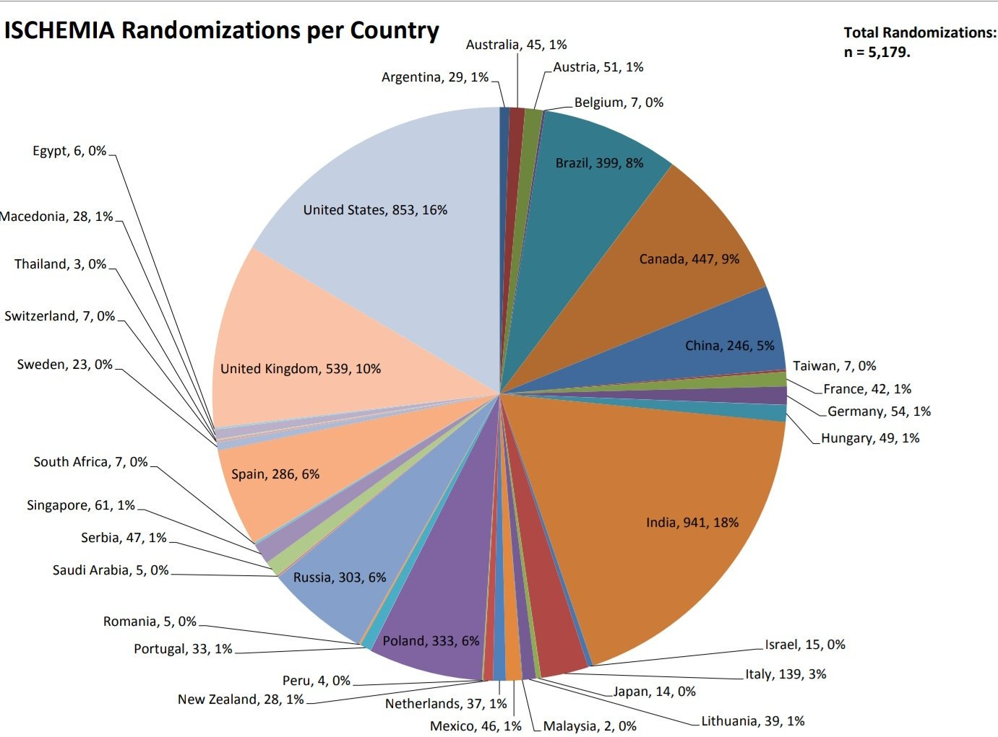

Slide 31
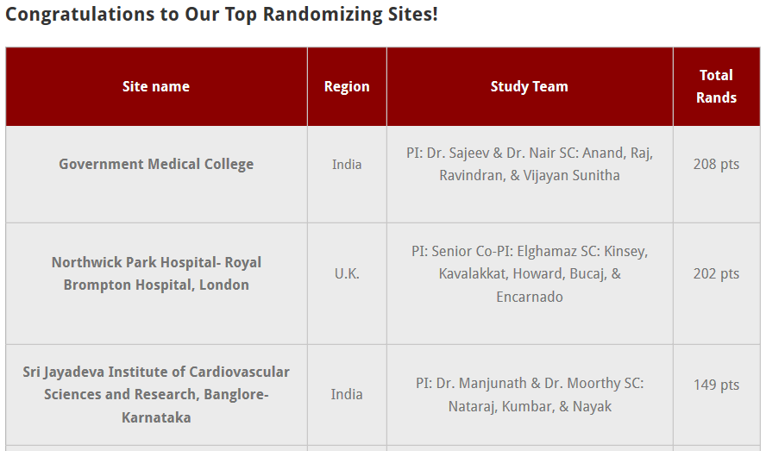

Slide 32
Baseline Characteristics
Characteristic | Total | INV | CON
Clinical
Age at Enrollment (yrs.)
Median | 64 (58, 70) | 64 (58, 70) | 64 (58, 70)
Female Sex (%) | 23 | 23 | 22
Hypertension (%) | 73 | 73 | 73
Diabetes (%) | 42 | 41 | 42
Prior Myocardial Infarction (%) | 19 | 19 | 19
Ejection Fraction, Median (%) (n=4637) | 60 (55, 65) | 60 (55, 65) | 60 (55, 65)
Systolic Blood Pressure, Median (mmHg) | 130 (120, 142) | 130 (120, 142) | 130 (120, 142)
Diastolic Blood Pressure, Median (mmHg) | 77 (70, 81) | 77 (70, 81) | 77 (70, 81)
LDL Cholesterol, Median (mg/dL) | 83 (63, 111) | 83 (63, 111) | 83 (63, 109.5)
History of Angina | 90% | 90% | 89%
Angina Began or Became More Frequent Over the Past 3 Months | 29% | 29% | 29%
Stress Test Modality
Stress Imaging (%) | 75 | 75 | 76
Exercise Tolerance Test (ETT) (%) | 25 | 25 | 24
Median values reported with 25th and 75th percentiles
Hochman JS et al. JAMA Cardiology. 2019 Mar 1;4(3):273-86.

Slide 33
Qualifying Stress Test: Core Lab Interpretation
Characteristic | Total | INV | CON
Baseline Inducible Ischemia*
Severe | 54% | 53% | 55%
Moderate | 33% | 34% | 32%
Mild/None | 12% | 12% | 12%
Uninterpretable | 1% | 1% | 1%
*Only severe qualified by ETT
Hochman JS et al. JAMA Cardiology. 2019 Mar 1;4(3):273-86.

Slide 34
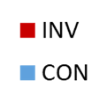
Baseline Coronary Artery Anatomy by CCTA
# of Vessels with >50 % Stenosis (%)
Specific Vessels with >50% Stenosis (%)
N=2982
(% of total)
N=3739
Hochman JS et al. JAMA Cardiology. 2019 Mar 1;4(3):273-86.

Slide 35
Risk Factor Management
Baseline vs last visit
No between group differences INV vs CON
High Level of Medical Therapy Optimization is defined as a participant meeting all of the following goals: LDL < 70 mg/dL and on any statin, systolic blood pressure < 140 mm/Hg, on aspirin or other antiplatelet or anticoagulant, and not smoking. High level of medical therapy optimization is missing if any of the individual goals are missing.
Baseline LDL = 83 mg/dL. Last visit LDL = 65 mg/dL.

Slide 36
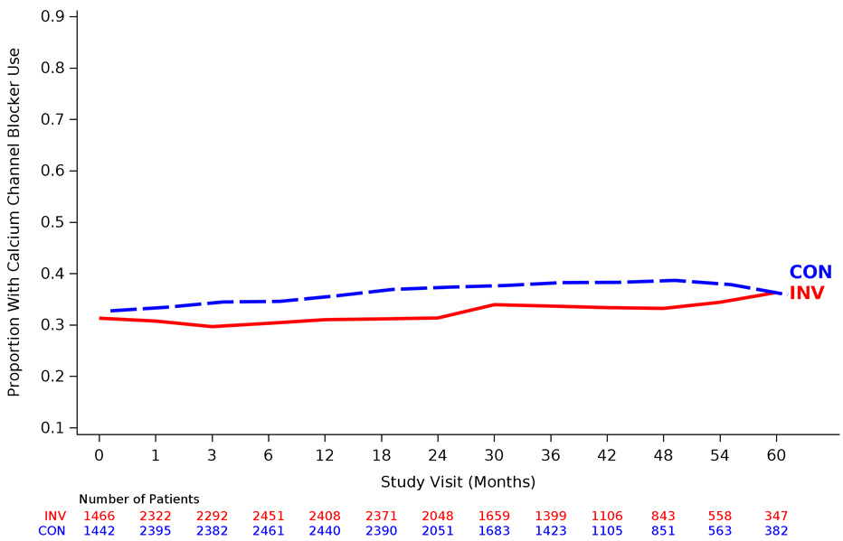
Medication Use Over Time
Calcium Channel Blocker
Beta Blocker
Other Anti-Anginal Medication
Dual Antiplatelet (DAPT)

Slide 37
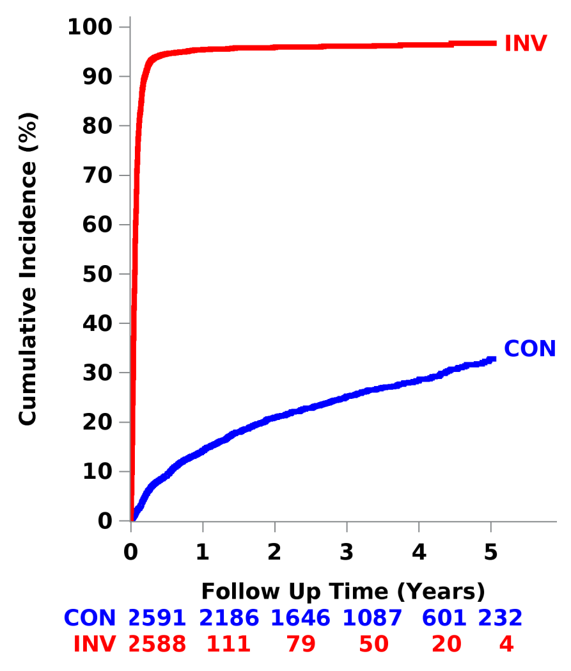
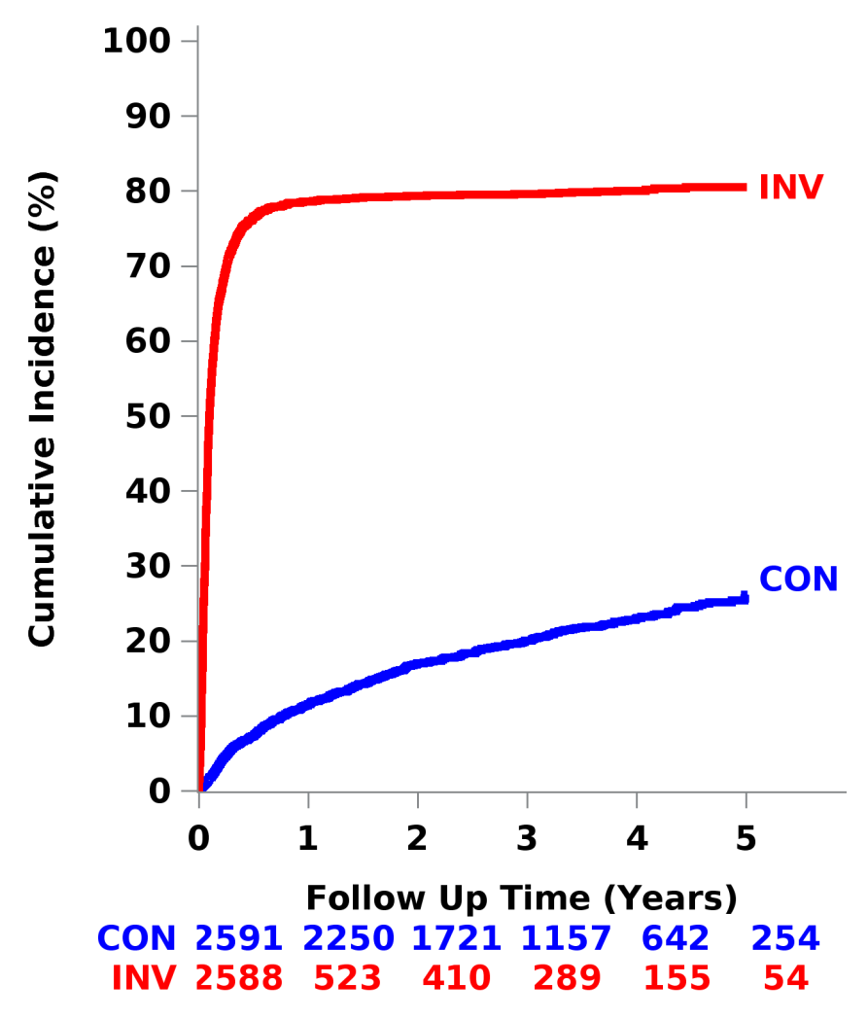

Cardiac Catheterization and Revascularization
Cardiac Catheterization
Revascularization
95%
96%
76%
79%
80%
Indications for cath in CON*
Suspected/confirmed event 13.8%
OMT Failure 3.9%
Non-adherence 8.1%
Revascularization in CON at 4 years not preceded by a primary endpoint event: 16%
28%
23%
9%
12%
7%
*Indications for Cath are percentages of CON patients whereas cumulative event rate shown at 4 years reflects censoring and the rate at that time point.

Slide 38
Mode of Revascularization
First Procedure for Those Revascularized in Invasive Group
(80% of INV)
Of the 20% with no revascularization
~2/3 had insignificant disease on coronary angiogram
~1/3 had extensive disease unsuitable for any mode of revascularization
First Procedure | Total
PCI | 74%
Successful, stent able to be placed | 93%
Of stents placed, drug eluting | 98%
First Procedure | Total
CABG | 26%
Arterial Grafts | 93%
IMA | 92%

Slide 39
Primary Outcome: CV Death, MI, hospitalization for UA, HF or
resuscitated cardiac arrest
Adjusted Hazard Ratio = 0.93 (0.80, 1.08)
P-value = 0.34
Absolute Difference INV vs. CON
CON
6 months:
Δ = 1.9% (0.8%, 3.0%)
15.5%
INV
13.3%
4 years:
Δ = -2.2% (-4.4%, 0.0%)
Subjects at Risk
CON | 2591 | 2431 | 1907 | 1300 | 733 | 293
INV | 2588 | 2364 | 1908 | 1291 | 730 | 271

Slide 40
Major Secondary: CV Death or MI
Adjusted Hazard Ratio = 0.90 (0.77, 1.06)
P-value = 0.21
Absolute Difference INV vs. CON
13.9%
CON
6 months:
Δ = 1.9% (0.9%, 3.0%)
INV
11.7%
4 years:
Δ = -2.2% (-4.4%, -0.1%)
Subjects at Risk
CON | 2591 | 2453 | 1933 | 1325 | 746 | 298
INV | 2588 | 2383 | 1933 | 1314 | 752 | 282

Slide 41
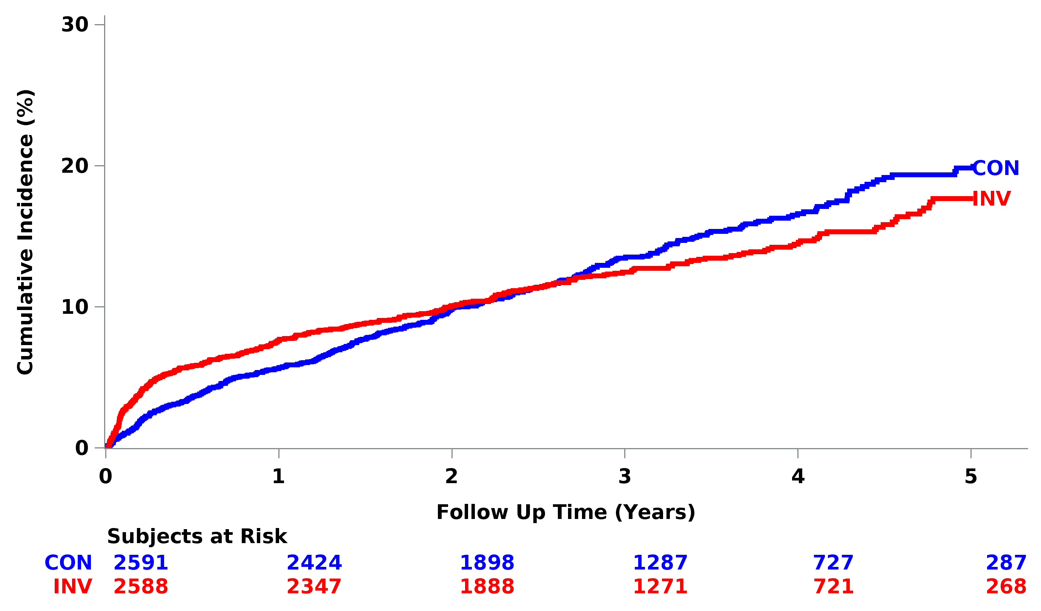
Net Clinical Benefit: CV Death, MI, UA, HF, RCA, Stroke
HR= 0.95 (0.82,1.10)
P-value= 0.50

Slide 42
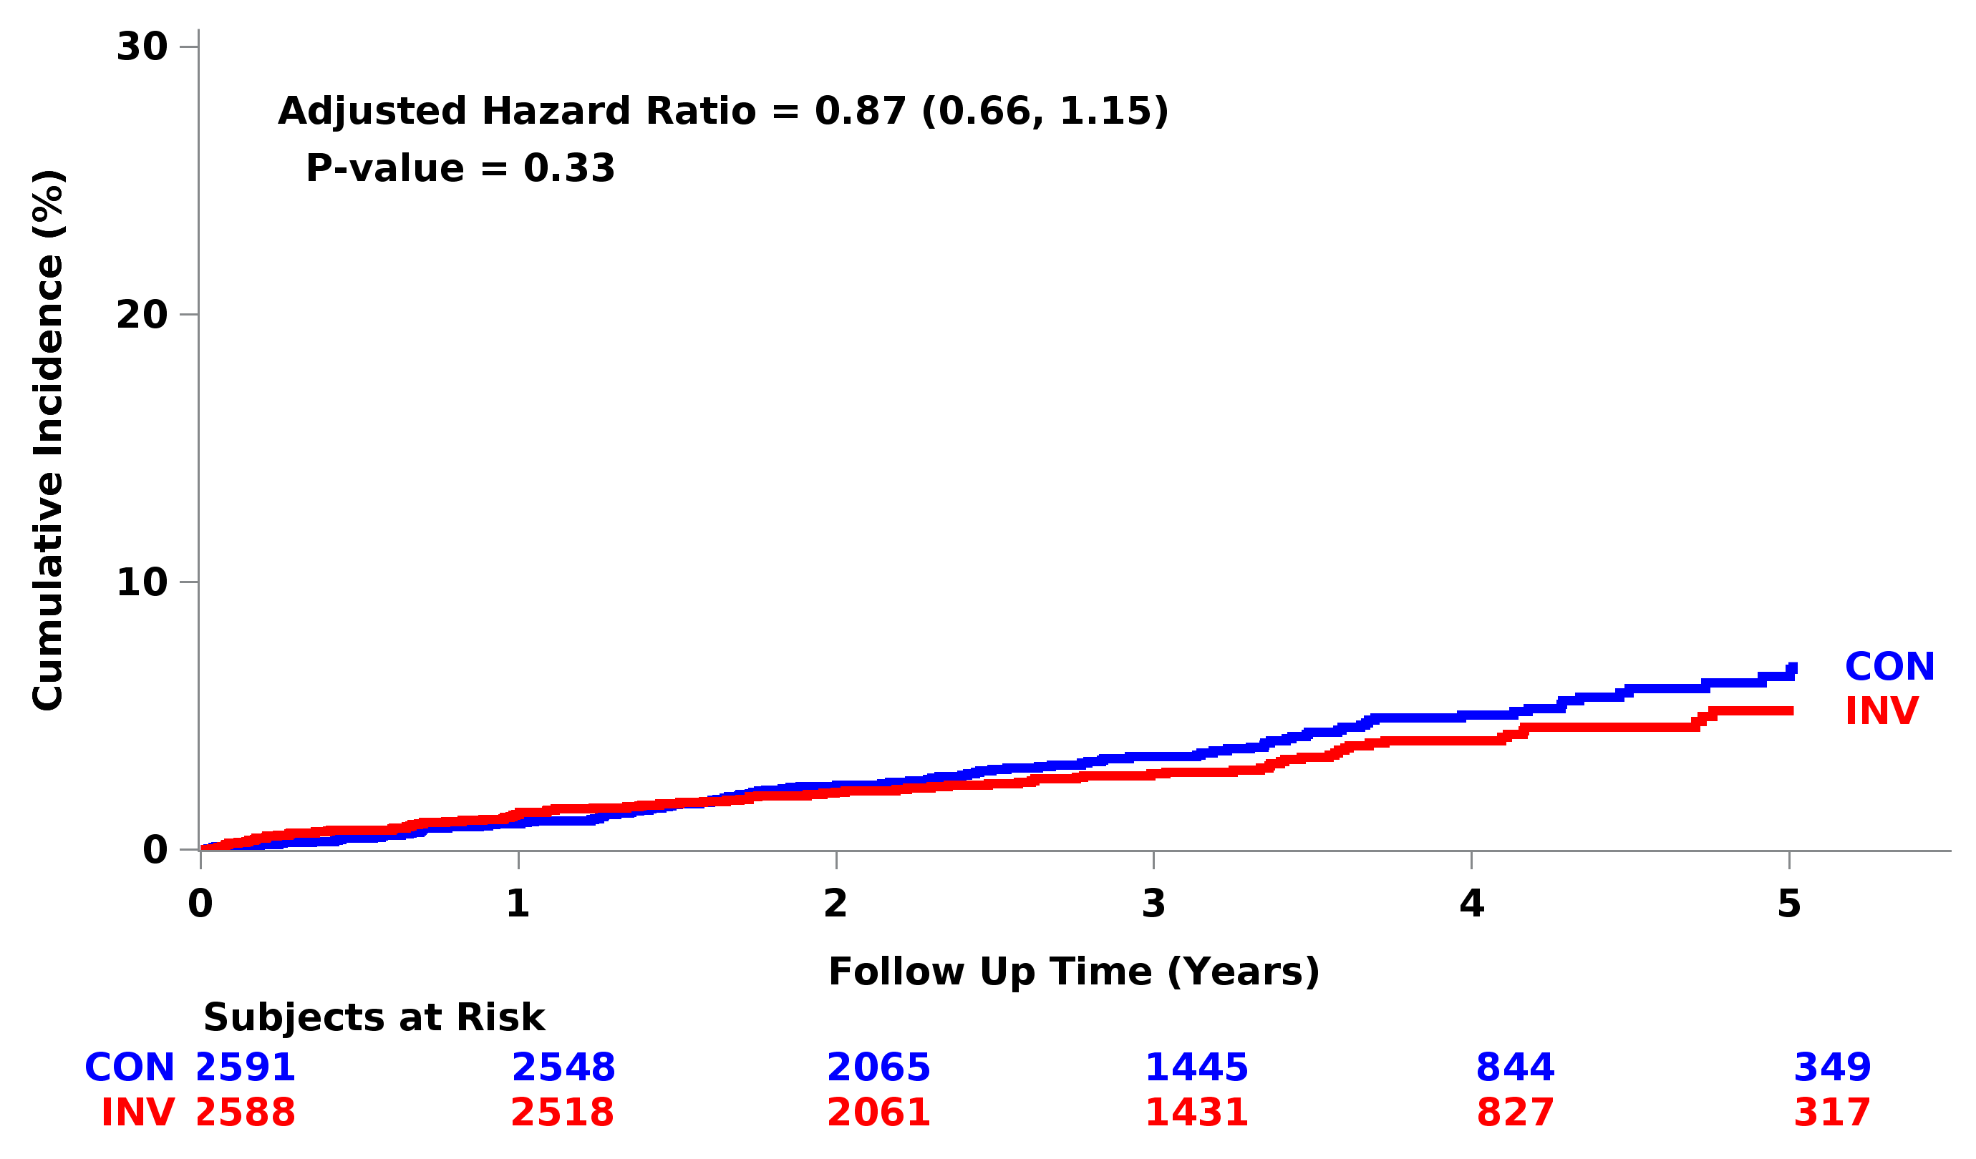
Cardiovascular Death

Slide 43
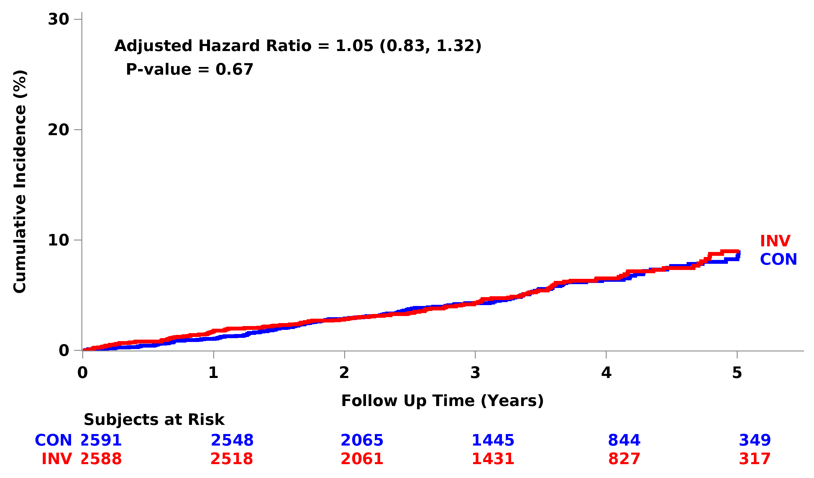
All-Cause Death
The probability of at least a 10% relative risk reduction of INV on
all-cause mortality is <10%, based on pre-specified Bayesian analysis.
6.5%
6.4%

Slide 44
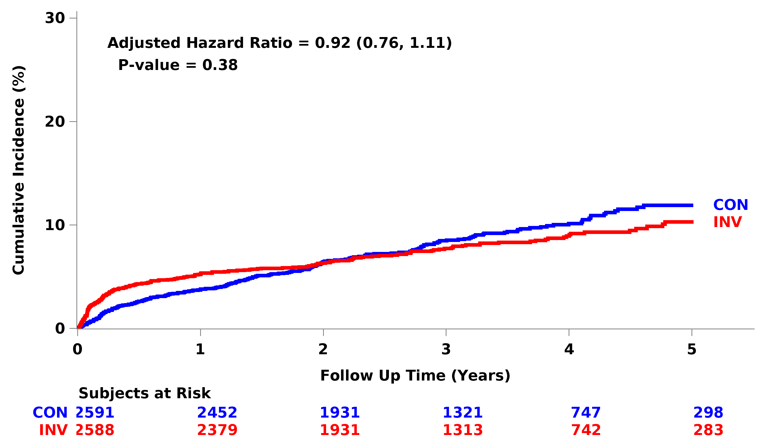
Myocardial Infarction

Slide 45
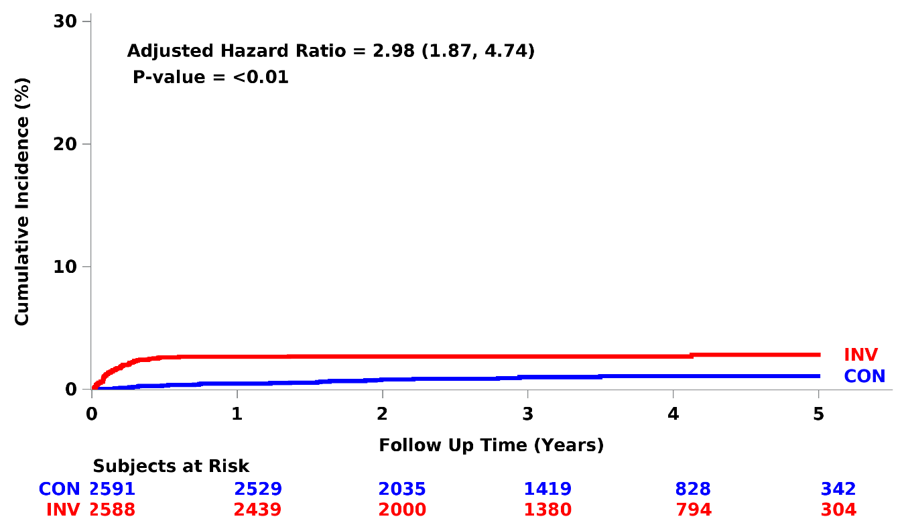
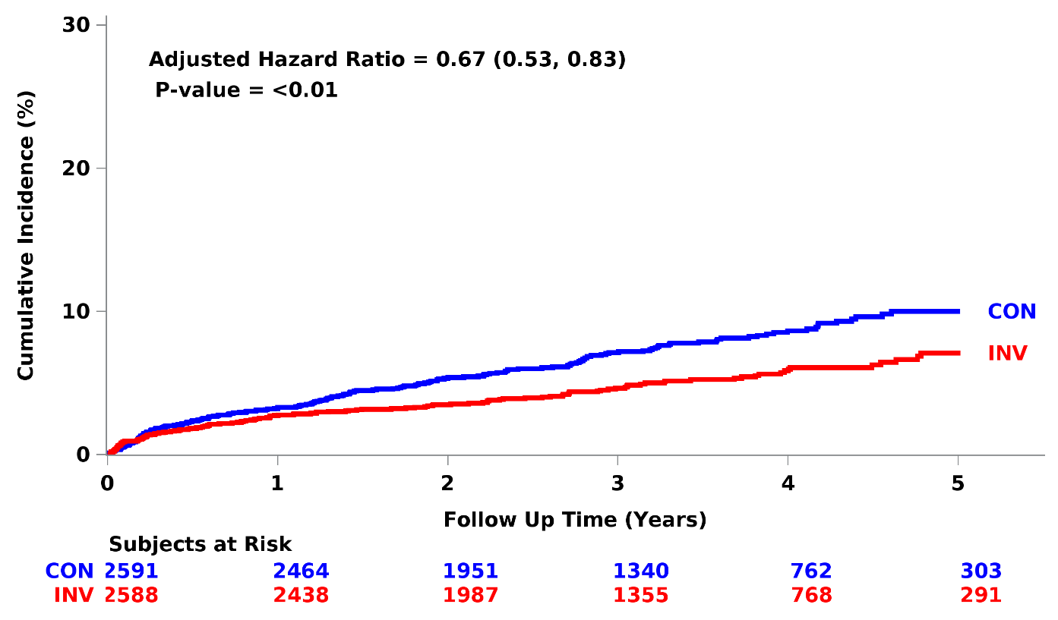
Procedural MI
Type 4a or 5 MI
Spontaneous MI
Types 1, 2, 4b, or 4c MI

Slide 46
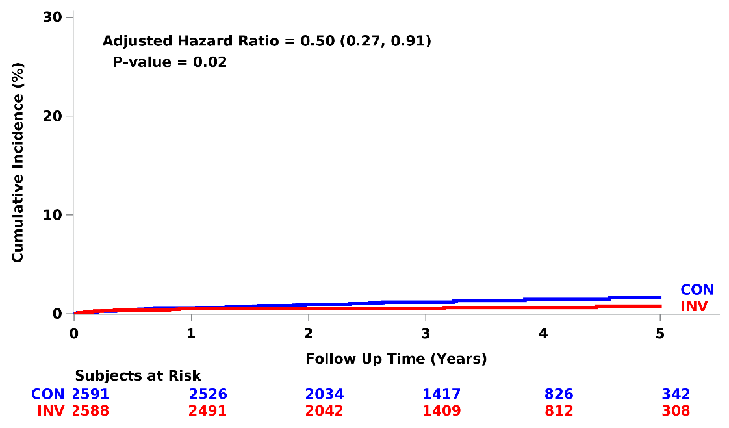
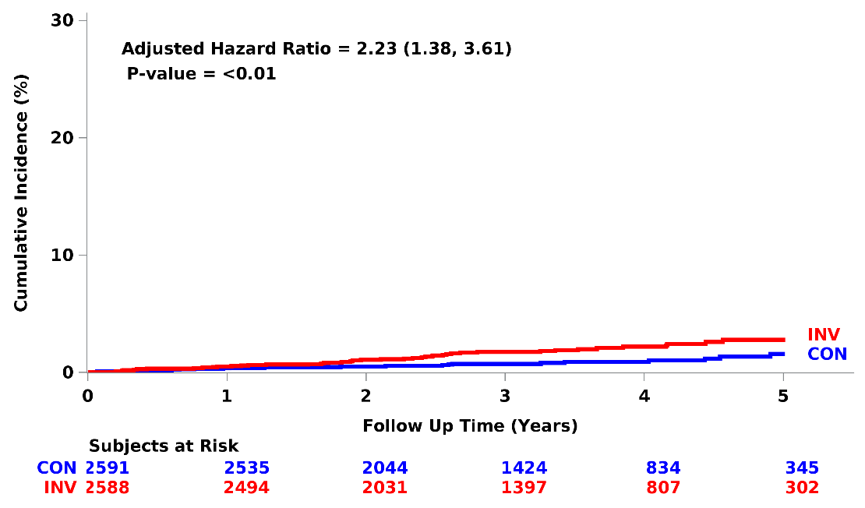
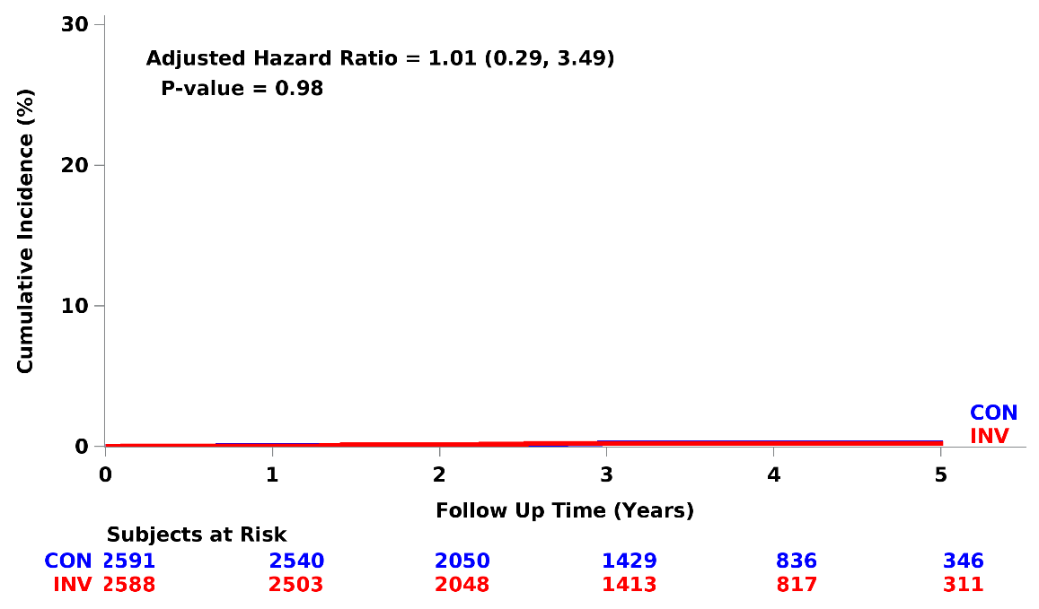
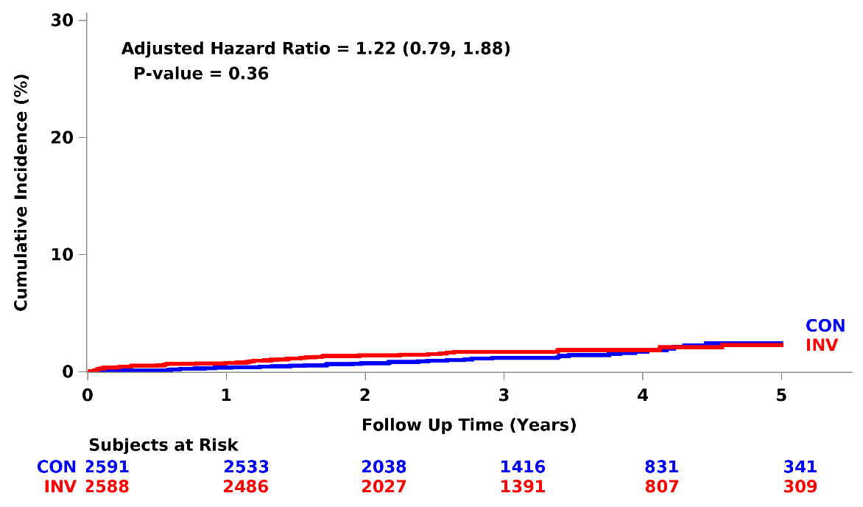
Hospitalization for Unstable Angina
Hospitalization for Heart Failure
Resuscitated Cardiac Arrest
Stroke

Slide 47
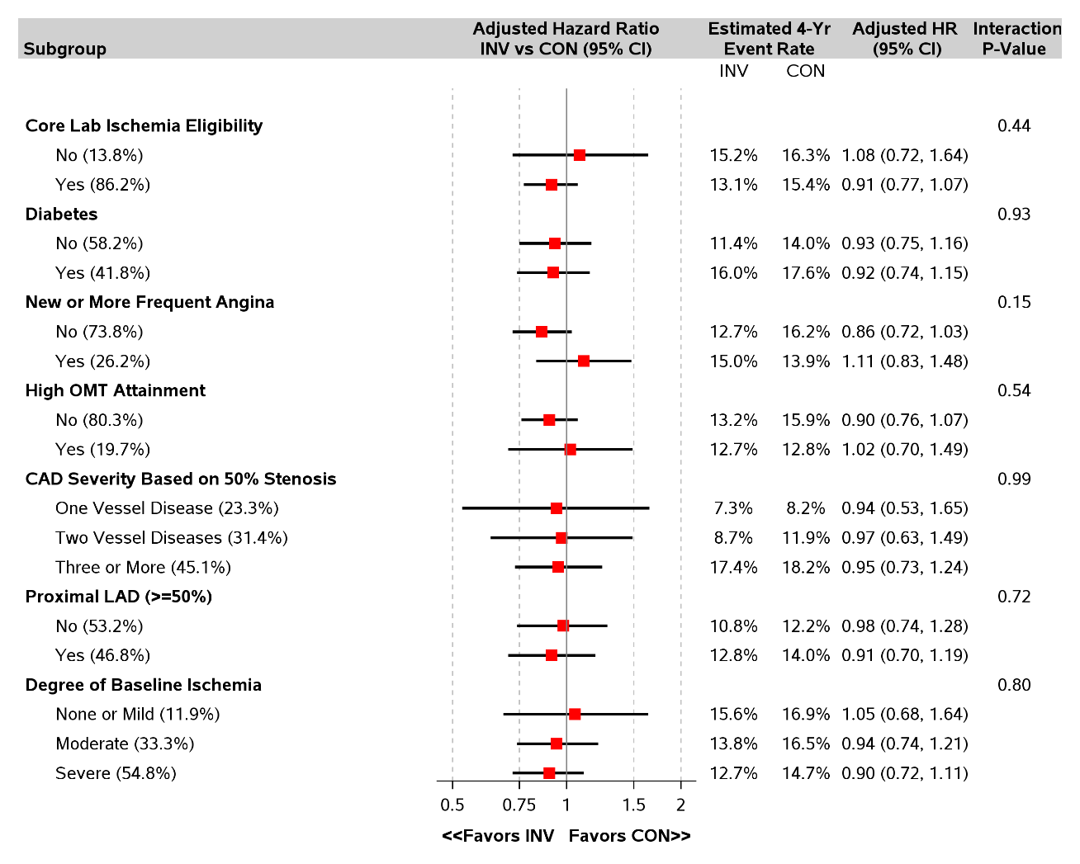
Primary endpoint
Pre-specified Important Subgroups
There was no heterogeneity of treatment effect
High degree of baseline medical Rx optimization
N=3739 for Prox LAD Y/N
N=2982 for # diseased vessels

Slide 48
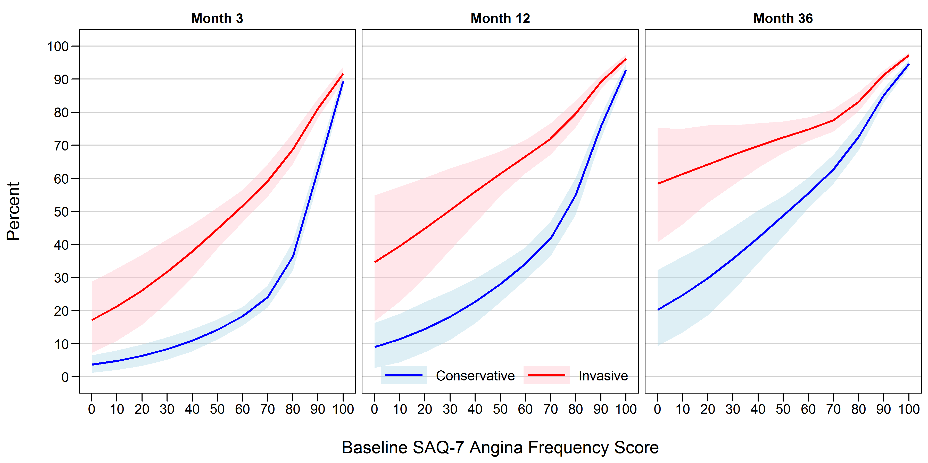
Probability of No Angina by Baseline Angina Frequency
No
Difference
45%
NNT = ~3
15%
Daily
Weekly
Monthly
None
n=8
8
67
30
172
140
509
500
850
693
1635

Slide 49
Primary endpoint and major secondary endpoint
(CV death or MI)
No heterogeneity of treatment effect
based on any characteristic
Age
Sex
Ethnicity
Race
Geographic region
Stress test, imaging vs no imaging
Stress imaging modality
Moderate or severe anterior ischemia
Prior MI
Prior cardiac cath
Prior PCI
Prior CABG
Ejection Fraction
eGFR

Slide 50
Limitations
Unblinded trial – no sham procedure
Based on exclusion criteria, the trial results do not apply to patients with:
  Acute coronary syndromes within 2 months
  Highly symptomatic patients
  Left main stenosis
  LVEF <35%
Trial findings may not be generalizable to centers with higher procedural complication rates
Completeness of revascularization has not yet been assessed
Women were enrolled in the trial but more often excluded from randomization compared to men due to less ischemia and more non-obstructive CAD

Slide 51
Summary
The curves cross for the primary endpoint and the major secondary endpoint at approximately 2 years from randomization
  ~2 in 100 higher estimated rate with INV at 6 months
  ~2 in 100 lower estimated rate with INV at 4 years
Procedural MIs were increased with an invasive strategy
Spontaneous MIs were reduced with an invasive strategy
Low all-cause mortality in both groups despite high-risk clinical characteristics, high-risk ischemia and extensive CAD
No heterogeneity of treatment effect, including by type of stress test, severity of ischemia or extent of CAD
Very low rates of procedure-related stroke and death

Slide 52
Conclusions
ISCHEMIA is the largest trial of an invasive vs conservative strategy for patients with SIHD
Overall, an initial INV strategy as compared with an initial CON strategy did not demonstrate a reduced risk over median 3.3 years for
  Primary endpoint - CV death, MI, hospitalization for UA, HF, RCA
  Major Secondary endpoint - CV death or MI
The probability of at least a 10% benefit of INV on all-cause mortality was <10%, based on pre-specified Bayesian analysis

Slide 53
Conclusions- Quality of Life
Patients with stable CAD and moderate to severe ischemia had significant, durable improvements in angina control and quality of life with an invasive strategy if they had angina (daily/weekly or monthly)
In patients without angina, an invasive strategy led to minimal symptom or quality of life benefits, as compared with a conservative strategy
In patients with angina, shared decision-making should occur to align treatment with patients’ goals and preferences

Slide 54

OTHER SIGNIFICANT CONTRIBUTORS NOT PREVIOUSLY LISTED
Steering Committee
Noel Bairey-Merz
Rolf Doerr
Vlad Dzavik
Shaun Goodman
Gilbert Gosselin
Claes Held
Matyas Keltai
Shun Kohsaka
Renato Lopes
Jose Lopez-Sendon
Aldo Maggioni
John Mancini
James K. Min
Michael Picard
Witold Ruzyllo
Joseph Selvanayagam
Roxy Senior
Tali Sharir
Leslee Shaw
Gabriel Steg
Hanna Szwed
William Weintraub
Harvey White
SDCC
Frank Rockhold
Sam Broderick
Zhen Huang
Lisa Hatch
Wayne Pennachi
Khaula Baloch
Michelle McClanahan-Crowder
Matthew Wilson
Jeff Kanters
Dimitrios Stournaras
Allegra Stone
Linda Lillis
CCC
Caroline Callison
Kevin Chan
Michelle Chang
Gia Cobb
Aira Contreras
Nadia Gakou
Margaret Gilsenan
Isabelle Hogan
Sharder Islam
Bevin Lang
June Lyo
Stephanie Mavromichalis
Samaa Mohamed
Anna Naumova
Albertina Qelaj
Arline Roberts
Vincent Setang
Kerrie Van Loo
Grace Wayser
Mark Xavier
Michelle Yee
Jeannie Denaro*
Site PIs (≥20 randomized)
Chakkanalil Sajeev
Rajesh Nair
Roxy Senior
Ahmed Elghamaz
Cholenahally Manjunath
Nagaraja Moorthy
Kreton Mavromatis
Whady Hueb
Marcin Demkow
Jose Luis Lopez-Sendon
Leo Bockeria
Jesus Peteiro
Jiyan Chen
Neeraj Pandit
Alexander Chernyavskiy
Sudhanshu Dwivedi
Paola Smanio
Gilbert Gosselin
Gurpreet Wander
Ariel Diaz
Balram Bhargava
Gian Piero Perna
Leonid Bershtein
Todd Miller
Tomasz Mazurek
Jarozlaw Drozdz
Denis Phaneuf
Alexandre de Quadros
Eapen Punnoose
Aleksandras Laucevicius
Elena Demchenko
Reto Gamma
Andrew Sutton
Herwig Schuchlenz
Pallav Garg
Milind Gadkari
Jorge Escobedo
Hanna Szwed
Subhash Banerjee
Thuraia Nageh
Joao Vitola
Kian Keong Poh
Jose Marin-Neto
Santhosh Satheesh
Atul Mathur
Majo Joseph
Joseph Selvanayagam
Benjamin (Ben) Chow
Rolf Doerr
Kevin Bainey
Sasko Kedev
Asim Cheema
Johann Christopher
Harmony Reynolds
Jonathan Newman
Jorik Timmer
Ruben Ramos
Asim Cheema
Abraham Oomman
Stefano Provasoli
Raffi Bekeredjian
Chris Nunn
David Foo
James Cha
Christophe Thuaire
Khaled Abdul-Nour
Peter Stone
Andras Vertes
Adam Witkowski
Steven Lindsay
CEC
Bernard Chaitman
Salvador Cruz-Flores
Eli Feen
Mario J. Garcia
Lisa Alderson
Eugene Passamani
Maarten Simoons
Hicham Skali
Kristian Thygesen
David Waters
Ileana Pina
Core Labs
ECG/ETT Core Lab
Bernard Chaitman
Bandula Guruge
Jane Eckstein
Mary Streif
Angiographic Core Lab
Ziad Ali
Philippe Genereux
Maria A. Alfonso
Michelle Cinguina
Maria P. Corral
Nicoleta Enache
Javier J. Garcia
Katharine Garcia
Jennifer Horst
Ivana Jankovic
Maayan Konigstein
Mitchel B. Lustre
Yolayfi Peralta
Raquel Sanchez
CCTA Core Lab
James Min
Reza Arsanjani
Matthew Budoff
Shenghao Chen
Chris Dailing
Kimberly Elmore
Millie Gomez
Manasa Gummalla
Cameron Hague
Niree Hindoyan
John Leipsic
John Mancini
Rine Nakanishi
Maximillian Sundiam
ICC
Leslee J Shaw
Larry Phillips
Abhinav Goyal
Holly Hetrick
Dana Oliver
Nuclear Core Lab
Daniel Berman
Sean Hayes
John Friedman
James Gerlach
Mark Hyun
Yuka Otaki
Romalisa Miranda-Peats
Piotr Slomka
Louise Thomson
CMR Core Lab
Raymond Kwong
Matthias Friedrich
Francois-Pierre Mongeon
Crystal Chen
Steven Michael
Echo Core Lab
Michael Picard
Filipe Henriques
Judy Hung
Marielle Scherrer-Crosbie
Xin Zeng
ARO’s/Country Leaders
GLCC
Harvey White
Caroline Alsweiler
KU Leuven
Frans Van de Werf
Kaatje Goetschalckx
Ann Luyten
Valerie Robesyn
CHRC
Shaun Goodman
Caroline Spindler
Neamat Mowafy
FIBULP
Jose Lopez-Sendon
Almudena Castro
Paloma Moraga
Victoria Hernandez
Jose Luis Narro
BCRI
Renato Lopes
Antonio Carvalho*
Julia Morata
Lilian Mazza Barbosa
ANMCO
Aldo Maggioni
Andrea Lorimer
Francesco Orso
Marco Magnoni
Martinia Tricoli
Laura Sarti
Franseca Biancchini
Martina Ceseri
SAHMRI
Joseph Selvanayagam
CRO’s
FOCUS
Nevena Garcevic
iProcess
Asker Ahmed
M Saleem
Richa Bhatt
Device donations:
Abbott Vascular
Medtronic, Inc.
St. Jude Medical, Inc.
Phillips Co.
Omron Healthcare, Inc.
Medications provided:
Amgen Inc
Arbor Pharmaceuticals, LLC AstraZeneca Pharmaceuticals, LP Merck Sharp & Dohme Corp.
Financial donations
Arbor Pharmaceuticals LLC AstraZeneca Pharmaceuticals LP
*in memoriam

Slide 55
ISCHEMIA Leadership
National Heart Lung & Blood Institute:
Yves Rosenberg, Jerome Fleg, Neal Jeffries, Ruth Kirby
Study Chair: Judith S. Hochman (New York University)
Study Co-Chair: David J. Maron (Stanford University)
Clinical Coordinating Center:
NYU Cardiovascular Clinical Research Center
Harmony Reynolds
Sripal Bangalore
Jeffrey Berger, Jonathan Newman
Stephanie Mavromichalis
Mandeep Sidhu (Albany Medical Ctr)
Executive Committee:
Karen Alexander
Sripal Bangalore
Jeffrey Berger
Daniel Mark
Sean O’Brien
Harmony Reynolds
Yves Rosenberg
Leslee Shaw
John Spertus
Statistical and Data Coordinating Center:
Duke Clinical Research Institute
Sean O’Brien
Karen Alexander
Lisa Hatch
Frank Harrell (Vanderbilt)
Leadership Committee:
Judith Hochman, Chair
David Maron, Co-Chair
William Boden
Bruce Ferguson
Robert Harrington
Gregg Stone
David Williams
EQOL Coordinating Center:
Daniel Mark (Duke University)
John Spertus (St. Luke’s Mid America Heart Institute)
Imaging Coordinating Center:
Leslee Shaw (Emory/Weil Cornell Medicine)
Top Countries/Regions Leaders:
Balram Bhargava (India), Roxy Senior (UK), Shaun Goodman, Gilbert Gosselin (Canada), Renato Lopes (Brazil), Witold Ruzyllo, Hanna Szwed (Poland), Leo Bockeria (Russia), José Lopez-Sendon (Spain), Aldo Maggioni (Italy), Harvey White (Singapore, New Zealand), Rolf Doerr (Germany)
Data Safety Monitoring Board:
Lawrence Friedman, Chair; Jeffrey Anderson; Jessica Berg; David DeMets; C. Michael Gibson; Gervasio A. Lamas; Pamela Ouyang; Pamela K. Woodard
Clinical Event Adjudication Committee Chair:
Bernard Chaitman (Saint Louis University)

