Slide 1
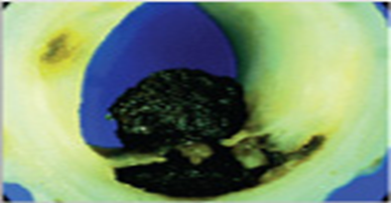
NSTEMI
DR.MUHAMMAD AMEEN C

Slide 2
OVERVIEW
Definition
History and examination
ECG, Biomarkers
Non invasive and invasive testing
Management
Special groups

Slide 3
CAD SPECTRUM

Slide 4
ACS VERSUS CCS
Sudden onset of symptoms at rest or with minimal exertion
Lasts atleast 10 minutes
Severe chest pain/pressure/discomfort
Accelertaing pattern of symptom
Awakens the patient from sleep

Slide 5
Clinical Presentation
Angina occurring at rest and prolonged, usually greater than 20 mins.
New onset (less than 2 months) angina of at least CCS class III severity
Previously diagnosed angina that has became distinctly more frequent, longer in duration or lower in threshold (increased by one or more CCS class to at least CCS class III severity)
Rest Angina
New onset Angina
Acclerated
Angina
Braunwald E. Circulation 1989

Slide 6
NSTE- ACS
DEFINITION
Spectrum of conditions which abruptly cause an unmet need of coronary blood supply to myocardium
ACS
ECG
STEMI
UNSTABLE ANGINA
NSTE-ACS
NSTEMI
Ischaemic ECG changes(not must)
Transient ST segment elevation
ST depression
T wave inversion
Severe blockage than total occlusion in 1 or more coronaries
Acute complete coronary occlusion
Aggressive therapeutic stratergy- for rapid coronary reperfusion
Cardiac biomarkers- not elevated
Cardiac biomarkers- elevated
NSTE-ACS- non ST elevation acute coronary syndrome

Slide 9
Epidemiology-Global Scenario
The annual incidence is 3 per 1000 inhabitants, but varies between countries.¹
Hospital mortality is higher in patients with STEMI than among those with NSTE-ACS².
At 6 months the mortality rates are very similar in both conditions (12% and 13%, respectively).²
At 4 years death rates were higher among patients with NSTE-ACS than with STE-ACS, with a two-fold difference.³
1.Fox KA et al ,Heart 2010
2.Mandelzweig L et al,Eur Heart J 2006
3.Terkelsen CJ et al, Eur Heart J 2005
Notes:
(7% vs. 3–5%, respectively),

Slide 10
EPIDEMIOLOGY
The fraction of ACS attributed to NSTEMI continues to increase, while that for STEMI is declining
Wider use of preventive measures(Aspirin,statin etc.)
Aging of population
Greater prevalence of T2DM and CKD
Lower rates of smoking
Broader use of hs-cTn

Slide 11
PATHOPHYSIOLOGY
Involves following processes singly or in combination
Disruption of an unstable coronary plaque (rupture/erosion/nodular calcification)
Coronary arterial vasoconstriction
Gradual intraluminal narrowing
Myocardial oxygen supply-demand mismatch

Slide 14
DIAGNOSIS: NSTE ACS
History and examination
ECG
Cardiac biomarkers
Imaging
GOALS
Recognize or exclude MI using cardiac biomarkers (cTn) Detect Rest ischaemia (serial or continuous ECGs) Detect significant coronary obstruction with CCTA and/or using stress testing
CCTA=coronary computed tomographic angiography

Slide 16
HISTORY
Symptoms
Chest discomfort Site: substernal Radiation: left arm/shoulder, superiorly to neck and jaw | Has atleast 1 of 3 features Occurrence at rest (or with minimal exertion), lasting > 10mins Relatively recent onset ( within prior 2 weeks) Crescendo pattern More severe, prolonged , or frequent than previous episodes
Angina equivalents Atypical symptoms: more common →Elderly Women patients with DM, CKD or dementia | Dyspnoea, epigastric discomfort, sweating, nausea, vomiting,syncope Other atypical symptoms: Anxiety, profound weakness,, dizziness, syncope, palpitation

Slide 17
Clinical Examination
Diaphoresis
Sinus Trachycardia,
Third/Fourth heart sound
Pale cool skin
Basilar rales
Hypotension

Slide 18
ECG
12 LEAD ECG
Performed as soon as possible (within 10 mins)
Normal ECG – does not exclude NSTE-ACS (ECG blind territory/episodic ischemia): take serial ECGs and Posterior +RV leads
ECG changes-
Transient ST segment elevation <20min (10% of patients)
New ST depression ( 1/3rd of patients)
T wave changes –more common but less specific
New and deep T wave inversions or normalization of Previously negative T wave
Bundle branch block/paced rhythm: difficult to interpret
Repeat ECG: every 30 minutes until the symptoms resolve

Slide 19
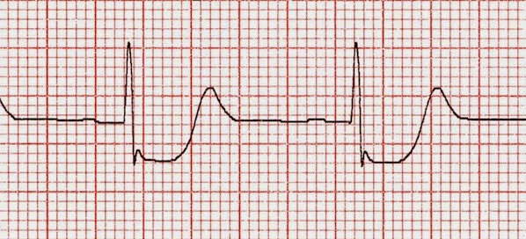
ECG criteria- NSTE-ACS
In 2 contiguous leads
New horizontal or downsloping ST-depression ≥ 0.5mm
and/or
T wave inversions > 1mm in leads with prominent R wave or R/S ratio > 1
Notes:
Abnormal Q wave
Any Q wave in v2 to v3 ≥20msec or QS complex in lead v2-v3
In 2 contiguous leads, Q wave ≥30msec and ≥0.1mV deep or QS complex I, II, aVL,aVF, or v4 – v6
R wave ≥40msec in v1-v2 + R/S ratio ≥1 with concordant positive T wave

Slide 20
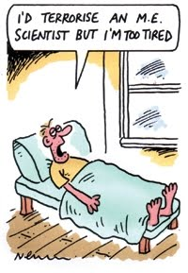
Electrocardiogram
A completely normal ECG in a patient with chest pain does not exclude the possibility of ACS
1% to 6% of such patients eventually are proved to have had an NSTEMI.
At least 4% will be found to have UA.*
don't worry ..u r fine.
I have seen your ECG
Doctor! I m dying….
*Rouan GW et al, Am J Cardiol 1989
Notes:
Ischemia in the territory of the circumflex artery or isolated right ventricular ischemia frequently escapes the common 12-lead ECG, but may be detected in leads V7–V9 and in leads V3R and V4R, respectively.²

Slide 21
ESC 2020

Slide 22
CARDIAC BIOMARKERS
Diagnosis, Risk stratification, Treatment
Cardiac troponins > CK-MB
Clinical presentation compatible with MI
+
Dynamic change of cardiac troponin > 99th percentile
CK-MB- rapid decline after MI – detection of early reinfarction
Copeptin : C- terminal part of vasopressin prohormone
Quantify endogenous stress level
Role : early rule out of MI when cTn not available
MI

Slide 23
Cardiac biomarkers
MARKER | DETECTION | PEAK | DISAPPEARANCE
Myoglobin | 1-4hrs | 6-7hrs | 24hrs
CK-MB | 3-12hrs | 12-18hrs | 2-3days
Total CK | 4-8hrs | 12-30hrs | 3-4days
cTnT | 4-12hrs | 12-48hrs | 5-15days
cTnI | 4-12hrs | 12-24hrs | 5-7days
IMA | 4-12hrs | 12-24hrs | 5-7days

Slide 24
hsTn

Slide 25
CARDIAC BIOMARKERS
Elevated cardiac troponin other than MI
CARDIAC | NON-CARDIAC OR SYSTEMIC
Tachyarrhythmia Congestive heart failure Hypertensive emergencies Infection/inflammation( myocarditis, pericarditis ) Stress cardiomyopathy Structural heart disease (E.g. AS) Aortic dissection Coronary spasm Cardiac procedures Infiltrative diseases (amyloidosis, haemochromatosis, malignancy) | Pulmonary embolism/ HTN Trauma (electrical shock, burns, blunt chest wall) Hypo or hyperthyroidism Toxicity (anthracyclines, snake venom) Renal failure Sepsis, shock Stroke or acute neurologic event Extreme endurance efforts (ultra marathon) Rhabdomyolysis

Slide 26
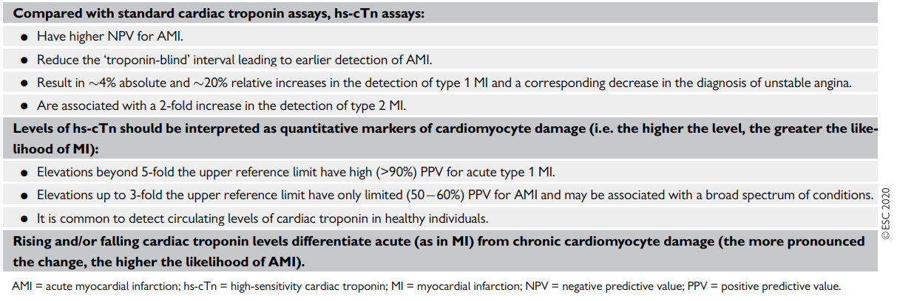

Slide 27
0 h/1 h rule-in & rule-out algorithm of non-ST-elevation acute coronary syndromes using high-sensitivity cardiac troponin assays

Slide 28
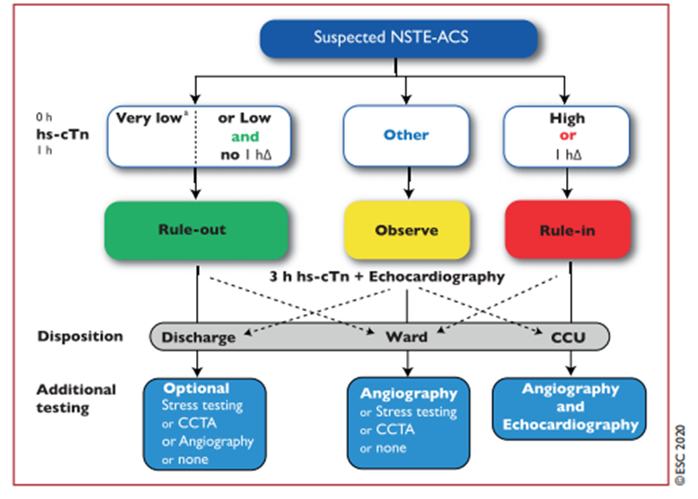
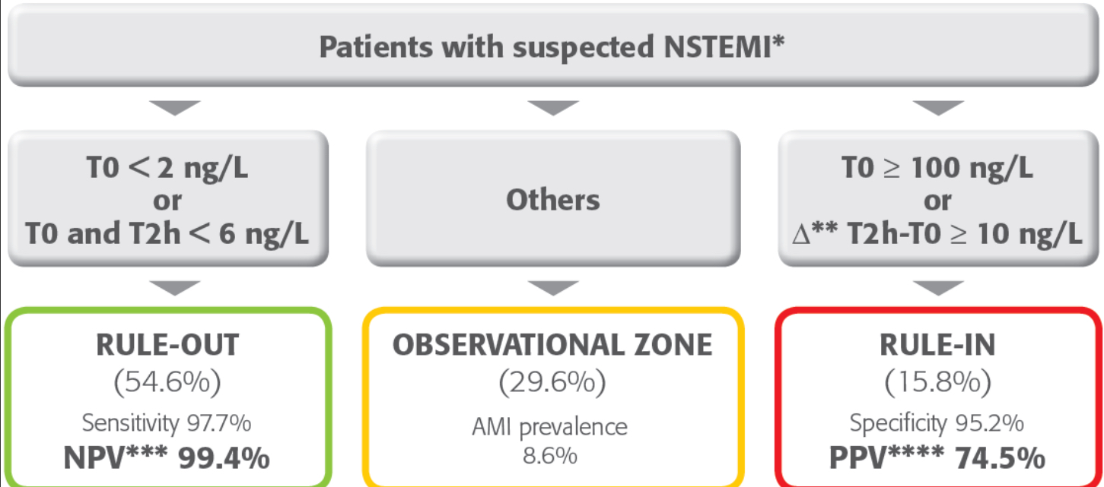
0h/1-2-3h Rule out algorithm

Slide 29
ESC 2020

Slide 30
NOVEL BIOMARKERS
Novel Biomarkers (predicting death and/or ischaemic events) | Description
Chemokine ligand 5 and 18 | Mediators of monocyte recruitment induced by ischemia
IL-6 | Stimulator of hepatic synthesis of CRP
IL-17 | Produced by CD4 T cells(role in host immunity and development of unstable plaque
Heart type fatty acid binding protein | Cytoplasmic protein involved in intracellular uptake and buffering of free fatty acids in myocardium
Myeloperoxidase | Hemeprotein released during degranulation of neutrophils and some monocytes
Pentraxin 3 | Inflamatory marker associated with thin –cap vulnerable plaques

Slide 31
ESC 2020

Slide 33
NON INVASIVE TESTING
Establishing presence of significant CHD
Diagnosing CHD as cause of cTn elevation in patients who may have other explanations
Extent of residual ischaemia → guide further management
Localising territory of ischaemia
Assessing LV function
Modaliteis
Echocardiography
Stress testing
MPI
Coronary imaging

Slide 34
Echocardiography
LV systolic function is an important prognostic variable in patients with CAD - easily and accurately assessed by echocardiography.
Transient segmental hypokinesia or akinesia may be detected.
Aortic dissection, pulmonary embolism, aortic stenosis, hypertrophic cardiomyopathy or pericardial effusion may be identified.
Cheitlin MD et al, Circulation 2003

Slide 35
Stress test
After 24 hrs of stabilization without symptoms of active ischaemia or haemodynamic or electrical instability
Stress MPI>DSE>TMT
TMT not preferred in the presence of significant baseline ECG abnormalities

Slide 36
CCTA
CCTA: Triple rule out
Allows visualization of coronary arteries-very high negative predictive value
Recognize or exclude the presence of epicardial CHD(best for low-intermediate probability)
Identify which vessels have coronary atherosclerosis
Risk stratification and prognosis

Slide 37
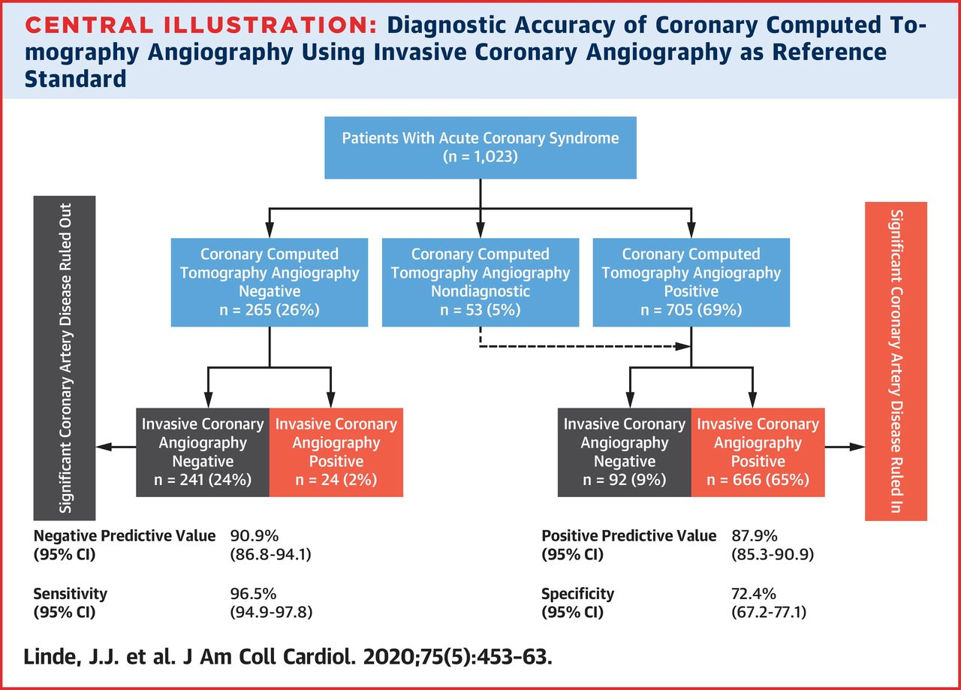
VERDICT Trial

Slide 38
CMR
Rapid scan protocol
Assess both perfusion and wall motion abnormalities
Detect scar tissue and differentiate from recent infarction
D/D between infarction and myocarditis or tako- tsubo cardiomyopathy
Normal stress CMR : excellent short term and mid term prognosis

Slide 39
INVASIVE IMAGING
Coronary angiography
85% have significant coronary obstruction
10%:LM
35%:TVD
20%:DVD
20%:SVD
INVASIVE CROSS SECTIONAL IMAGING: plaque morphology,guide stenting
Intravascular ultrasound
optical coherence tomography

Slide 40
ESC 2020

Slide 41
RISK ASSESSMENT AND OUTCOMES
Clinical presentation
ECG: Cumulative ST depression
Biomarkers
Quantitative assessment of ischaemic risk: superior to clinical assessment
GRACE Risk score
TIMI Risk score (7 variables)
TIMI RISK SCORE
0-2:Low risk
3-4:intermediate
5-7:high risk
GRACE RISK SCORE(in hospital)
1-108-:Low risk
109-140:intermediate
141-372:high risk
GRACE: GLOBAL REGISTRY OF ACUTE CORONARY EVENTS
TIMI: THROMBOLYSIS IN MYOCARDIAL INFARCTION

Slide 42
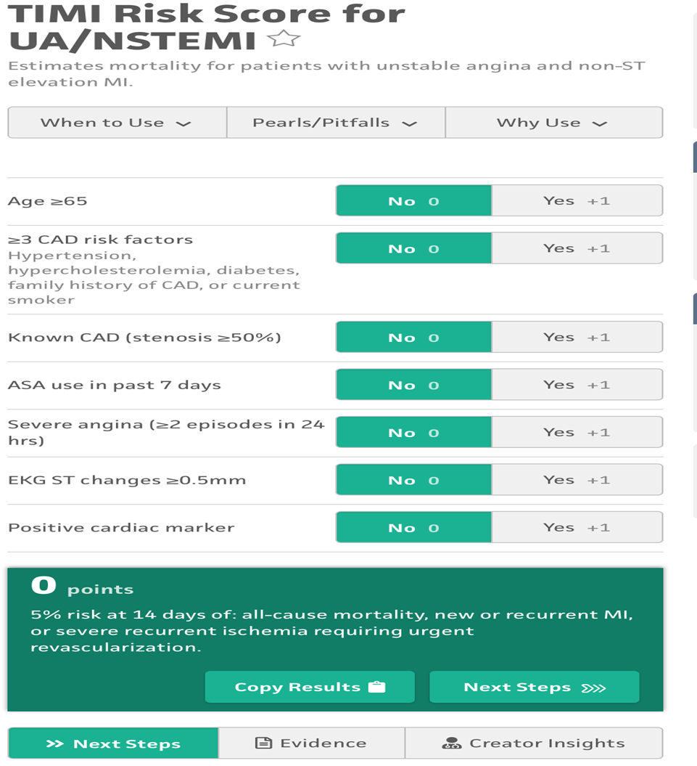
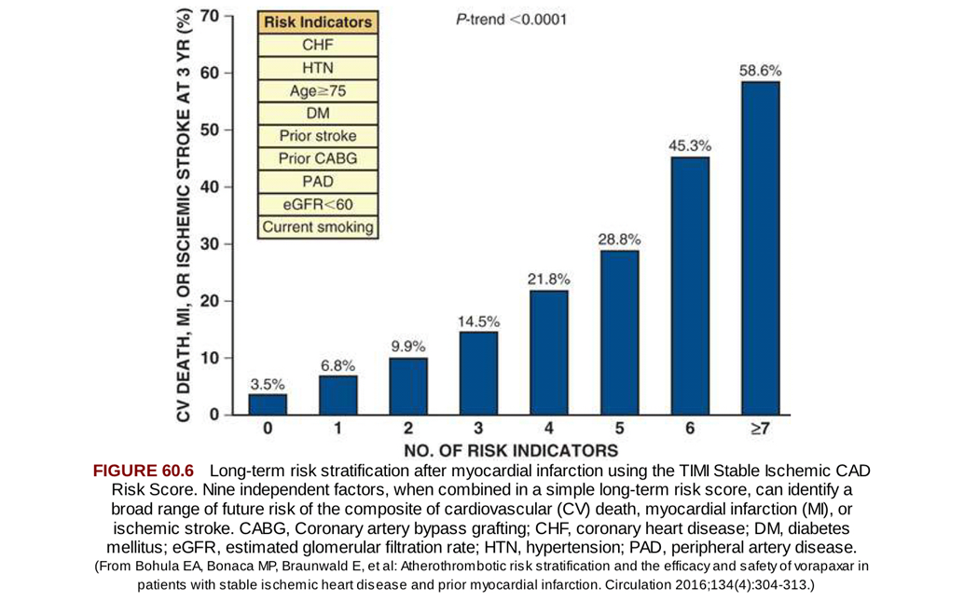

Slide 44
ESC 2020

Slide 45
Bleeding Risk Assessment
CRUSADE
ACUITY
ARC-HBR
PRECISE-DAPT

Slide 47
MANAGEMENT
MEDICAL MANAGEMENT
ANTI-ISCHEMIC TREATMENT:
Nitrates
Beta blockers
Calcium channel blockers
ANTI-THROMBOTIC THERAPY:
Antiplatelet drugs + Statins
Anticoagulants
INVASIVE VS CONSERVATIVE STRATERGY
LONG TERM MANAGEMENT

Slide 48
1)ANTI ISCHAEMIC TREATMENT
GOAL: Decrease myocardial oxygen demand
Increase myocardial oxygen supply
Oxygen therapy : if spo2 < 90 % or if respiratory distress
DRUGS
NITRATES | Only for symptomatic relief ( IV > Oral) Recurrent angina/ uncontrolled HTN/ signs of heart failure;no mortality benefit
BETA BLOCKERS Chronic beta blocker: continue unless Killip class 3 or more | Mortality Benefit Early initiation unless C/I
Calcium channel blockers | In suspected/confirmed vasospastic angina No clear mortality benefit /reinfarction Nifedipine may worsen ischemia
Ischaemic symptoms/signs persist despite treatment (irrespective of ECG and cardiac troponin levels) : Immediate coronary angiography

Slide 49
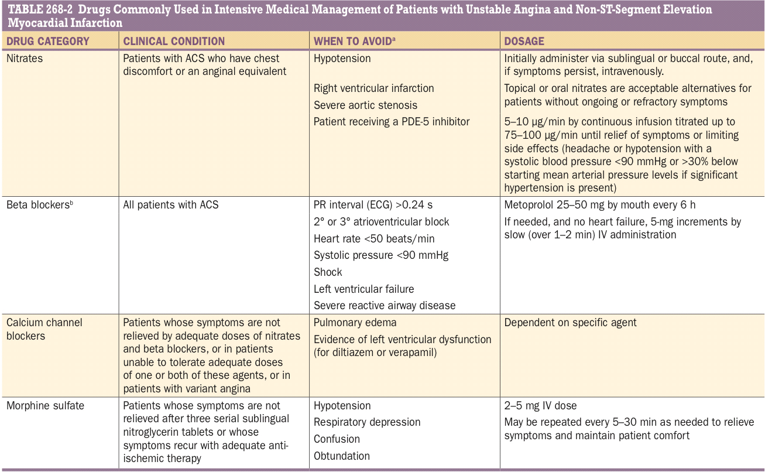

Slide 50
ANTITHROMBOTIC THERAPY

Slide 51
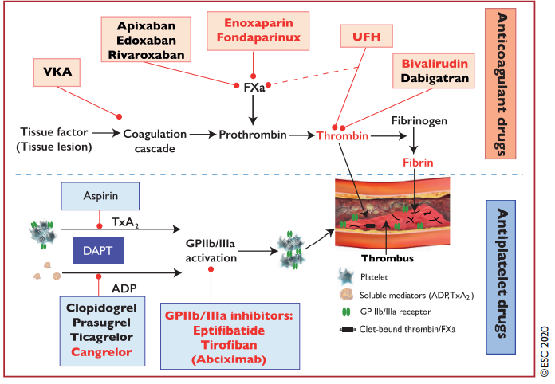

Slide 52
ANTIPLATELET THERAPY

Slide 53
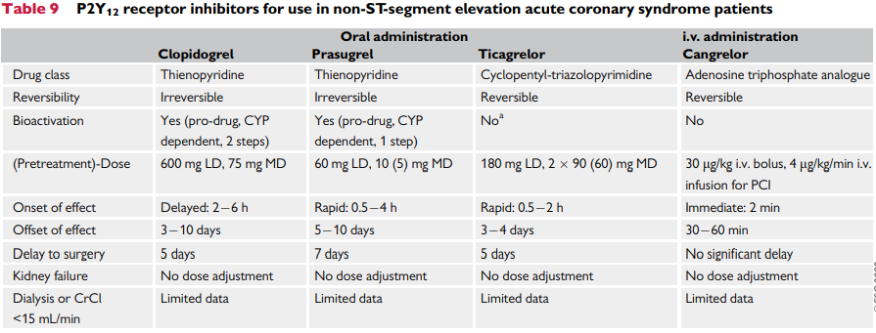

Slide 54
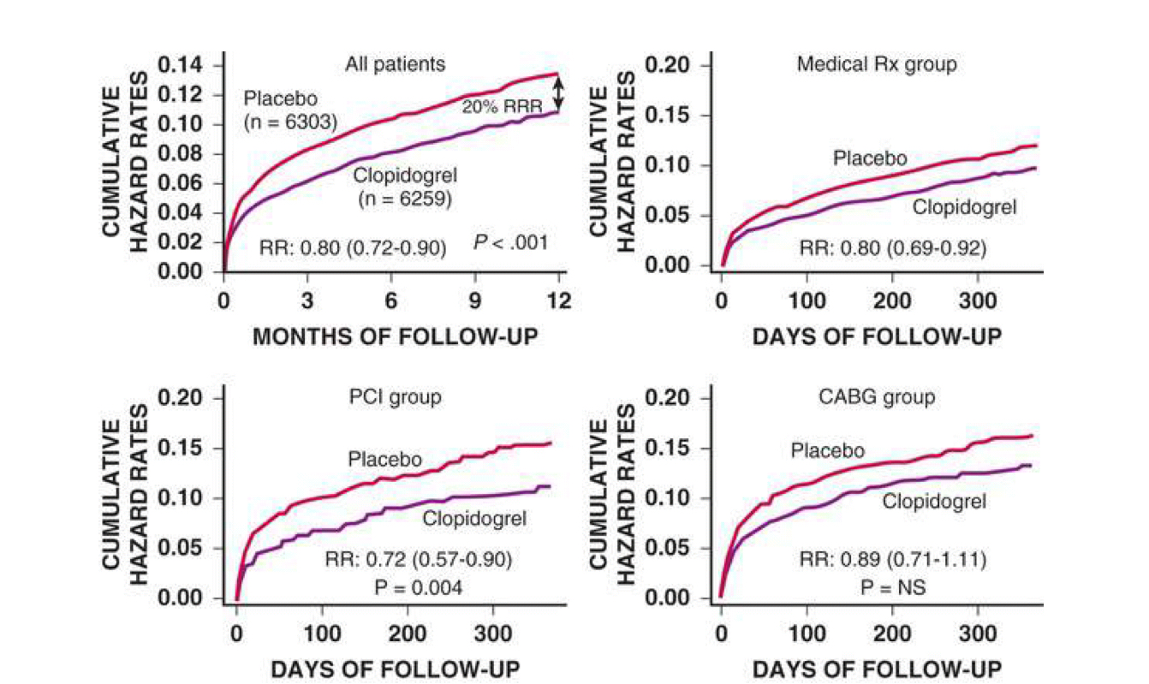
 | result | conclusion
CLARITY TIMI 28 TRIAL (n=3491) (2005) | Addition of clopidogrel to aspirin and fibrinolytic therapy for STEMI Primary efficacy end point Placebo: 21.7% Clopidogrel:15% ( P <0.001) | Addition of clopidogrel improves patency rate of IRA and reduces ischaemic complication
CURE (n=12562) (2001) | Primary outcome (composite death from CVS causes, non fatal MI, or stroke ) Clopidogrel : 9.3% Placebo: 11.4% (p <0.001) 2nd primary outcome( refractory ischaemia) Clopidogrel : 16.5% Placebo:18.8%( p=<0.001) | Clopidogrel has beneficial effects (risk of major bleeding increased) 3.7 v/s 2.7 p=0.001

Slide 56
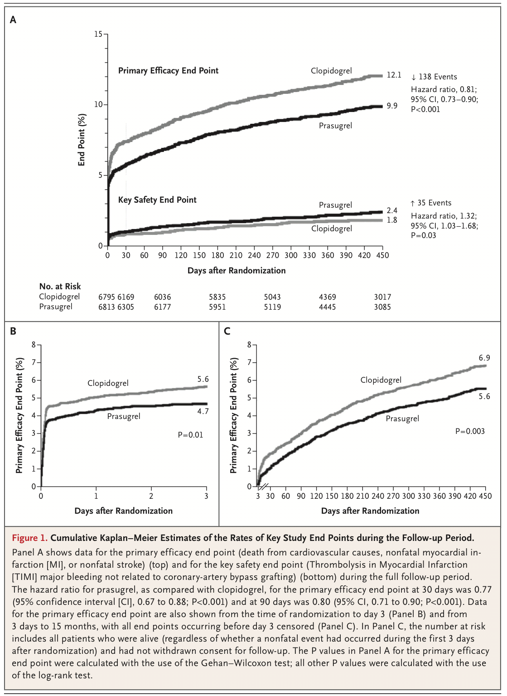
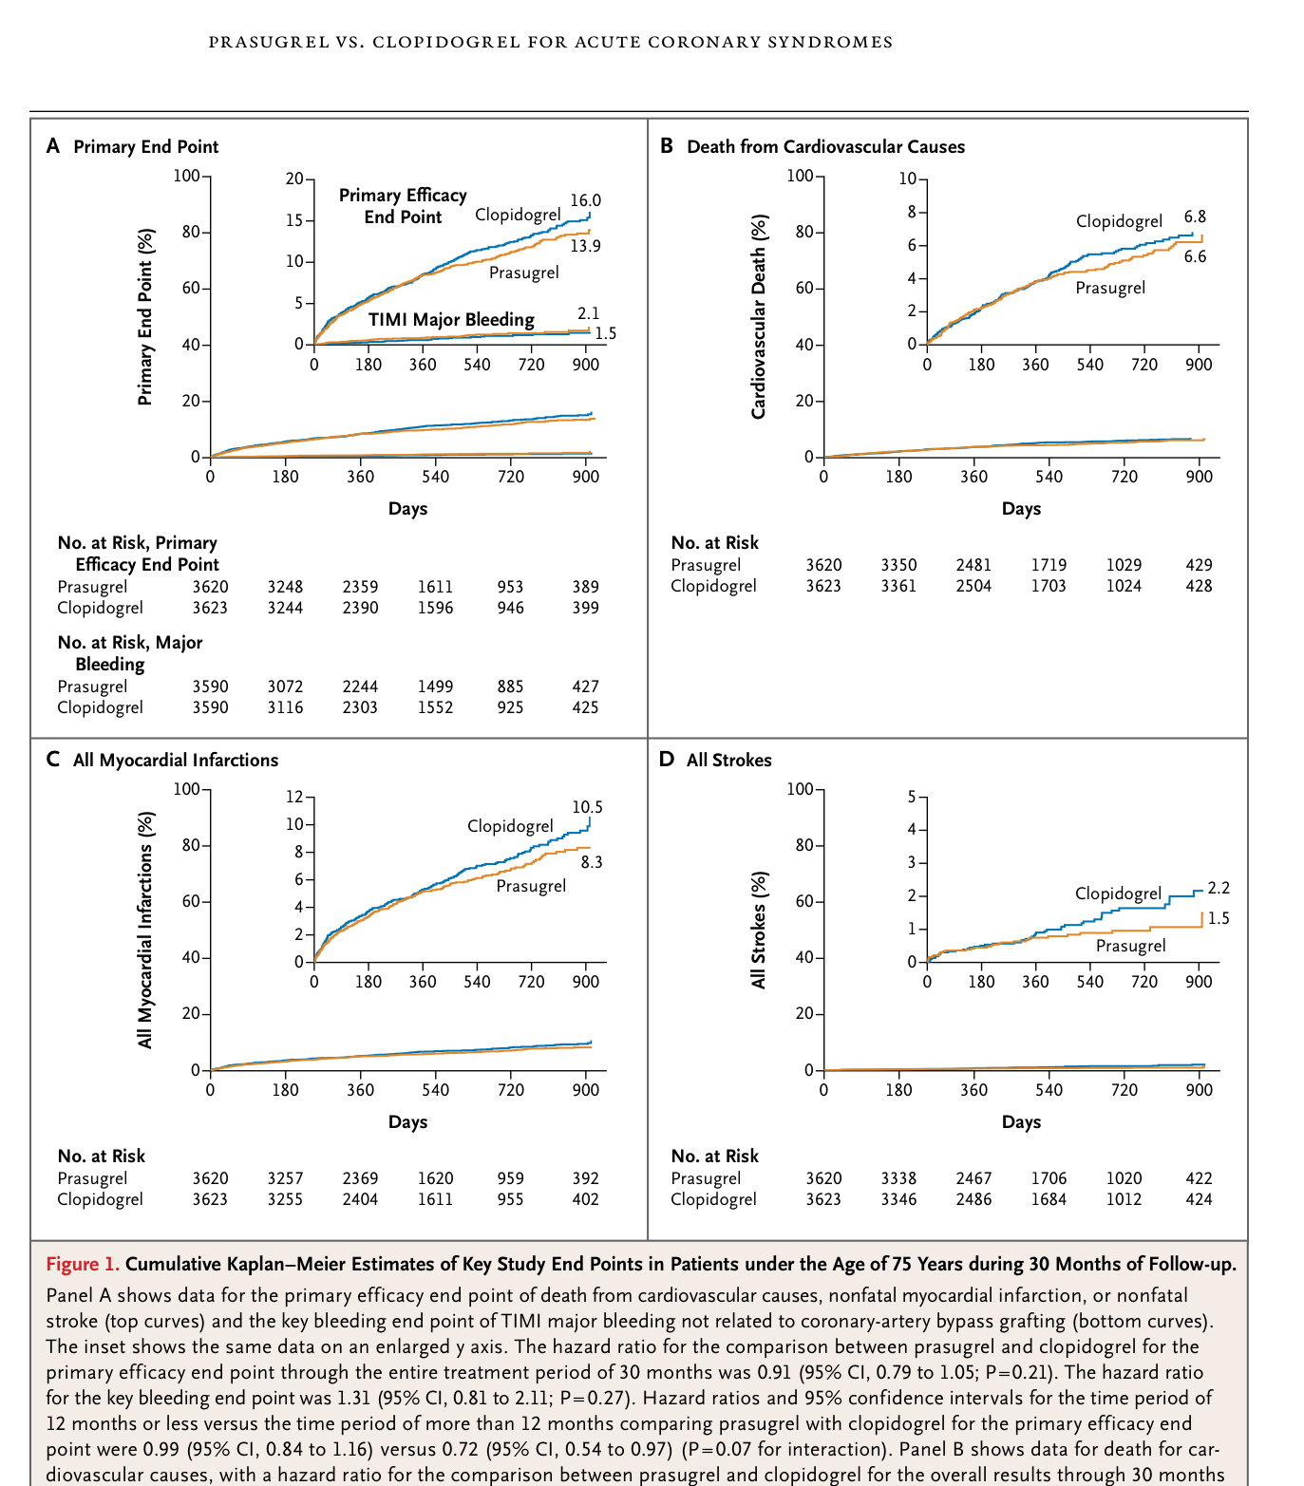
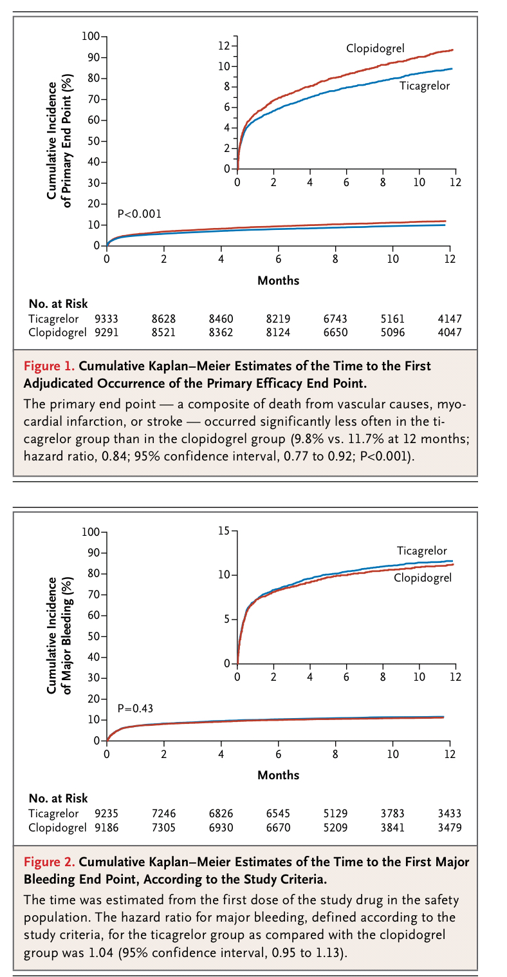
 | results
TRITON-TIMI 38 ( Prasugrel vs clopidogrel in ACS scheduled PCI) | Prasugrel: 9.9%, clopidogrel:12.1 %( HR- 0.81, 95 % CI 073 to 0.90 p <0.001 )
TRILOGY ACS ( prasugrel vs clopidogrel in NST ACS who don’t undergo revascularization) follow up 17 months | Prasugrel: 13.9 % Clopidogrel: 16% , HR:0.91, 95% CI 0.79-1.05) P = 0.21
PLATO TRIAL (Ticagrelor v/s clopidogrel for prevention of cardiovascular events at 12 months in 18624) in ACS | Ticagrelor ( 9.8%) Clopidogrel (11.7%)(HR- 0.84, 95 % CI , 0.77-0.92; p <0.001)
Notes:
TRITON –TIMI : 38: trial to assess improvement in therapeutic outcomes by optimizing platelet inhibition with prasugrel – thrombolysis in MI
TRILOGY ACS- the targeted platelet inhibition to clarify the optimal strategy to medically manage acute coronary syndromes
PLATO: the study of platelet inhibition and patient outcomes

Slide 57
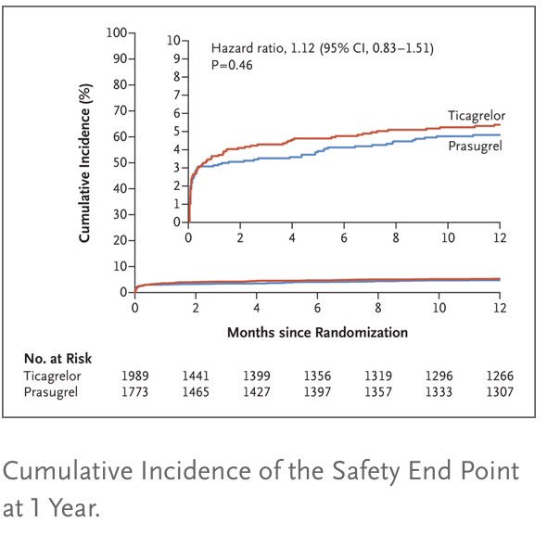
ISAR-REACT 5

Slide 58
TWILIGHT

Slide 59
ESC 2020

Slide 61
PRECISE-DAPT SCORE
PREdicting bleeding Complications In patients undergoing Stent implantation and subsEquent Dual Anti Platelet Therapy
To decide on DAPT duration
Score <25: no increase in bleeding and a significant reduction in the MACE

Slide 62
EXTENDED DAPT/DAT

Slide 63
ESC 2020

Slide 64
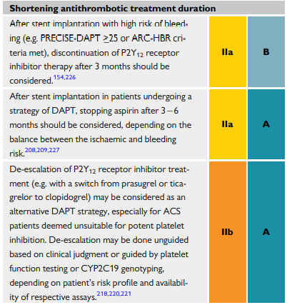
ESC 2020

Slide 67
ESC 2020

Slide 68
Anticoagulation

Slide 69
ESC 2020

Slide 70
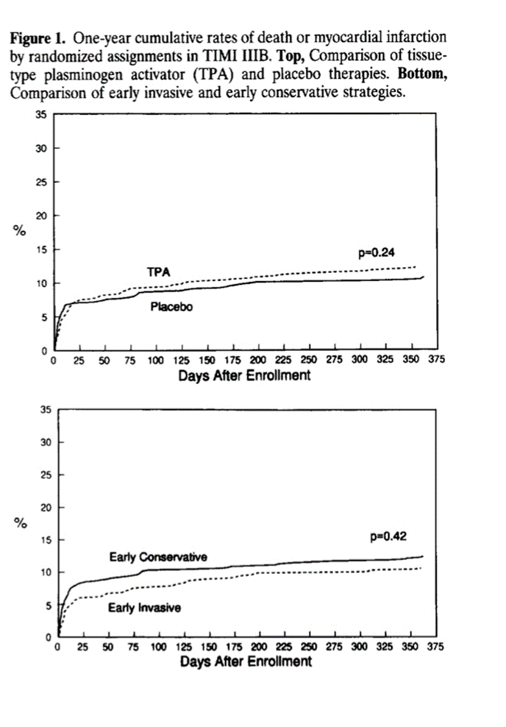
INVASIVE V/S CONSERVATIVE MANAGEMENT

Slide 74
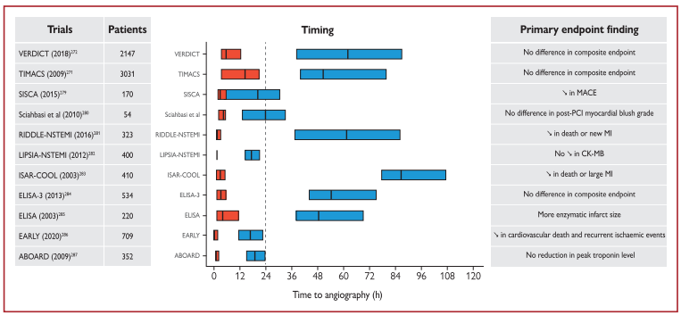

Slide 77
RAAS INHIBITORS
LVEF < 40%
DM, HTN or stable CKD (unless contraindicated)
ACE I : intolerant → ARBs
Aldosterone blockade :
Without renal dysfunction ( creat > 2.5 mg/dl (males)/ > 2 mg/dl (females)
No hyperkalaemia (> 5 meq/l)
Who are receiving therapeutic doses of ACEI and betablockers and have LVEF of ≤ 40% , DM or heart failure

Slide 79
Lipid Lowering Therapy

Slide 80
Lifestyle Measures

Slide 81
Ambulation
If stable without recurrent chest discomfort or ECG changes for atleat 12-24hrs.

Slide 82
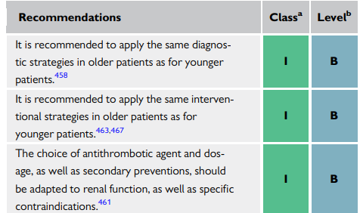
Older Adults
More likely to present with atypical symptoms
Always calculate creatinine clearance for drug dosing
Exclusive use of low dose Aspirin (75mg)
Avoid Prasugrel
Advanced age shouldn’t deter otherwise indicated intervention

Slide 83
Women
More likely to present with atypical symptoms
Younger women are more likely to have nonatherosclerotic causes of angina
More likely to have non-obstructive CAD
Likely to get lower rates of evidence based care due to bias

Slide 84
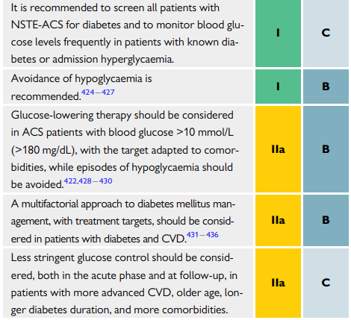
Diabetes
U shaped relation between glucose level and CVS outcome

Slide 85
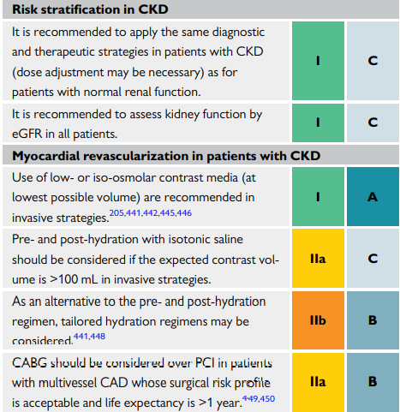
CKD
Likely to have multiple comorbidities
Increased risk of recurrent ischemic events
Underrepresented in trials and undertreated in practice
Increased bleeding risk

Slide 86
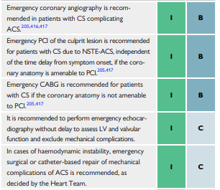
Heart Failure
Early invasive approach
Ventricular assist devices may be required

Slide 88
CULPRIT SHOCK TRIAL

Slide 89
Gaps in NSTE-ACS Care
Utility of risk prediction models
DAPT duration
P2Y12i pre-treatment
Long-term beta-blocker therapy
Utility of biomarkers other than hs-cTn in rapid rule-out
Optimal timing of invasive intervention
Culprit vs complete revascularisation

Slide 90
TAKE HOME MESSAGE
NSTEMI has a long term prognosis worse as compared to STEMI
A normal ECG does not exclude possibility of UA/NSTEMI
Risk stratification is an important early step - reveals risk, helps decide treatment intensity
An invasive approach is now standard of care for most NSTEMI patients – early invasive better than selective invasive in selected cases

Slide 91
TAKE HOME MESSAGE
CKMB valuable in Re-infarction
Bleeding risk ->ARC-HBR assessment
DAPT guidance -> PRECISE-DAPT score
CMR: key diagnosis for pts with working diagnosis of MINOCA
SCAD: 22-35% ACS in women<60, OCT useful for diagnosis

Slide 92
TAKE HOME MESSAGE
hs-Tn recommended, but remember Myocardial Injury
0- 1 hr algorithm: best option
hs-Tn, BNP, GFR having prognostic value
CCTA: high NPV to exclude ACS
hs-Tn levels, Grace score >140, New ST-T changes, Clinical instability -> Early invasive strategy
Radial access is recommended
Very short TAT in AF

Slide 93
THANK YOU

