Slide 1
ECHOCARDIOGRAPHY-BASICS
Dr.Muhammad Ameen C
Senior Resident-Cardiology
GMCH Kozhikode

Slide 2
Echocardiography
Technique of using ultrasound to examine the heart and great vessels

Slide 3
Father of ultrasound

Slide 6
Principle of ultrasound
Sound
Mechanical disturbance transmitted through a medium
Properties
Frequency:number of times per sec,sound undergoes a cycle of rise and fall(Hz). Appreciated as pitch
Wavelength:distance travelled in one cycle
Velocity : depends on medium
Intensity/Amplitude:loudness(dB)

Slide 11
Characteristics of US
Can be directed as a beam and focused
Obeys the rules of reflection and refraction
Targets of relatively small size reflect US and can be detected and characterized

Slide 12
Disadvantages
Ultrasound is poorly transmitted through a gaseous medium
Attenuation occurs rapidly, especially at higher frequency

Slide 13
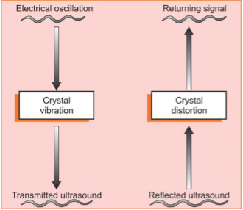
Mechanics
Relies on piezoelectric effect
Property to transform electrical current into ultrasound waves

Slide 14
Reflected signal gives information about the depth and nature of tissue studied
Most reflection occurs at tissue interfaces
Reflectivity
High:white (bone)
Low:grey (muscle)
Nil:black (air)

Slide 15
Pulse repetition period

Slide 16
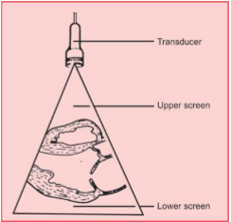
Location of image depends on time lag between transmission and reflection of US

Slide 17
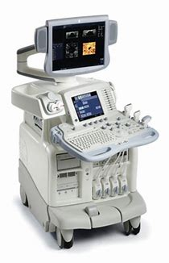
Equipment -Echograph
Transducers
Monitor
Processing unit

Slide 18
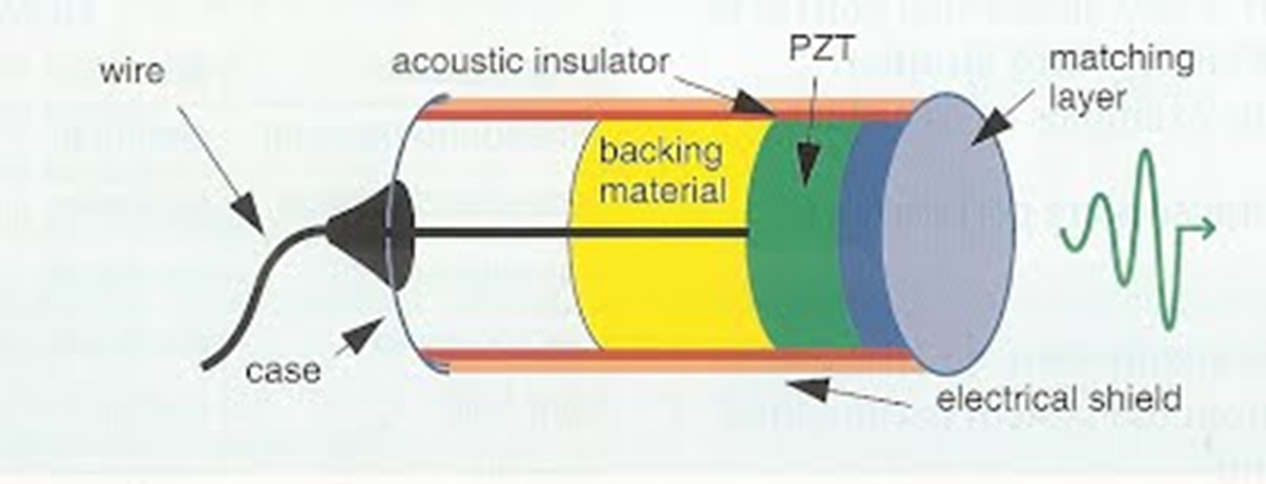
Transducer
Contains piezoelectric crystals
Generate and receive sound waves

Slide 19
Piezoelectricity
Piezoelectric ceramics : ferroelectrics, barium titanate, and lead zirconate titanate
Piezoelectric elements are interconnected electronically
The frequency of the transducer is determined by the thickness of these elements.
Each element is coupled to electrodes, which transmit current to the crystals, and then record the voltage generated by the returning signals.

Slide 20
Cardiac transducer
Electric force<>deformation<>US waves
Phased array
1-5 MHz
Orientation : notch/groove/ridge
Screen orientation : marker on upper right of image
Most fragile part of system. Can be easily damaged

Slide 22
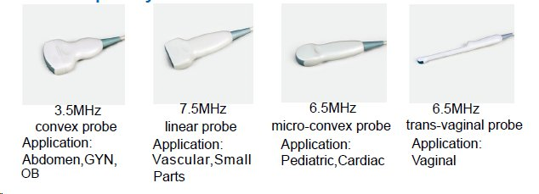
Transducer
↑frequency -↓wavelength-↓penetration-↑resolution
↓frequency-↑wavelength-↑penetration-↓resolution

Slide 25
Intracardiac probe

Slide 26
Frequency
Neonates : 7.0-7.5 MHz
Children : 3.5-5.0 MHz
Adults : 2.0-2.5 MHz

Slide 28
Transducer technology
Linear array
Phased array

Slide 32
Wave motion
An ultrasound beam as it leaves the transducer is parallel and cylindrically shaped beam. Eventually, however, the beam diverges and becomes cone shaped .
The proximal or cylindrical portion of the beam is referred to as the near field or Fresnel zone.
When it begins to diverge, it is called the far field or Fraunhofer zone.

Slide 35
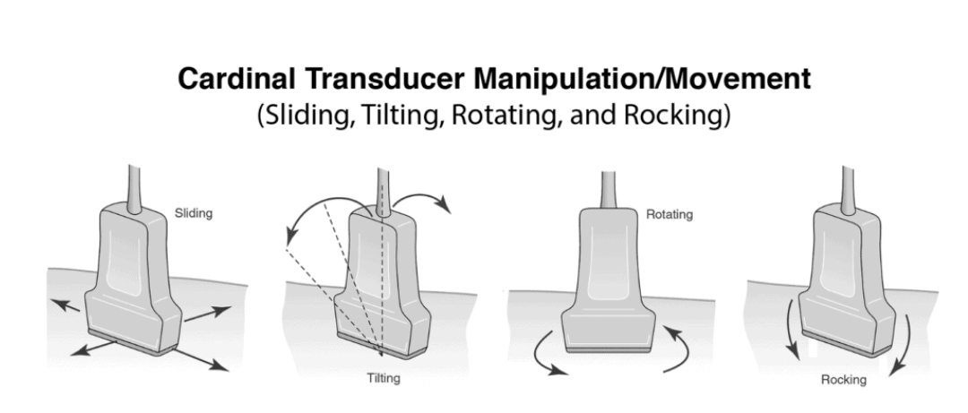
Transducer adjustments
Alignment
Rotation
Tilt

Slide 36
Behaviour of US in tissue
Reflection: specular echoes at interfaces
Refraction: change in direction due to change in speed
Scattering: when encounter small structures
Attenuation:loss of US as it propagates through a medium

Slide 39
Attenuation

Slide 40
Modalities
2D
3D
4D
M mode

Slide 42
A(amplitude) mode
Oldest type
Amplitude is plotted against distance
Not in clinical use

Slide 43
B mode
Brightness mode
Amplitude is recorded as brightness

Slide 44
M(Motion) Mode
One scan line
Higher frame rate
High sensitivity for movement
High temporal resolution
To assess
Cavity size and wall thickness
Excursion of walls and cusps
Timing of cardiac events

Slide 45
2D Echo
Electric signal produces a dot on display
Density and position of dot is determined by nature and depth of tissue
90-120 scan lines
90 ̊ arc
To evaluate
Anatomy of heart
Intracardiac mass

Slide 47
3D
Recreated from multiple 2D planes
Depth as an additional dimension
Done by imaging along a pyramidal US beam
True live or near real-time images
Real time 3D is known as 4D
Post processing, slicing and cropping possible
Best for evaluation of valvular disease, chamber volume and function
Limitation : stitching artefact

Slide 51
Harmonic imaging
Tissues resonate at multiples of transmitted frequency (harmonic frequencies)
Transducer receives frequencies at multiples of the emitted frequency
Improves signal-to-noise ratio
Better delineation of endocardial border
Disadvantage:valve leaflets may appear artificially thick

Slide 53
Image resolution
Ability to distinguish two objects that are close together
Teomporal : with respect to time
Spatial
Axial :parallel to US beam (objects above and below)
Lateral : perpendicular to US beam (objects side by side)

Slide 55
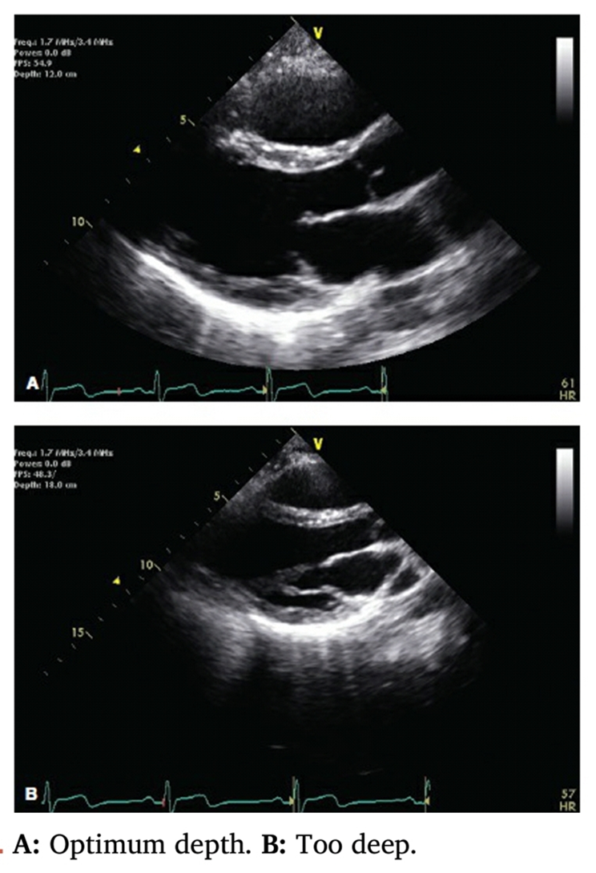
Depth
Set 1-2cm beyond cardiac boundary

Slide 56
Gain
Controls overall amplification of the echo signals
Intracardiac blood should be as dark as possible without losing definition of walls

Slide 58
Time gain compensation
Little difference in densities of blood, musle and fat
Echoes from interfaces will be small
TGC increases amplification during the time echoes from a particular pulse returns
The last to arrive are amplified much more than the first

Slide 60
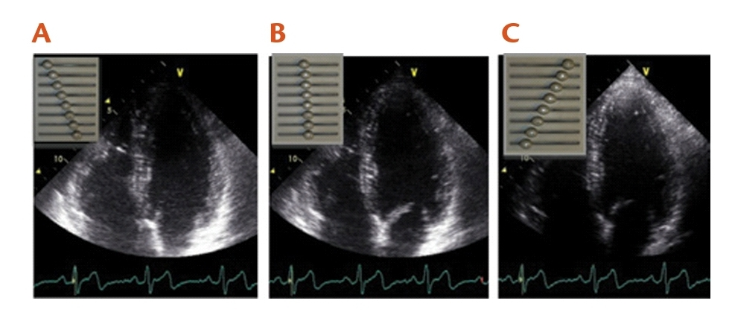
Depth gain compensation
Near field objects appear brighter
Depth specific amplification of echo signals

Slide 61
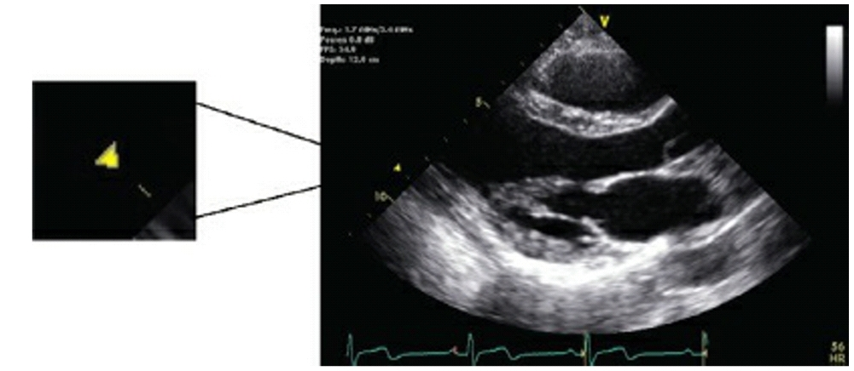
Focal position
Controls the depth at which US beam is focused
Around this region spatial resolution is optimal

Slide 62
Frame rate
Number of still images displayed per unit time
Controls number of lines in single frame and number of frames per second
Higher the frame rate, better the temporal and worse the spatial resolution

Slide 63
Artefacts
Flase, missing, mislocated or distorted structures
Caused by
Interaction of US waves with tissues
Physical properties of US beam
Image reconstruction algorithms

Slide 64
Side lobe artefact
A portion of energy concentrate off to the side of the central beam and propagate radially – edge effect
Seen in strongly reflecting targets
Most common: AV groove and fibrous skeleton

Slide 66
Reverberation artefact
Produced by non-soft tissue structures
Reflected echoes bounce back and forth between the highly reflective object and the transducer
Seen in clacified/prosthetic valve
To avoid
Use minimum power and adequate gel
Rotate the paient or change the angle

Slide 69
Shadowing
Seen in case of strong reflectors
Due to absence of echoes behind the target
Result of high attenuation of signals
Opposite of reverberation
Common in prosthetic valves

Slide 71
Near-field clutter
Ringdown artefact
Arises from high-amplitude oscillations of the piezoelectric elements
Common in RV free wall and LV apex

Slide 73
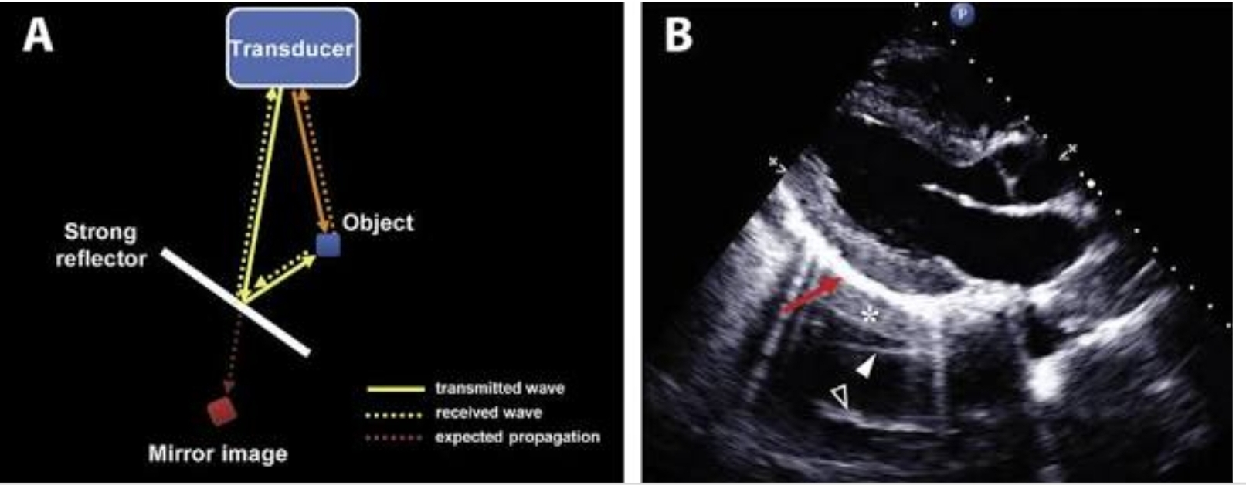
Mirror artefact
US beam takes an indirect return journey after hitting a reflective surface
True image above and mirror image below

Slide 74
Tissue damage
Heating
Due to too much acoustic energy
Monitored by thermal index (TI)
TI should be below 2
Cavitation
Formation of small gas bubbles followed by collapse
Monitored through mechanical index (MI)
MI should remain below 1.9 (most scanners <1.1)

Slide 75
Mechanical Index
Measure of mechanical pressure exerted on tissues by US waves
MI should be lowered during contrast echo to prevent early burst of bubbles

Slide 76
Thermal index
Energy lost through attenuation is largely converted to heat
TI : ratio of actual beam power to that required to raise the temperature of a specific tissue by 1 ̊C
Important in TEE-minimised by automatic thermal cut-out mechanism

Slide 77
Ergonomics and Set up
Comfortable height
Always use same hand
Lie down with abducted left arm
Avoid sunlight for optimal contrast
Explain the procedure
Privacy and need of chaperone

Slide 78
Respiration
Acquire most views at held end-expiration
A2C and subcostal views at held end-inspiration

Slide 79
Thank You

